Slide 1
From Acquisition to Access: Building a Video Game Collection
Presley Dyer & Stephanie Galipeau

Slide 2

About Georgia Tech
Located in Atlanta, Georgia, Georgia Institute of Technology is an R1 public university serving over 56,000 students.
The Library’s Technical Services department is comprised of five librarians and nine professional staff.

Slide 3
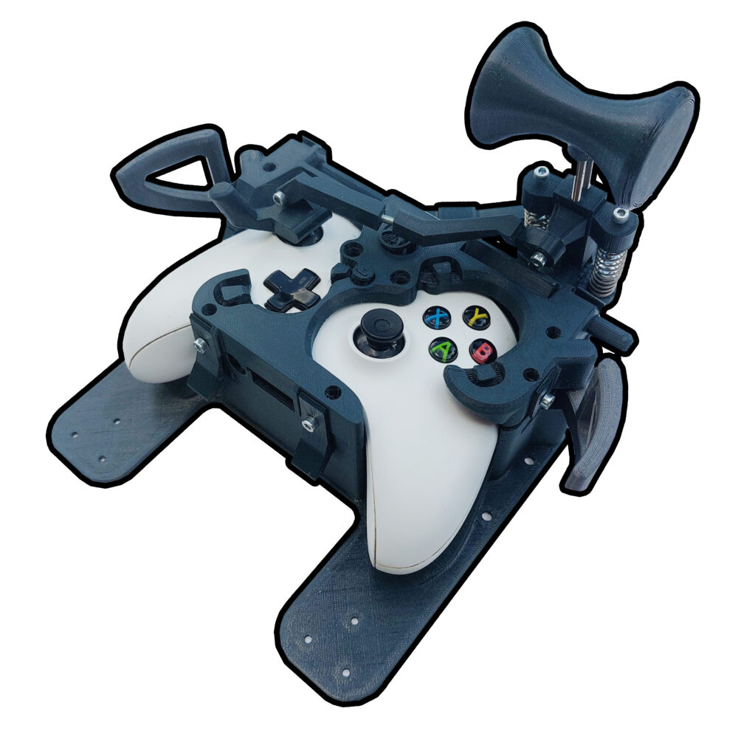
Why a Video Game Collection?
Dominant medium: Video games are a popular form of entertainment today.
Builds on what we do: Extends existing services — Gadgets, Media Scholarship Commons, retroTECH Lab.
Academic relevance: Supports Computational Media, HCI, AI/ML, and Digital Media programs at GT.
Promotes community, wellness, and play alongside research. AdaptaPlay, an accessible gaming controller add-on for players with disabilities.
https://akoskvida.com/projects/gaming-controller-add-on/

Slide 4



Project Progress
Proposal
Submitted
Funding Pivot
Soft Launch
Oct 2024
Summer 2025
Spring 2026
LAUNCHED!
Collection
Development
Ordering &
Cataloging
Game Night
April 1, 2026
Spring 2025
Fall 2025

Slide 5






Pilot Parameters

Slide 6

Vendor Selection
Thomas Klise/Crimson Media
History: Established U.S. media distributor for schools and public libraries since 1966.
Format Range: Sells games for PS4, PS5, Switch, Xbox One, and Xbox X.
Library Optimization: Removes code-in-the-box material and DLC-only titles.
Flexible Processing: Provides publisher, DVD, or locking case options with custom processing (wrapper/barcode).

Slide 7



Project Roadblock
Funding Challenge
The Problem:
Initial Tech grant funding fell through.
The Opportunity:
One-time Institute funds became available.
The Constraint:
The funds had to be fully spent within one week to meet fiscal year-end procurement deadlines.

Slide 8

Acquisitions
Project Pivot
Operational Adjustments
Strategic Pivot:
Turned to Amazon due to P-card compatibility and rapid shipping.
Rapid Order Fulfillment:
Selection team moved quickly, ordering 200 games.
Incompatible Games:
Five games were inadvertently sourced from third-party European vendors and had to be pulled due to geographic incompatibility.

Slide 9
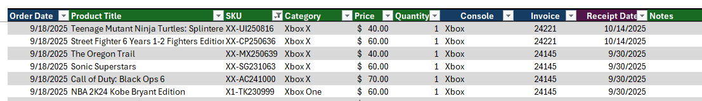
Acquisition Workflows
Fulfilling the Pilot (Sept 2025-Feb 2026)
Additional Funding: Secured from Library’s Monograph budget.
Alma Setup: Created new vendor record and import profile for brief records and PO lines.
Workflow Test: Placed test order with Klise to test Tech Service’s newly developed workflows.
Optimized Spending: Allotted funds were fully spent by Feb 2026, with only four release cancellations.

Slide 10
Building a Cataloging Framework
Peer Institution Consultation
1
Reached out to several university libraries with established video game collections to understand their cataloging practices and physical processing workflows.
OLAC Best Practices (Documentation available via OLAC Resources)
Consulted Online Audiovisual Catalogers (OLAC) field-by-field recommendations and MARC examples for video games, including genre terms and platform formatting guidance.
Best Practices for Cataloging Video Games Using RDA and MARC21 (2018)
OLAC Best Practices for Cataloging DVD-Video, Streaming Media, and Video Games (2023)
Guidelines for OLAC Video Game Genre Terms (olacvggt) (2018)
Alphabetical List of Genre Terms in the OLAC Video Game Genre Vocabulary (2019)
2
3
Local Cataloging Policy
Created GT Library’s internal cataloging policy for video games, documenting MARC fields, physical processing, and Alma item setup.

Slide 11
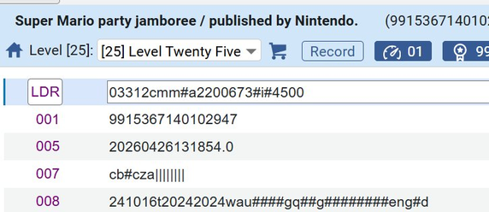
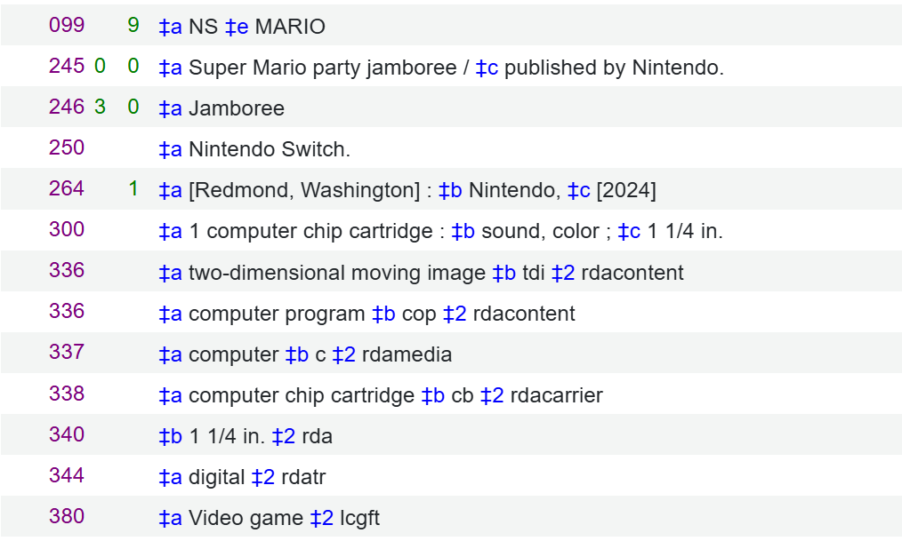
Key MARC Fields in Practice
Fixed fields — LDR / 007 / 008
LDR/06 m Computer file (all video games)
LDR/07 m Monograph
007/00 c Electronic resource
007/01 b Chip cartridge (Switch); o = disc (PS5/Xbox)
008/06 t Publication & copyright date
008/22 g/e/j Audience: general, adult, or juvenile
008/23 q Form: Direct electronic
008/26 g Type of computer file: Game
Variable fields — 099 / 3xx
099 Local call number: console prefix (NS / XB / PS) + first word of title
336 Content type: computer program $2 rdacontent
337 Media type: computer $2 rdamedia
338 Carrier: chip cartridge or computer disc $2 rdacarrier
380 Form of work: Video games $2 lcgft (required)

Slide 12
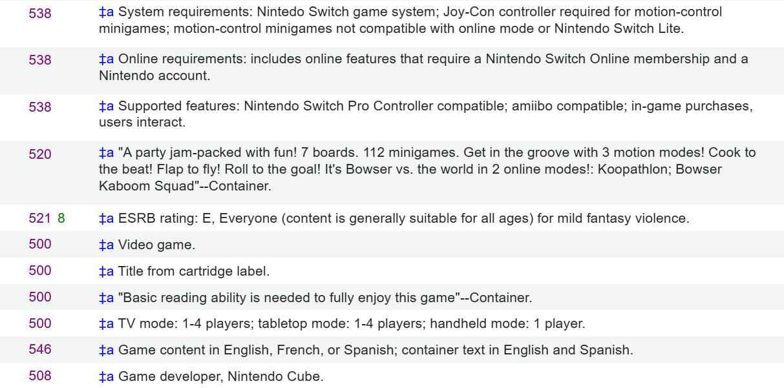
Key MARC Fields in Practice
Notes & requirements — 538 / 520 / 521 / 508
538
System requirements (mandatory)
520
Summary / description
521
ESRB rating: E, Everyone
508
Creation/Production Credits Note

Slide 13
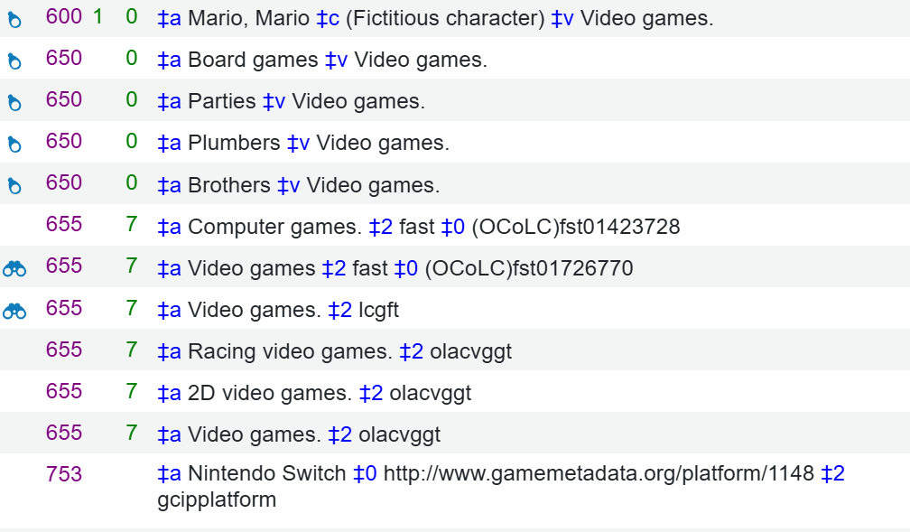
Key MARC Fields in Practice
Notes & requirements — 600/650 / 655 / 753
600 / 650
Subject headings (name + topical)
655
Genre headings: olacvggt + lcgft
753
System details: platform + $2 gcipplatform

Slide 14
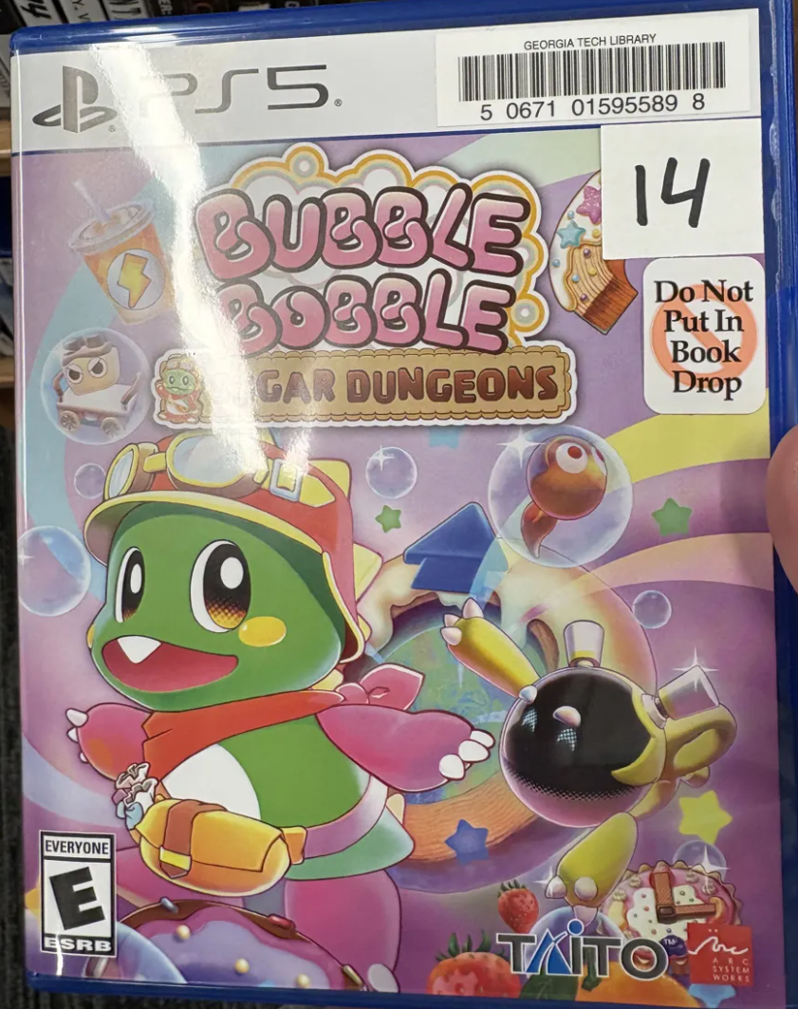
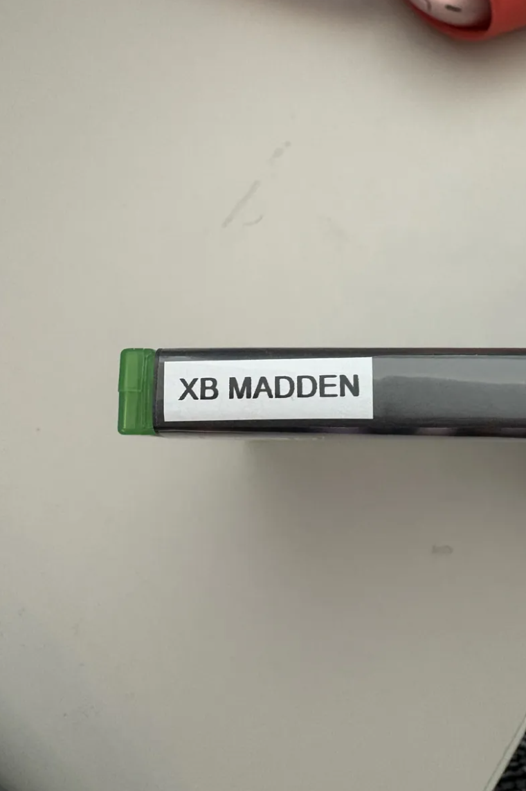
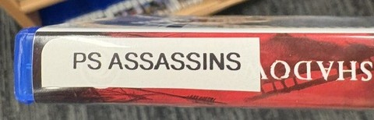
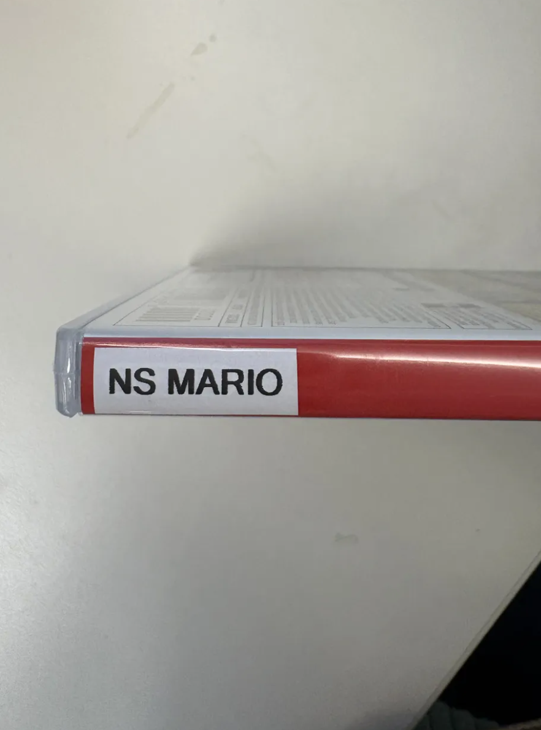
Physical Processing
Barcode: Upper right corner of inner jacket sleeve
Spine label: Console abbreviation + first title word, landscape orientation, bottom of spine
XB MADDEN | PS ASSASSINS | NS MARIO

Slide 15
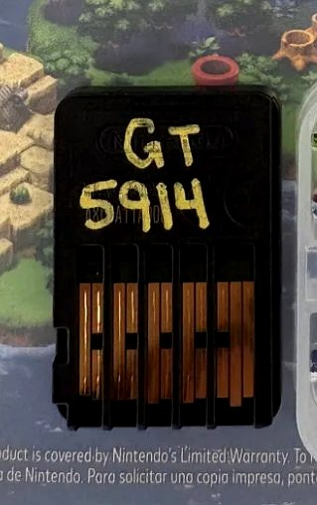
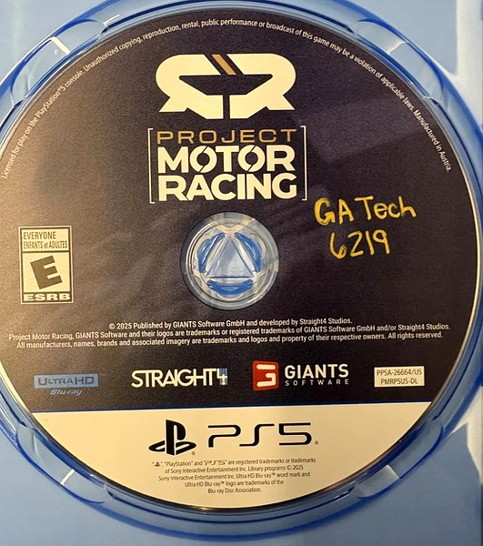
Item Markings
Nintendo Switch
PS5 and Xbox Series X
Mark: "GT" + last 4 barcode digits
Surface: Back of cartridge chip
Ink: Gold paint marker preferred; black Sharpie if needed
Example: GT 5914
Mark: "GaTech" + last 4 barcode digits
Surface: Front face of disc
Ink: Gold paint marker preferred; black Sharpie if needed
Example: GA Tech 6219
Note: Markings identify items as Georgia Tech Library property and help staff match discs and cartridges to their cases. The last 4 barcode digits tie each piece to its item record in Alma.

Slide 16
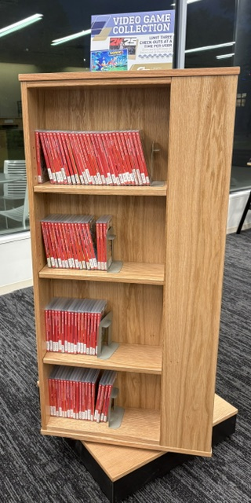
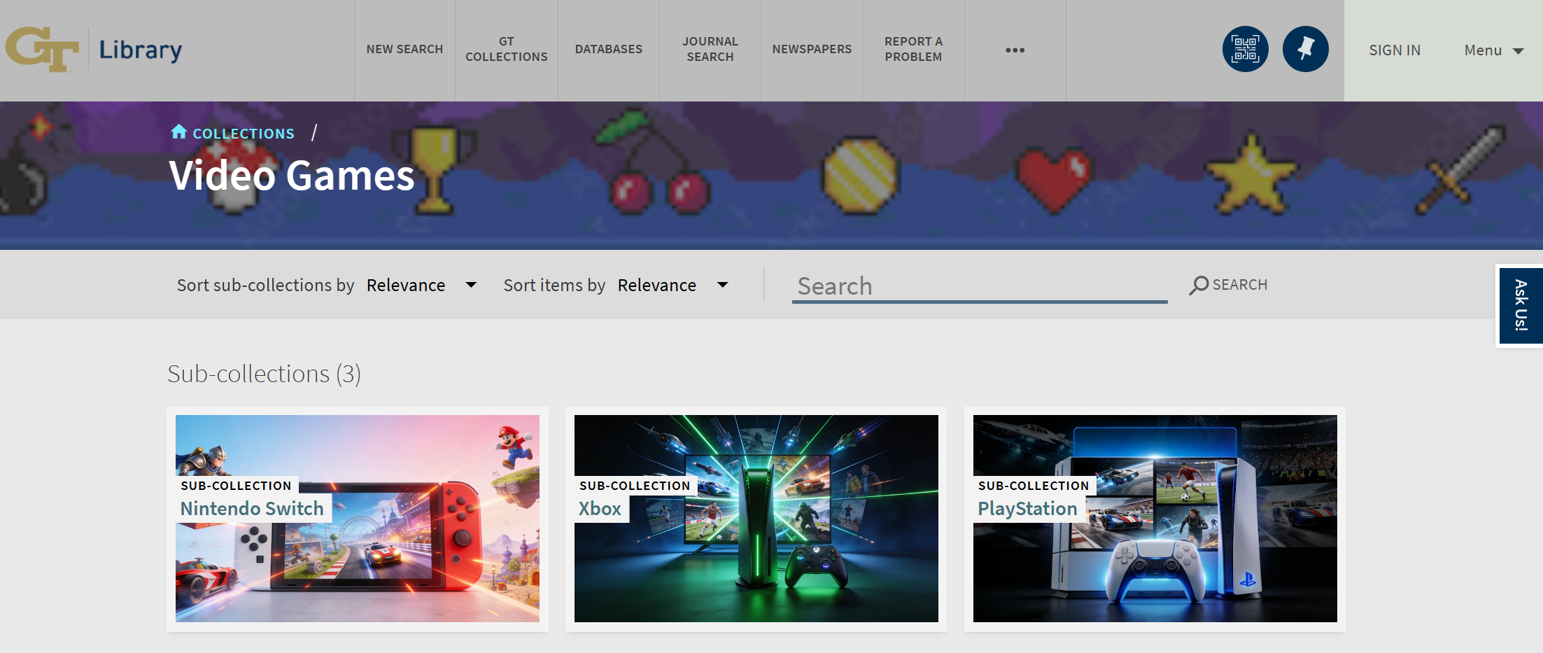
Access & Discovery
Housed in a dedicated display stand next to the info desk
Loan policy: 3 items, 7-day checkout, one renewal
Searchable in Primo by material type and browsable as “Video Games” collection
As of May 11, there have been 223 checkouts.

Slide 17
Challenges & What We Learned
Challenges
What We Learned
Industry shifting toward digital-only distribution
Library discounts don't yet apply to games — full price assumed
Platform dependency: hardware tied to software access
Flexibility is key: formats and platforms will keep evolving
Local documentation is essential — nothing existed before
Cross-department communication makes or breaks the workflow

Slide 18
Questions?
Presley: presley.dyer@library.gatech.edu
Stephanie: ​stephanie.galipeau@library.gatech.edu

