Slide 1
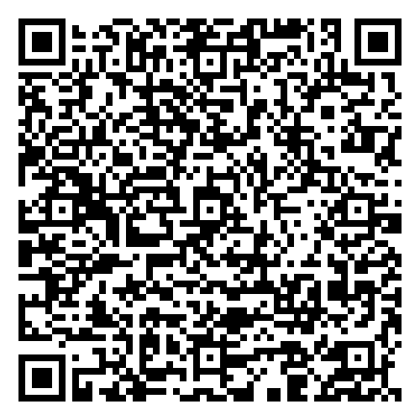
Customizing Your Library’s EDS!
Alyshia Bagley
Electronic Resources Librarian Georgia Southern University
Ed Sperr
Systems and Discovery Librarian University of Georgia
with the assistance of
Russell Palmer and Mike White of GALILEO

Slide 2
Who are we and why are we here?
EDS administrators (either hands-on or via GALILEO) have varied levels of experience and bandwidth
How much do we need to know?

Slide 3
Who is this presentation for?
Staff newly tasked with administering your library’s EDS instance
Staff who are responsible for overseeing your library’s EDS, but who have GALILEO do the heavy lifting
Anyone else in Public or Tech Services who wants to know how EDS works

Slide 4
What is EDS?
EBSCO Discovery Service: EBSCO’s discovery layer product
EDS can search:
Your library’s EBSCO databases
EDS Indexes & Subject Indexes
Partner databases that you add and configure (will require a custom link)
“Custom catalogs” (usually including your Library’s OPAC)
More at https://connect.ebsco.com/s/article/What-content-is-included-in-my-EBSCO-Discovery-Service-EDS-profile?language=en_US

Slide 5
Do you fit the Profile?
EBSCO administration tasks are performed against ‘profiles,’ including:
Your EBSCOhost Databases profile
Your production EDS profile
Any test EDS profiles you have set up
Your API profile (that powers the bento at GALILEO)

Slide 6
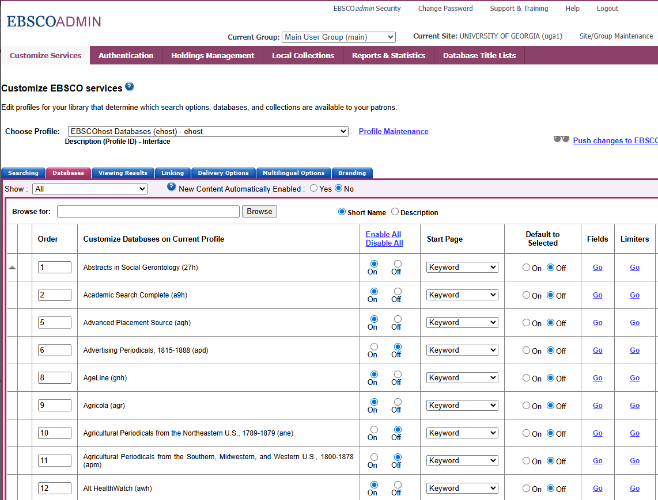
Selecting what to include
If you’re doing this yourself, use EBSCOAdmin:
EBSCOAdmin > Customize Services > Databases
Make sure you’re changing the correct profile!
Otherwise, contact GALILEO:
https://www.galileo.usg.edu/contact

Slide 7
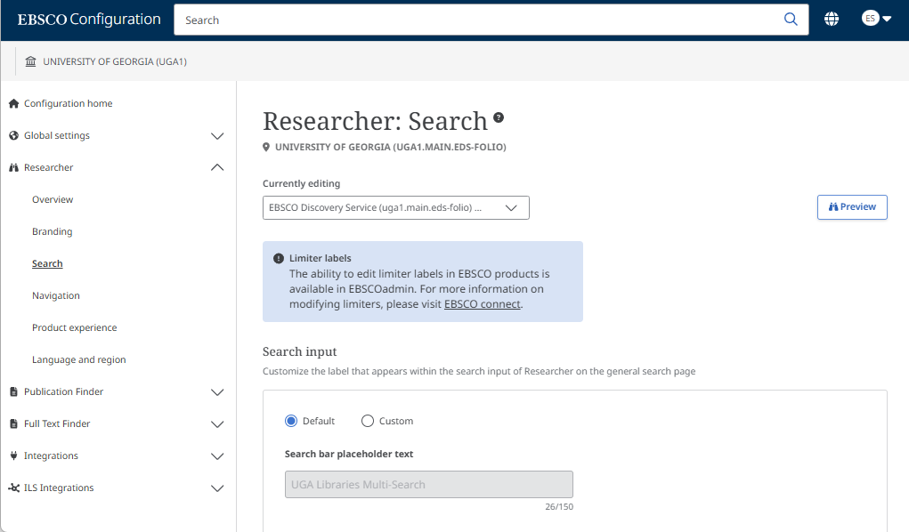
Basic search configuration
EBSCO Experience Manager
Experience > Researcher > Search
Can configure:
Allowed and default modes
Advanced or standard results
Custom filters

Slide 8
Other configuration options
Integrations of external services
Including LibKey, Chat and more!
https://connect.ebsco.com/s/article/Apps-and-Integrations-for-EBSCO-Discovery-Service?language=en_US
Custom placards
Up to 200 custom pointers to a specific page/resource when a particular term is searched
https://connect.ebsco.com/s/article/Integrating-Custom-Placards-in-the-new-EBSCO-Discovery-Service-user-interface?language=en_US

Slide 9
More info…
EBSCO News
EBSCO Discovery Service: Administration
EBSCO Discovery Service Foundations Series
Configuring the search
Managing content and linking
Branding and integrations

Slide 10

Questions?
Alyshia Bagley
abagley@georgiasouthern.edu
Ed Sperr
esperr@uga.edu
GALILEO
https://www.galileo.usg.edu/contact

