Slide 1
Determining Discovery: How First-Year Students Use Primo
Sonya Slutskaya & Karen Viars
Georgia Tech Library
GUGM, May 18, 2018

Slide 2
Agenda
Why
How
Study Set Up
Results
Lessons Learned
Q&A
Notes:
Introduction (Karen)

Slide 3
Why?
Benefits for information literacy instruction
Benefits for catalog interface improvement
Notes:
Why?

Slide 4
How?
IRB approval process
ENGL 1101 and 1102 classes
Partnership with faculty
Notes:
How (Karen)

Slide 5
Study Set Up
Total | 87
Class 1 | 4
Class 2 | 33
Class 3 | 50

Slide 6
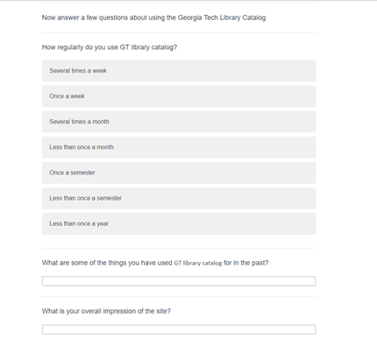
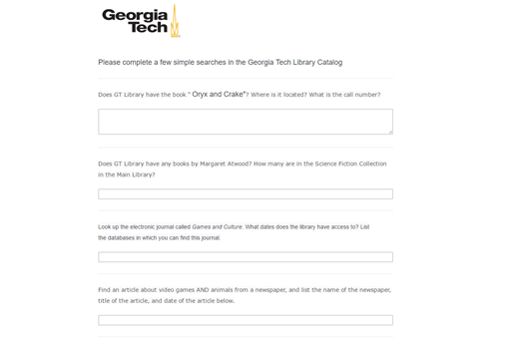
Study Set Up: Qualtrics Survey
Primo Exercises
Survey about the experience

Slide 7
Study Set Up: Qualtrics Survey
Animals in Video Games:
Does GT Library have the book " Oryx and Crake"? Where is it located? What is the call number?
Look up the electronic journal called Games and Culture. What dates does the library have access to? List the databases in which you can find this journal.
Find an article about video games AND animals from a newspaper,
Southern Literature:
Does GT Library have a book by Flannery O'Connor? Where is it located? What is the call number?
Look up the electronic journal called Southern Cultures. What dates does the library have access to? List the databases in which you can find this journal.

Slide 8
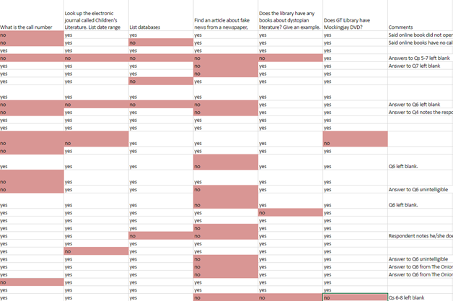
Study Set Up: Grading Rubric
YES – correct
NO – incorrect
Comments

Slide 9
Results
 | Successful | Errors | Total
Does GT Library have the book xxx (title)? | 80 | 4 | 84
What is the xxx book location in the library | 78 | 6 | 84
What is xxx book call number | 77 | 7 | 84
Does GT Library have books by xxx (author)? | 83 | 1 | 84
What is the location of the book by xxx author? | 72 | 12 | 84
What dates does the library have access to xxx electronic journal | 64 | 20 | 84
Please list what sources you can get electronic journal xxx from | 59 | 25 | 84
Find a book on the subject. Limit material type (book) | 74 | 10 | 84
In GT Library Search you need to find a newspaper article on xxx topic | 33 | 51 | 84
Find a DVD. Limit material type (DVD) | 79 | 5 | 84

Slide 11
Results

Slide 12
Results: Journals Availability

Slide 13
Results
Notes:
Could not find a newspaper
Could not find an article

Slide 15
Super helpful I wish I knew about it earlier.
Seems useful for many resources that I have had to buy in the past
I did not know this resource was provided by GT
Trash
So so
Notes:
Requires training 6.17%
Needs better navigation 3.70%
Needs to be more user friendly 1.23%
User friendly 7.41%
Easy to navigate 14.81%
Rich content 14.81%

Slide 17
If you could change something about the site, what would it be?
There should be a tutorial on how to use it, or make it easier.
More distinctly separate different types of resources
Add a newspaper material type
Add more languages in the advanced search
I would have books listed first in the general results, since most often people search for books
It isn't the easiest to understand, like the abbreviation of where the item actually is is confusing along with the links to other pages
If you click on the call number it should go to a map to show you where it actually is

Slide 18
Communicating Results
Shared the results of our research with:
the Library’s Content Discovery Group
Head of the Campus Engagement and Scholarly Outreach Department (CESO)
Associate Dean of Learning and Research Services
Faculty members who so generously allowed us time
Director of the Writing and Communication Program (WCP)
Chair of the School of Literature, Media and Communication

Slide 19
Leveraging Results
The Content Discovery Group incorporate the research findings to assist with their decisions about altering the existing interface to address the concerns and recommendations, or migrating to a new one.
Beginning in Fall semester 2017, English 1101 and 1102 classes are taught by a group of five librarians. This research alerts these librarians to the types of tasks students find easy or challenging, as well as sharing students’ overall impressions and attitude toward the discovery tool.

Slide 20
Lessons Learned
Collect user feedback regularly
Faculty support is critical
Be transparent with students, provide rationale
Make the assessment relevant to the class
Allow time for IRB review
Pilot the assessment instrument

Slide 21
Ask Us Anything
Sonya Slutskaya - Metadata Strategist
Sofia.slutskaya@library.gatech.edu
Karen Viars - Humanities & Science Fiction Librarian
Karen.viars@library.gatech.edu
Notes:
Ask Us Anything

