Slide 1
The Drop-in Librarian
David Edens Instructional Services Librarian
Tamatha Lambert Director, ABAC Libraries

Slide 2
Inception
World Domination Roaming/Roving Librarian + Competing sessions Drop-in Librarian
Notes:
World Domination- Fall 2017 Teaching & Learning
Faculty wanted to attend more sessions than possible, expressed interest in our session/regret that they missed it
Roaming Librarian concept- reference librarian moving around campus for student assistance
Combined into idea of librarian office calls for faculty- meet instructors on their time in their space

Slide 3
VENN DIAGRAM (Of course we had to have a Venn Diagram.)
Drop-in Librarian
Conflicting schedules
Faculty
Notes:
On one hand, faculty with need
On other hand, busy teaching schedule and limited group sessions
Solution? On-call librarian visits to faculty’s offices when they’re available

Slide 4
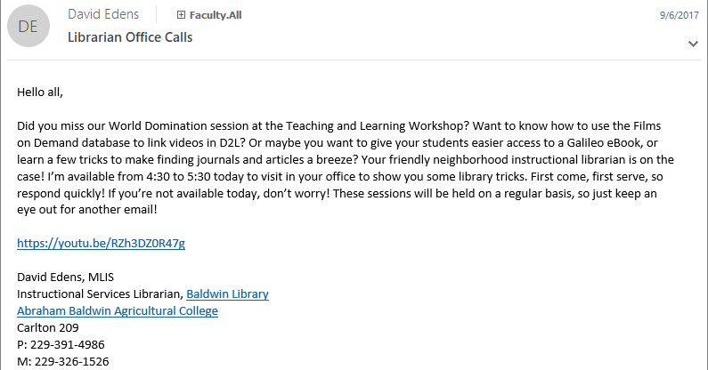
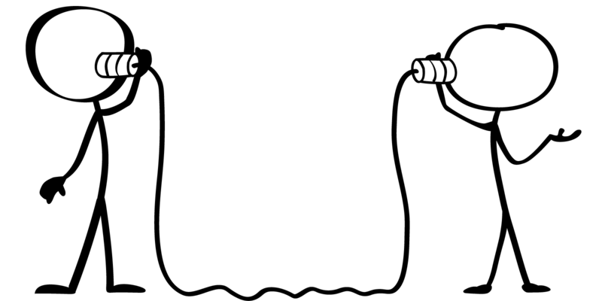
Outreach
Notes:
So how do we get faculty buy-in?
Email provides invitation/permission for faculty to ask us in.

Slide 5
Teaching the Tech
1. World Domination: New Catalog-Primo
2. Georgia View: Embedding Content
3. Search Alerts: RSS/Email
Notes:
Three major sessions: World Domination to show off the new version of Primo, embedding content in Georgia View, and generating search alerts via email and RSS feed.
You know the first one, but we will show you the process for the second and third options- and how we showed our faculty.

Slide 6
What’s next?
Scheduling
Anchor to sessions
New Tech
Notes:
Each open session for Drop-in Librarian has seen different buy-in from faculty. Over the last year, we’ve noted several variables that seem to affect if and when our faculty need this support. First, we see the most activity early in the semester, when new faculty are learning the ropes and veterans need a refresher. Further, we are planning to have longer on-call times- instead of offering three hours in an afternoon, for example, offering all-day call periods two or three times in a week. Secondly, going back to the original reasoning behind the office calls, we get a lot of responses when we tie these visits to a session- if a faculty member misses the session, they can still get the information! Finally, any time we put out the word about a new technology, feature, or technique- or one in which we see a gap in knowledge for our users, an on-call session sees a rise in activity for the one-on-one training.

Slide 7
“Better Call David” Promo

Slide 8
David Edens
Tamatha Lambert
Instructional Services Librarian dedens@abac.edu
229-391-4986
Director, Baldwin Libraries tlambert@abac.edu
229-391-4993

