Slide 1
GIL EXPRESS BASICS
MARY POLAND AND VIKI TIMIAN
ACCESS SERVICES
UNIVERSITY OF GEORGIA LIBRARIES
OCTOBER 14, 2020

Slide 2
GETTING STARTED WITH GIL EXPRESS
Subscribe to these lists :
GIL Fulfillment Community - G2FULFILLMENT@LISTSERV.UGA.EDU
GIL General Information – GA-G2ALL@LISTESERV.UGA.EDU
GIL Express Courier Information – GIL-COURIER-L@LISTSERV.UGA.EDU
To subscribe to the email lists go to the website - listserv.uga.edu
Or, email helpdesk@usg.edu

Slide 3
USEFUL LINKS FOR GIL EXPRESS
https://sites.google.com/view/g3almatraining/

Slide 4
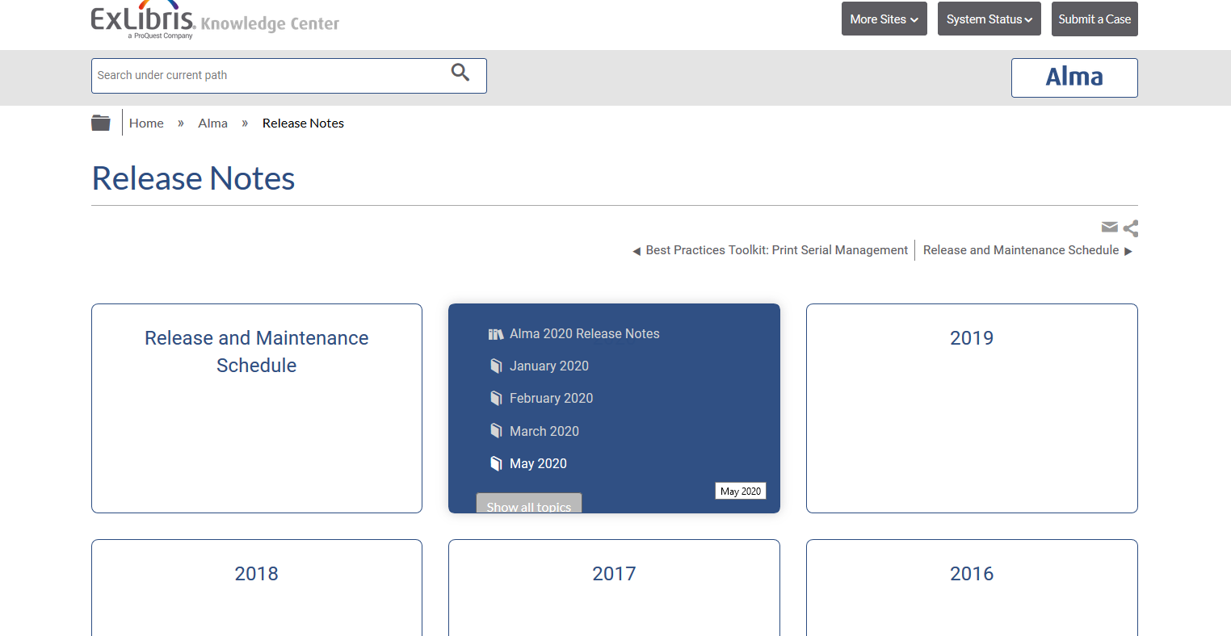
Link to Ex libris release notes
https://knowledge.exlibrisgroup.com/Alma/Release_Notes

Slide 5
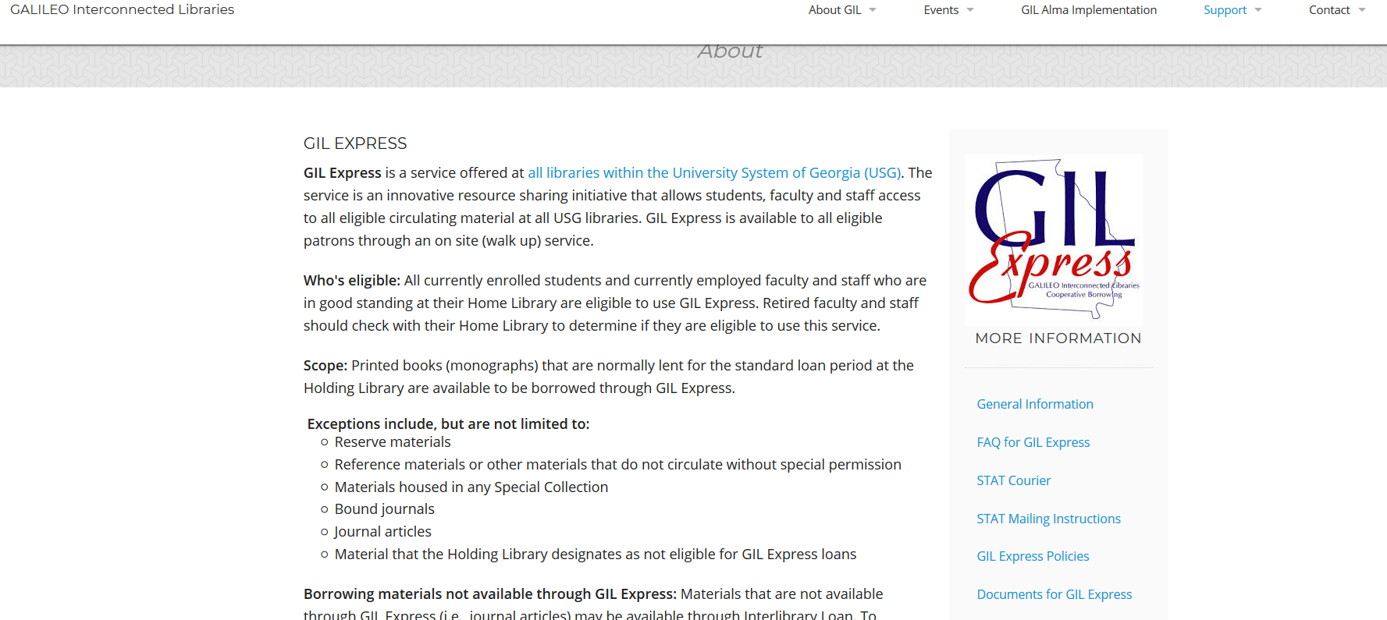
USEFUL LINKS FOR GIL EXPRESS
http://gil.usg.edu/gil_express

Slide 6
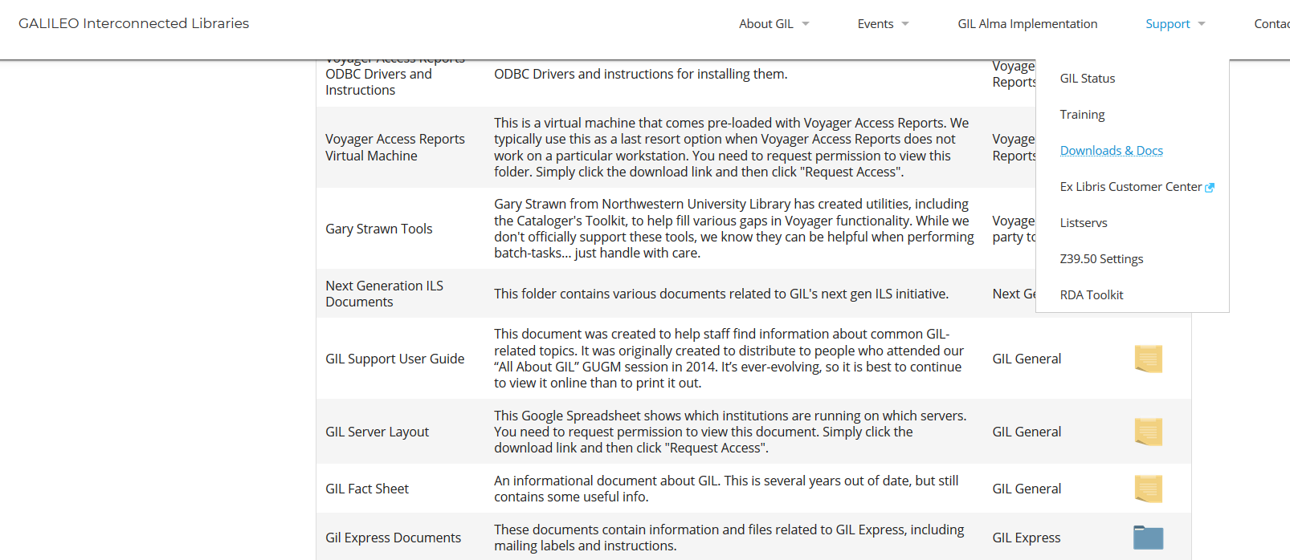
GIL EXPRESS DOCUMENTS
https://gil.usg.edu/

Slide 7
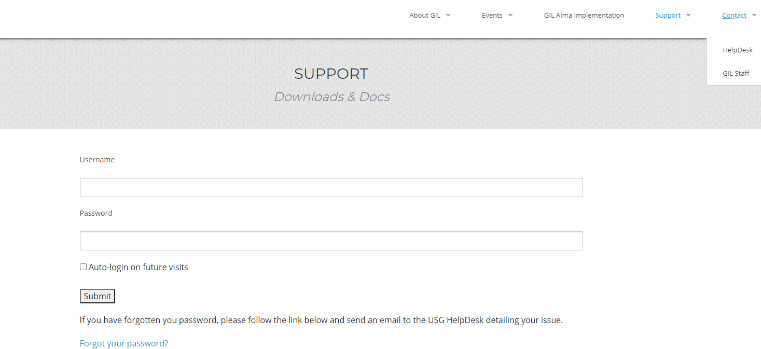
DOCUMENTS LOGIN PAGE

Slide 8
GIL EXPRESS DOCUMENTS
GIL Express Contact List - A list of contacts for each library with email addresses and phone numbers. This list is updated each fall and spring. You’ll also get emails on the G2FULFILLMENT listserv about these updates from time to time.
Closed-Dates Chart - This chart is available for each semester – Spring, Summer, and Fall. It can be useful when you are suggesting another library to a patron. For example, if GGC or GSU had something that couldn’t be requested via GIL Express and the patron needed to visit the library to access it. You would look at the chart to see if they are open.
STAT Courier Information – The STAT documents located here include STAT labels for ILL and GIL Express, STAT logsheets, delivery locations, route codes and address codes.
Institutional Billing – Instructions on how to process Institutional Billing invoices for your library are located here. There is also a PowerPoint about Institutional Billing.
GIL Express Blocking – Patrons from your libraries with overdue GIL Express books should be blocked in Alma using the daily GIL Express Blocking Report. Information on how to block patrons with overdue GE books using the GIL Express blocking reports is provided here. Not everyone who works with GIL Express will receive the blocking report. If you are not (but should be) receiving this daily email, submit a GIL Support Help Desk ticket.

Slide 9
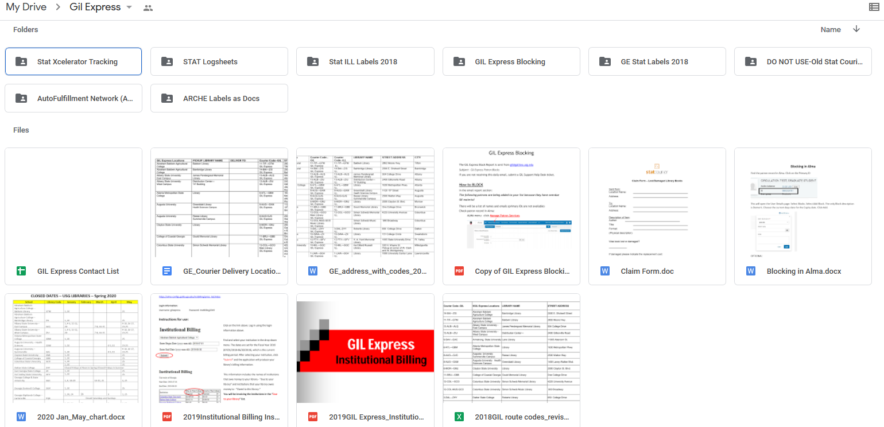
DOCUMENTS GOOGLE DRIVE

Slide 10
GIL EXPRESS IN ALMA
The functions you have access to in Alma are based on your User Role(s).
You need the role(s) for each location where you will be working.
These roles are assigned by the Alma Administrator for your library/department.

Slide 11
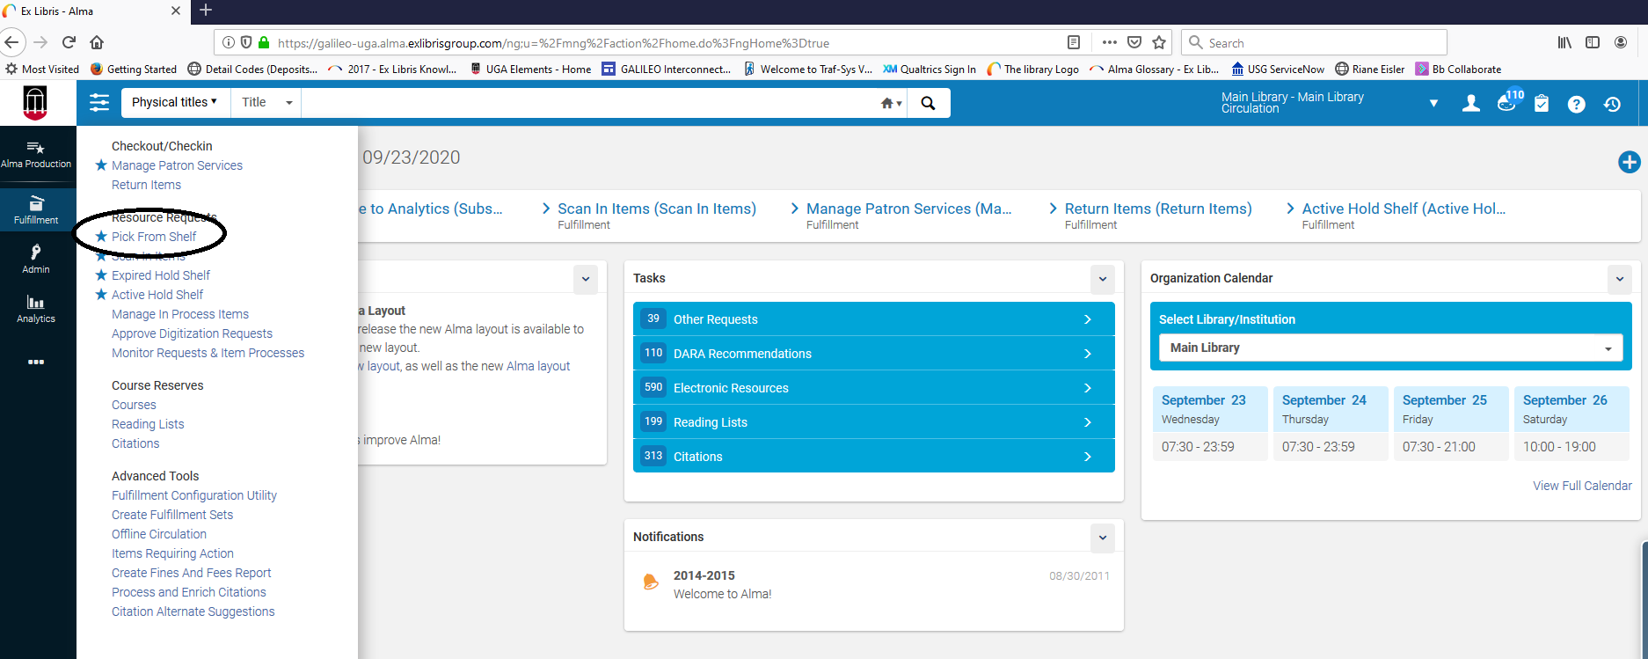
Viewing GIL Express requests

Slide 12
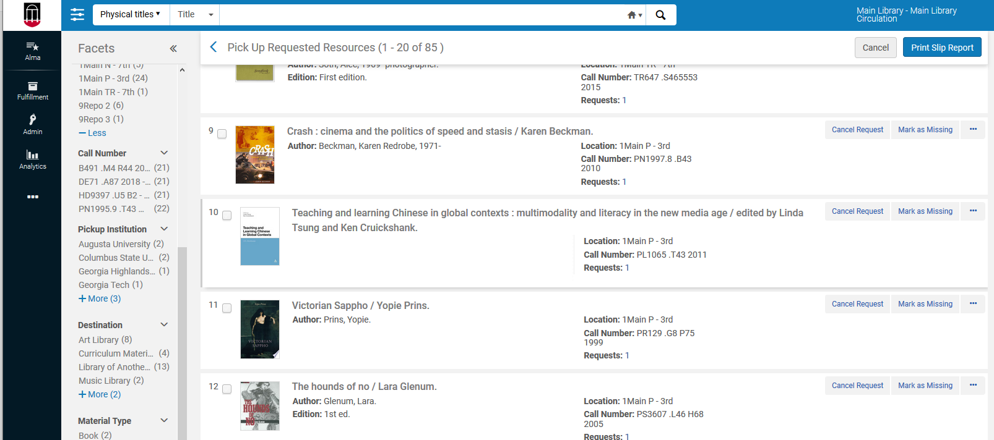
Pick From Shelf

Slide 13
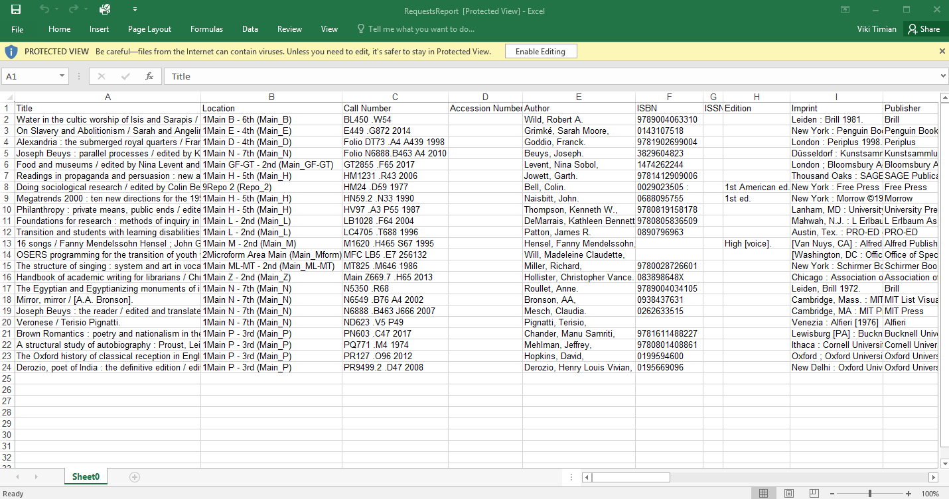
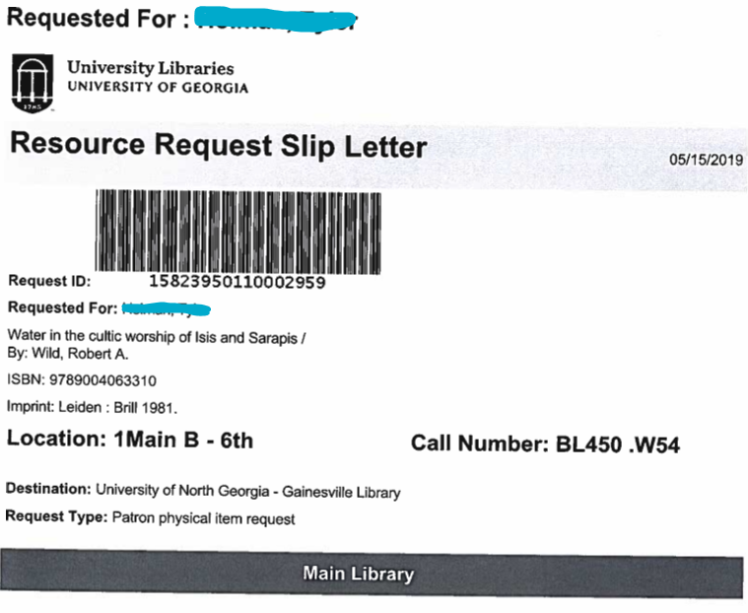
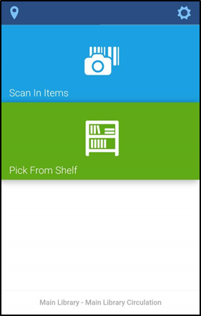
HOW DO YOU PICK FROM SHELF?
Print Slips
Print Slip Report
Alma Mobile
Full Alma on tablet

Slide 14
Processing Pick From Shelf
Books are pulled from the shelf and scanned in Alma. Always use the Scan In function for GIL Express books. Scan In moves items from one workflow process to another and automatically generates a Transit Slip. Transit slips are placed in the books being sent to other libraries.
GIL Express books are sent to other USG libraries through STAT courier. USG institutions who are members of ARCHE (Atlanta Regional Council for Higher Education) can use the ARCHE van for deliveries to other member institutions.
Book bands are placed on the books. The books are then placed in secure, barcoded bags for delivery. PDF labels for the bags are located on the GIL Express website.
Books that are not found should be marked as missing and the request should be cancelled.

Slide 15
RECEIVING REQUESTED MATERIAL
Scan in each item to determine how to process
Hold Shelf Processing – YES - The item not yet ready for the hold shelf and is designated for hold shelf processing for a specific time before the hold is activated. After the designated time, the hold is activated by scanning the book barcode a second time and the On Hold Shelf Letter is sent to patron.
Hold Shelf Processing – NO – Hold is activated immediately when the book barcode is scanned. Item placed directly on the Hold shelf. An On Hold Shelf Letter is sent to the patron, indicating that the item is ready for pickup at the hold shelf
When scanned, the item is routed to another location. This could happen for several reasons: patron cancelled item, item sent to the wrong location, etc. Send the item to the directed location and contact the owning library if necessary.

Slide 16
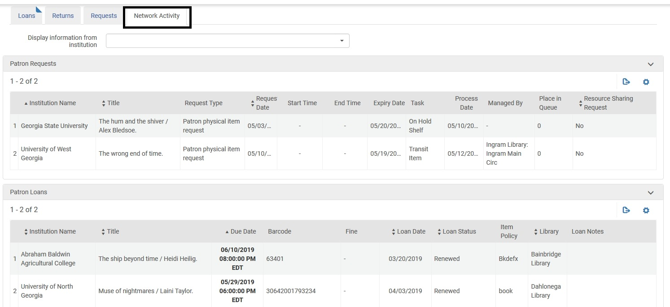
Viewing GIL Express Activity
GIL Express information, including the Hold status, is located under the “Network Activity” tab on the Patron’s Account

Slide 17
MANAGING YOUR HOLD SHELVES
Patron doesn’t want the item – cancelling an active hold
Go to the Active Hold Shelf
For Gil Express items, Update Expiry is the only option available to change
Update expiration date to a past date
This action sends the record to the Expired Hold Shelf
Patron doesn’t pick up and item - hold expires
Record is moved to the Expired Hold Shelf

Slide 18
EXPIRED HOLD SHELF
Send to Institution: Items to go to another institution (GIL Express)
Reshelve: Items handled by your “currently at” location’s circulation desk
Send to Circulation Desk: Items handled by another circulation desk within the same Library
Send to Library: Items to go to another library within your institution
Activate Next: Items that have another request pending in the queue for pickup at that same circulation desk

Slide 19
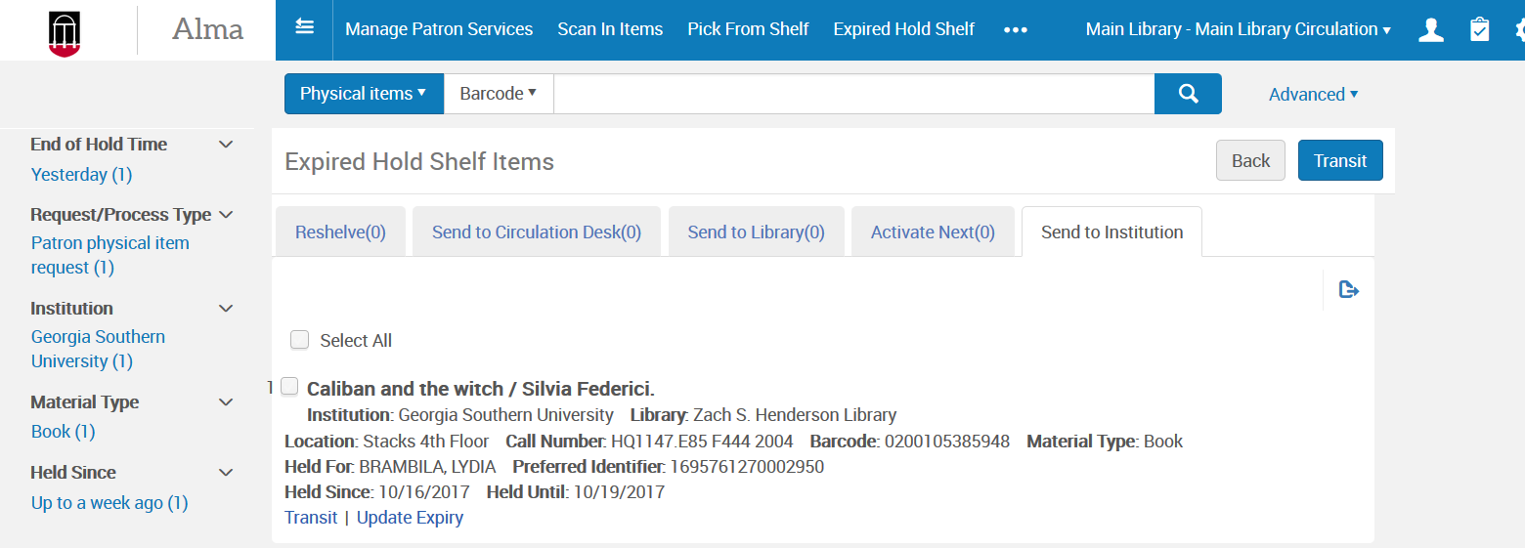
PROCESSING GE EXPIRED HOLDS
On the Expired Hold Shelf page, select Send to Institution
Click the Transit link associated with the relevant item or, to send multiple items, select the Select All check box, click Transit.
The item is put in transit and a transit slip will print.

Slide 20
PATRON INFORMATION
You can search for a GIL Express patron in your Alma. If you check the “Find user in another institution” and search by
the person’s name you sometimes get the Quick User Management screen. Avoid this by using the patron’s ID number or by not checking “Find user in another institution” and searching as one of your institution’s patrons. You can also click the “Update User” button to get to the Patron Services screen.

Slide 21
LETTERS AND NOTICES
This is a list of letters and notices in Alma that patrons might receive when borrowing books through GIL Express.
On Hold Shelf Notice
Courtesy Letter
Lost Loan Letter
Lost Loan Notification Letter
Shortened Due Date (RECALL) Letter

Slide 22
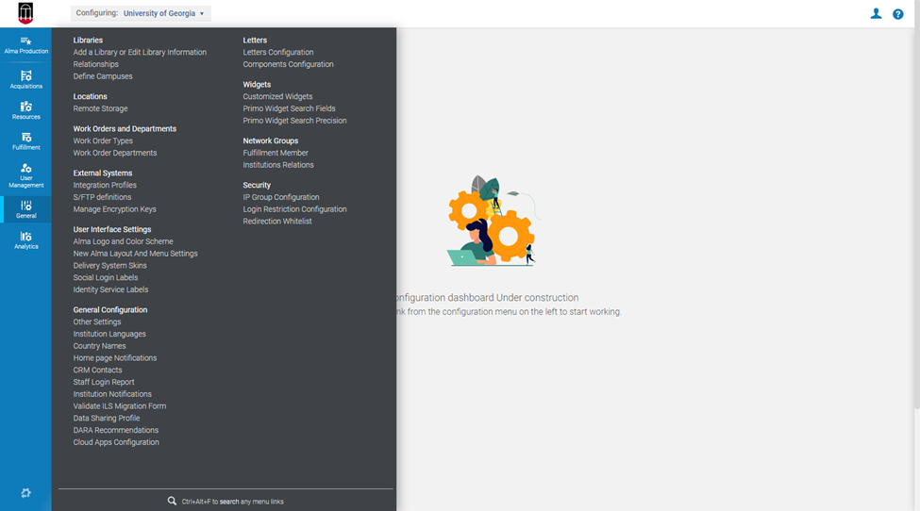
LETTER CONFIGURATION IN ALMA
The Letters Administrator role is required to make changes to your letters/notifications.
Go to Configuration (your screen will look different depending on your assigned roles)
Go to the General section and Click on Letters Configuration

Slide 23
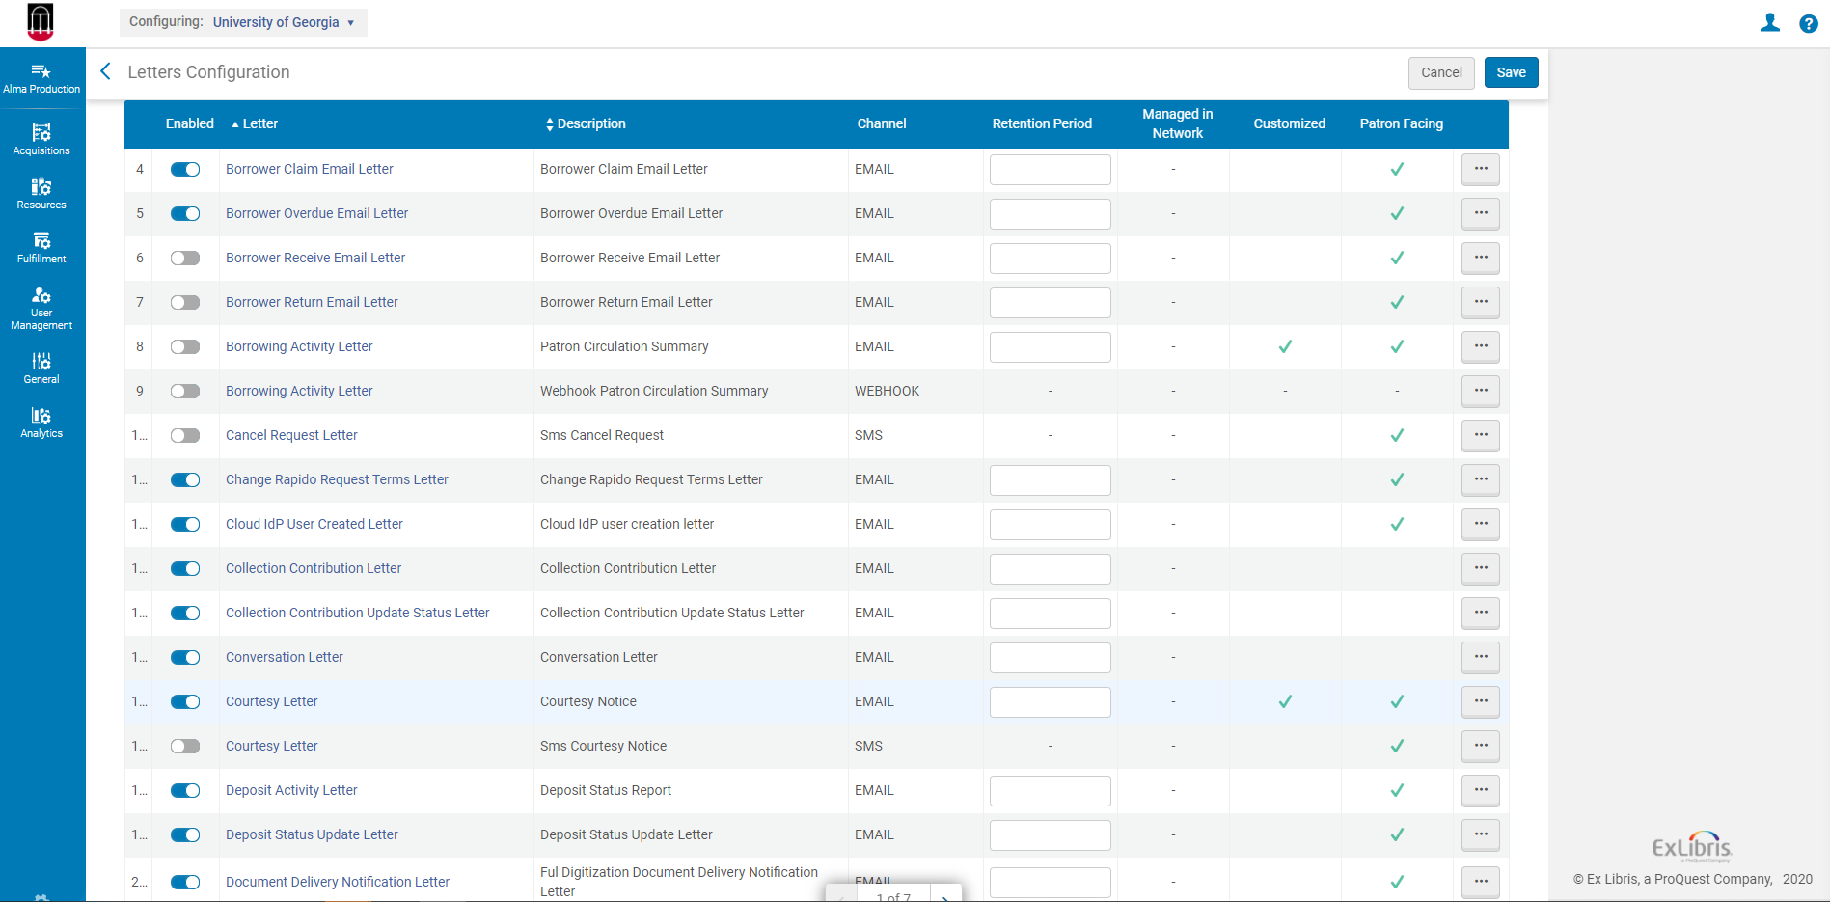
List of Letters
To edit a letter or notice, click on the ellipses.

Slide 24
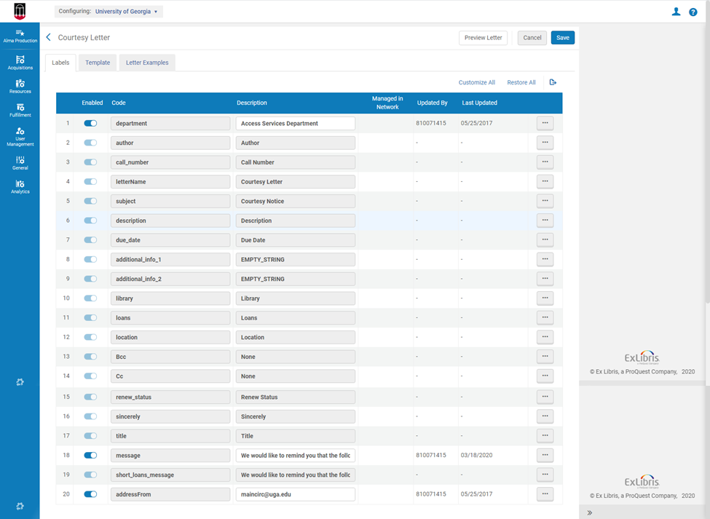
LETTER CONFIGURATION
From here you can easily modify any of the fields by clicking on the ellipses and selecting “Customize”
You can preview the basic view of the letter with the Preview Letter button
And if you are skilled in XML and XSL, the template tab is easily accessible.

Slide 25
Additional Resources for Alma Letters
GIL Wiki: https://sites.google.com/view/g3almatraining/fulfillment/notices-letters
Ex Libris Presentations: https://knowledge.exlibrisgroup.com/Alma/Training/Extended_Training/Presentations_and_Documents_-_Letters
Ex Libris Documentation: https://knowledge.exlibrisgroup.com/Alma/Product_Documentation/010Alma_Online_Help_(English)/050Administration/050Configuring_General_Alma_Functions/070Configuring_Alma_Letters

Slide 26
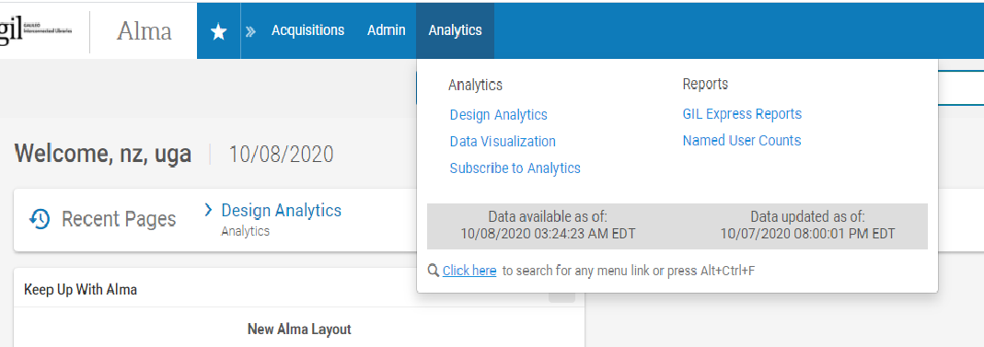
GIL EXPRESS REPORTS in the Alma network
GIL Express Reports are available in the Network Zone at https://galileo-network.alma.exlibrisgroup.com/. The institutional leads for each library should have the username/password for the Alma in the Network Zone or you can submit a service ticket to get them. Once you are logged in, the reports are under Analytics--Reports--GIL Express Reports.

Slide 27
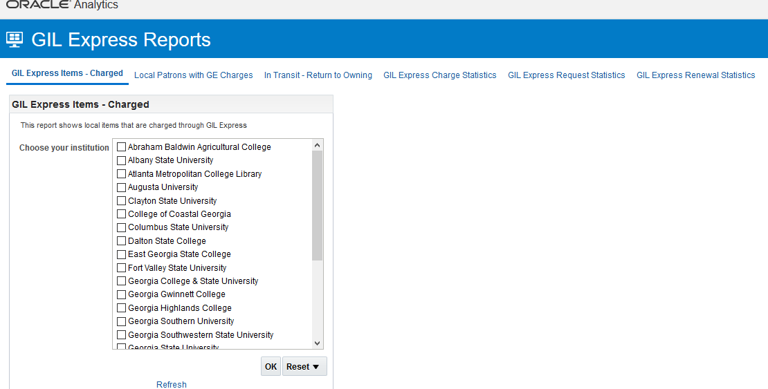

Slide 28
GIL EXPRESS REPORTS/Institution level
There’s no need to go to the Network Zone for reports on USG patron with your libraries’ books. You can create reports in your Alma Analytics to get information about your libraries’ materials loaned through GIL Express.

Slide 29
Criteria for active loans report

Slide 30
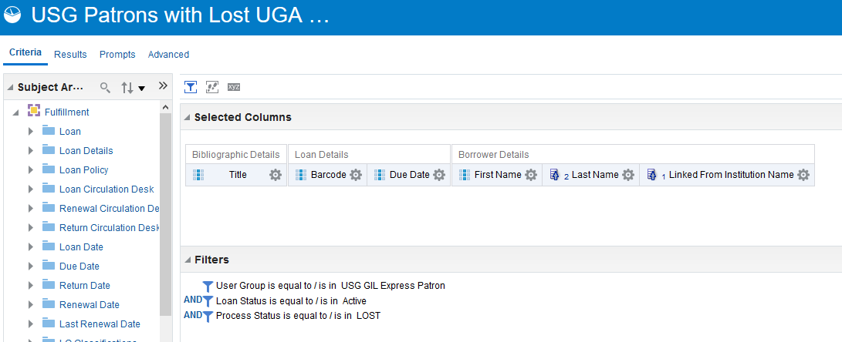
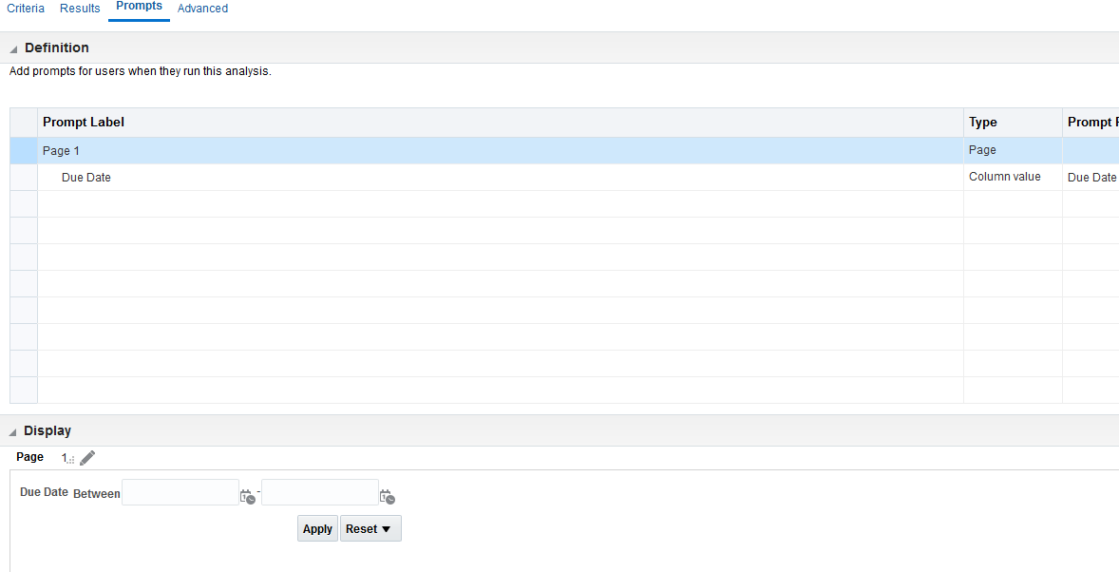
criteria for lost books report

Slide 31
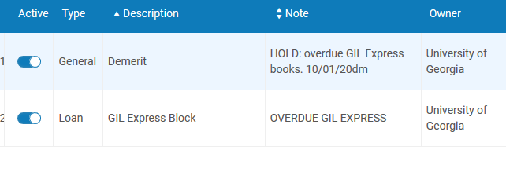
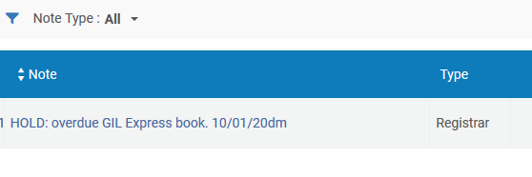
GIL Express blocking
Detailed instructions on blocking patrons in Alma are available on the GIL Express website as noted at the beginning of this presentation. The GIL Express Block is added by the system. At UGA, we add the Demerit block to prevent additional GIL Express requesting and loans. We add a note about the hold as well. We also block the person in Banner.
When the person is removed from the blocking list, the GIL Express Block is automatically removed. We manually remove the Demerit Block and remove the hold in Banner.

Slide 32
Institutional billing
Institutional Billing occurs once a year. The accounting period is July 1 through June 30 of each year.
This year, the process is delayed. More information about this year’s billing process will be provided on the G2 Fulfillment listserv.
Detailed instructions for Institutional Billing are located on the GIL Express website noted at the beginning of this presentation. The instructions are updated for each billing cycle.
Not everyone who works with GIL Express will be involved with Institutional Billing. Contacts for billing may not be the same as those listed on the GIL Express Contact List.

Slide 33
Summary
G2Fulfillment Community
GIL Express Website and Alma Wiki
User Roles Determine Alma Privileges
Managing Expired Hold Shelf
Letters/Notices Configuration
GIL Express Reports
Blocking and Billing
Viki Timian, Head of Access Services
UGA Libraries
vtimian@uga.edu
Mary Poland, Assistant Head of Access Services
UGA Libraries
mwpoland@uga.edu

