Slide 1
External Authentication in

Slide 2
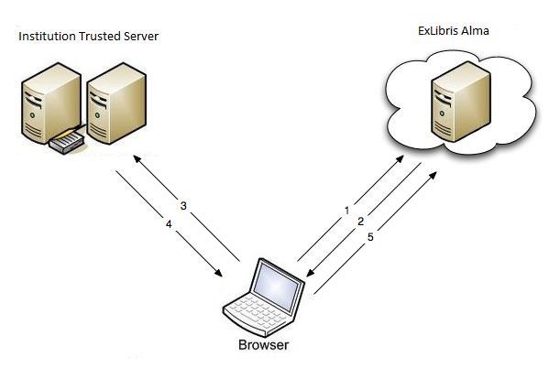
What is External Authentication?
External authentication is a type of access control where a trusted source verifies a user’s credentials.

Slide 3
Types of users in Alma
Internal
Created in Alma, password managed in Alma
Mostly limited to some small patron groups and one or two Sysadmin type accounts
External
Imported via SIS Integration, password managed externally
Majority of users will fall in this category

Slide 4
Updating External Auth
Authentication methods will continue to change
Updates and new methods can be tested with Alma
Will always require help from your local IT teams

Slide 5
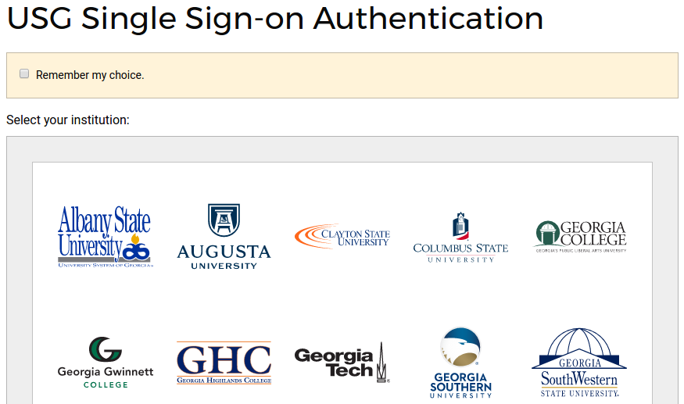
Future Plans?

Slide 6
External Authentication in
Thank you!
Questions?

