Slide 1
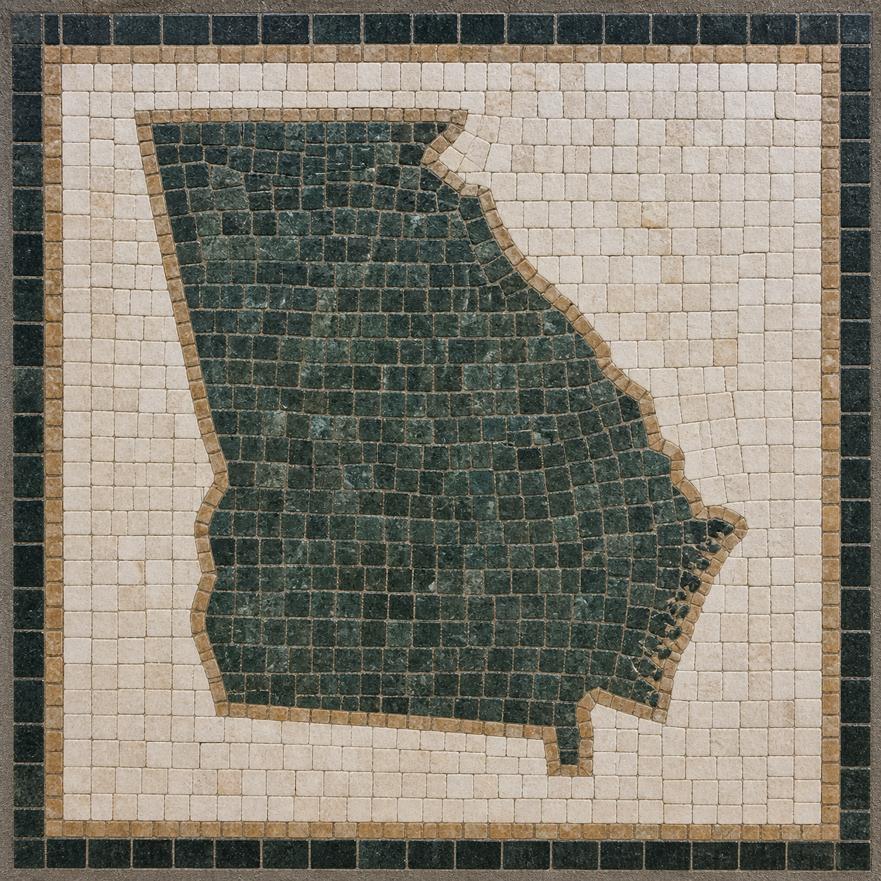

Good Information for Libraries: GIL Talks
Simon Hunt Chris Fishburn Sean Purcell Sean Boyle

Slide 2
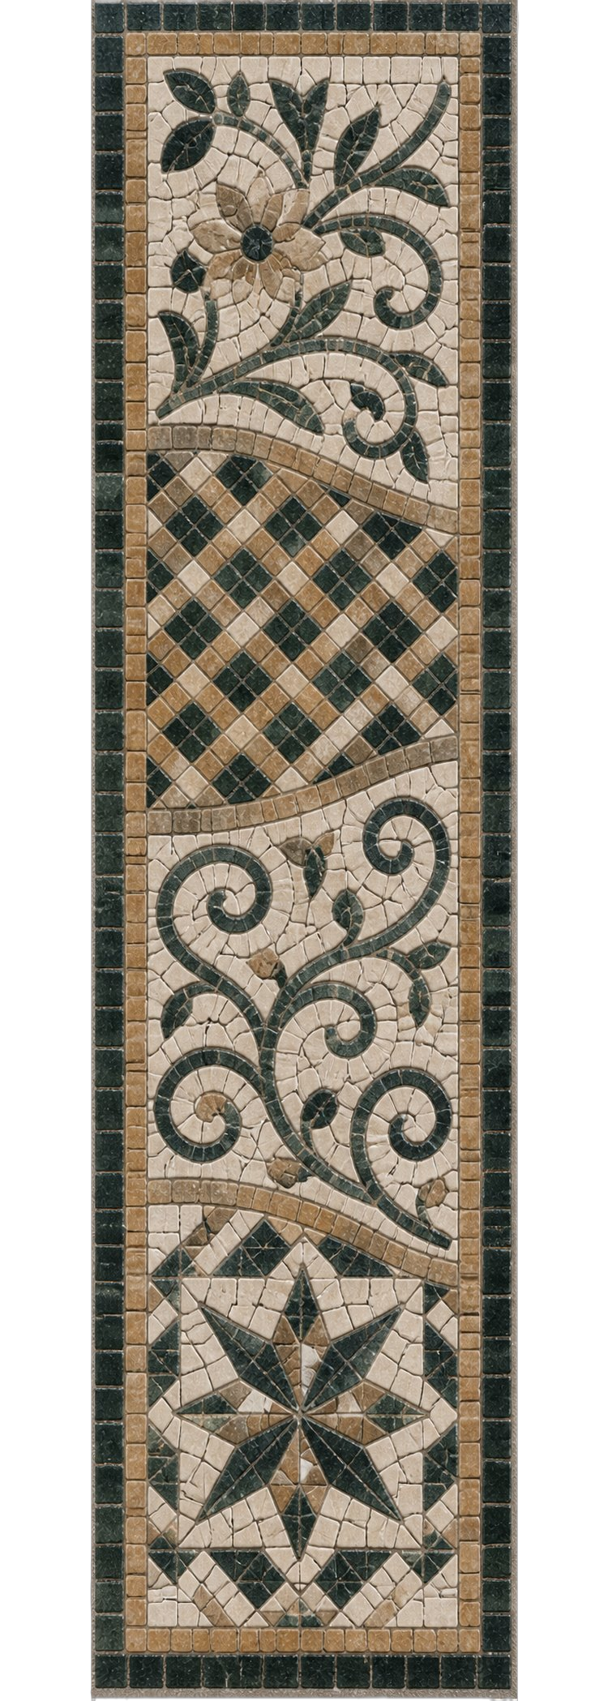
Summary
Import profiles configuration
Primo NDE customization
Dedicated GIL Area Inside GALILEO Admin
Upcoming projects on the GIL Roadmap.

Slide 3
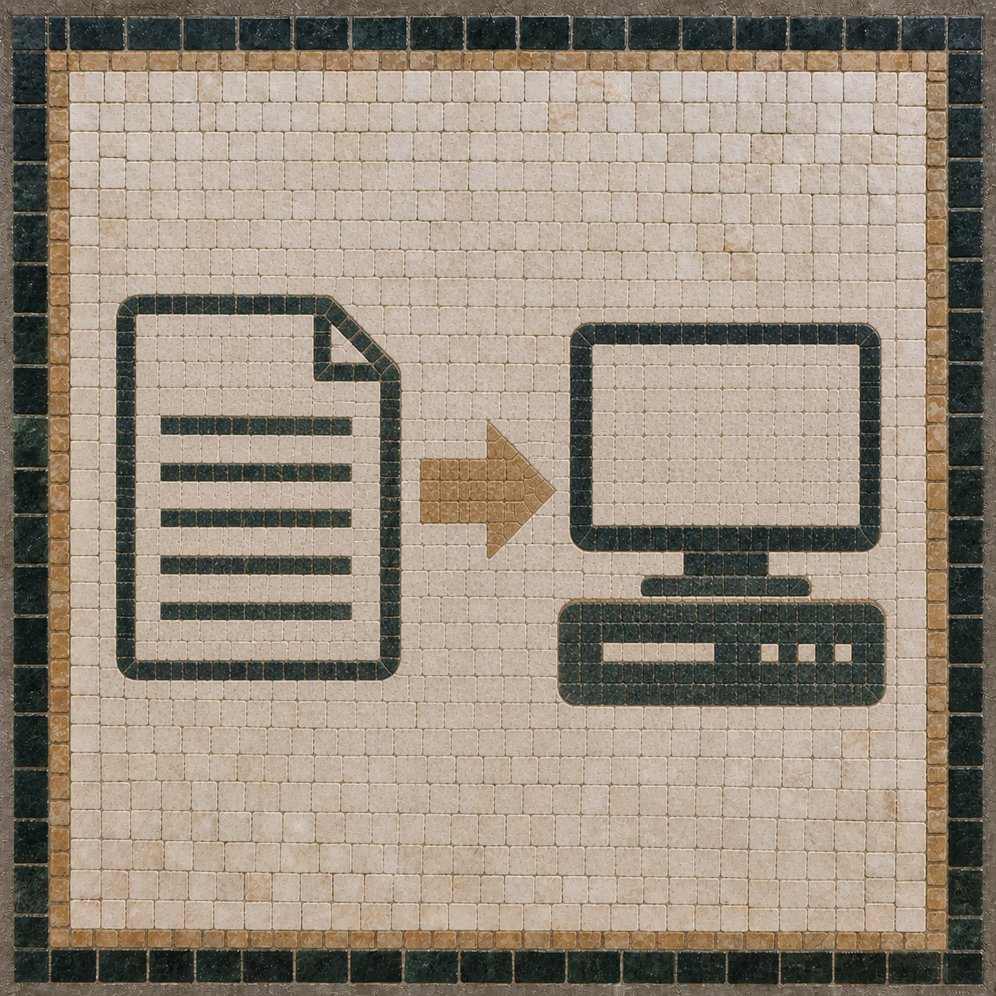
Import profiles configuration and best practices
Simon Hunt GIL/GALILEO Systems Librarian
Notes:
Today I'm going to talk about some best practices for importing MARC records into Alma that we've established over the years. I won't be covering every aspect of import profiles; just a few key components.

Slide 4
Import profiles – best practices
Know your data
Notes:
The most important thing about importing records is to know your data

Slide 5
Import profiles – best practices
Know your data
Who is supplying the records?
Brief? Full? Glorified citations?
Character encoding?
OCLC numbers or other identifiers?
Purpose of the records?
Notes:
All of these considerations will affect your choices when setting up an import profile, and understanding the data you're bringing in will help you avoid bad overlays or duplication.
Alma provides a lot of options for importing and matching records, and a lot of opportunities to cause trouble in our shared catalog. Let's look at a few key parts of the import profile.

Slide 6
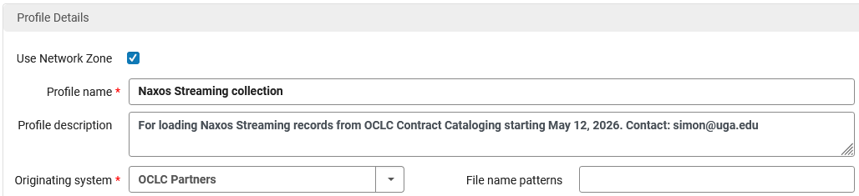
Import profiles – best practices
In Alma’s Import Profile configuration
Use the Network Zone? Probably, yes.
Exceptions:
Contract-restricted records (shelf-ready)
Records with no identifiers to match (035)
Equipment records (laptops, headphones, etc.)

Slide 7
Import profiles – best practices
Clear, concise naming – make it make sense
Detailed description – leave notes!

Slide 8
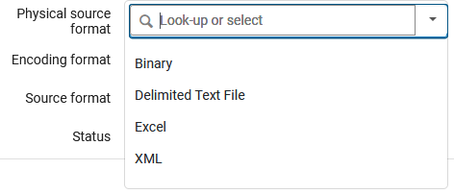
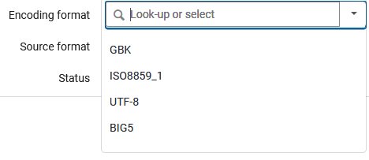
Import profiles – best practices
Physical source format:
Binary (.mrc) or XML (check your file)
Encoding format:
UTF-8 or IS08859_1 (MARC-8)
Notes:
For physical source format, you're likely going to be using a MARC binary or XML file for bibliographic records. You can use the Excel or delimited text options to create bibs, but these are really for special cases like equipment records or adding item records in batches.
If you're importing a binary MARC file, you will need to set the encoding format, and this is where you really need to know what you're importing. BIG5 and GBK are for records cataloged in Traditional or Simplified Chinese, which we won't need. You'll need to be able to tell the difference between records with UTF-8 or ISO8859_1 (MARC-8) encoding.

Slide 9
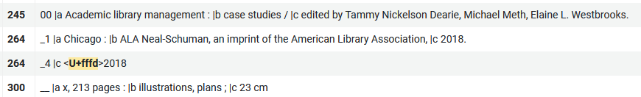
Import profiles – best practices
Encoding format (character set)
Notes:
A mis-match in encoding can show up as a broken copyright symbol,

Slide 10
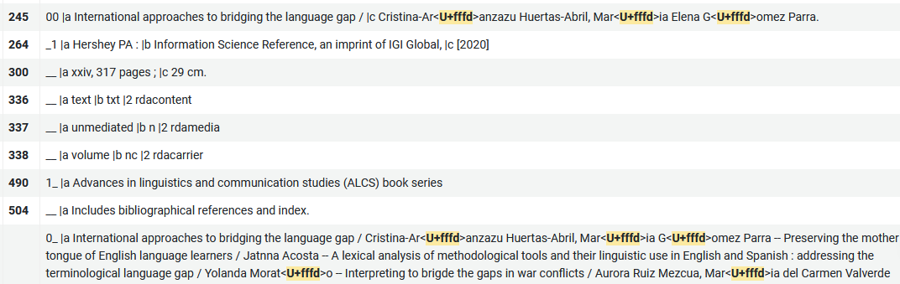
Import profiles – best practices
Encoding format (character set)
Notes:
or diacritical markings,

Slide 11
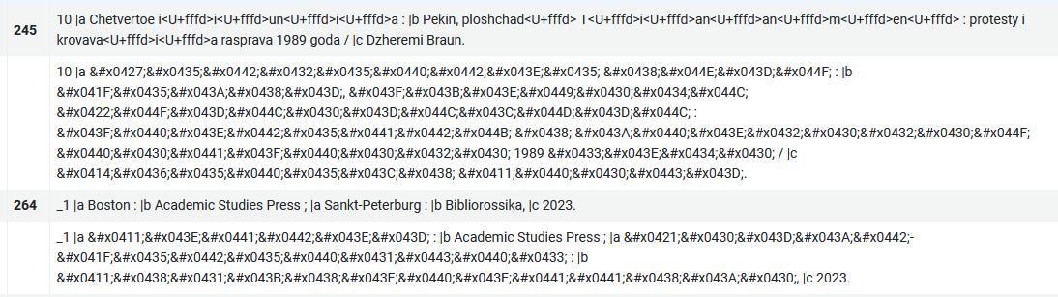
Import profiles – best practices
Encoding format (character set)
Notes:
or non-Latin characters getting mis-mapped.

Slide 12
Import profiles – best practices
Encoding format: how to tell
Method 1: ask the supplier
Method 2: open in MarcEdit and check the LDR position 09
MARC-8 (empty pos 09)
=LDR 02028nam 2200469 i 4500
UTF-8 (pos 09 = a)
=LDR 02028nam a2200469 i 4500
Notes:
If the vendor didn't tell you what character set the records use, you will need to do some sleuthing.

Slide 13
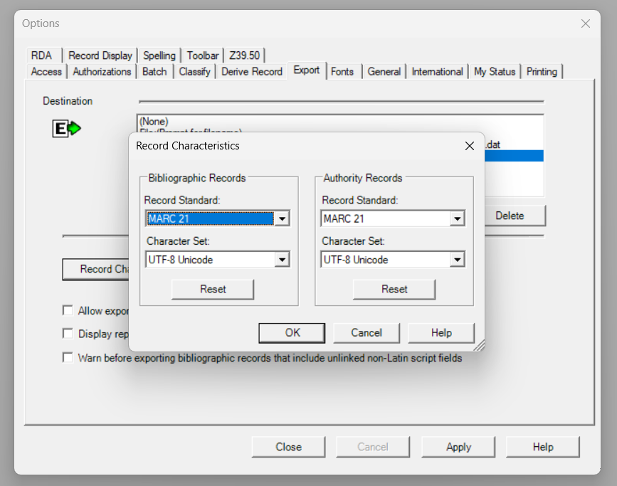
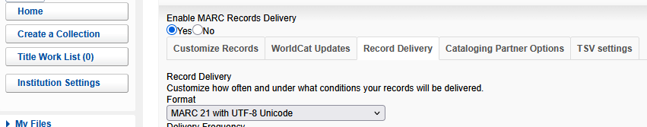
Import profiles – best practices
Connexion and
WorldShare
Notes:
Taking a quick detour, if you're importing from OCLC Connexion or WorldShare, check to make sure your client's export settings are set correctly: Connexion should always be UTF-8 and WorldShare should be set to match your Alma import setting.

Slide 14
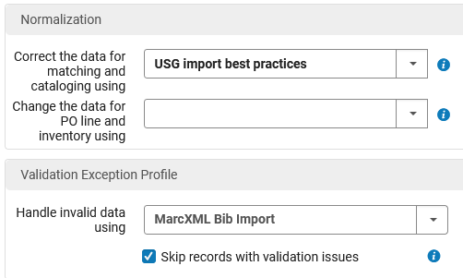
Import profiles – best practices
In Alma
The “USG import best practices” normalization rule aligns with USG Cataloging Committee policies. Highly recommended!
Notes:
The normalization section is another important piece of the import profile. The option you select here will run a set of normalization rules on the incoming records.
For most types of record import, I strongly recommend you use the rule called "USG import best practices." This rule set was designed to align with the bibliographic record policy created by the Cataloging Committee. It filters out fields that don't comply with that policy, including obsolete fields and subject fields that use vocabularies that we don't utilize here, as well as fields and links from non-USG institutions and systems.
This normalization rule set should be used in pretty much every import profile.

Slide 15
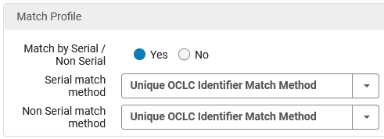
Import profiles – best practices
Match methods
Best options:
Unique OCLC Identifier Match Method
001 to MMS ID Match Method
035 (Other System Identifier) Match Method
Avoid or use with extreme caution:
Matches based on ISSN or ISBN
Anything with "fuzzy" in the name
Notes:
When you get to the Match Profile section, keep in mind that there are many options here that can cause the system to match your record against something that is pretty unrelated to the actual resource. Alma is designed to help smooth over any friction in importing, and if you let it have its way, we'll end up with an undifferentiated blob of a catalog that will frustrate all but the most casual information seekers.

Slide 16
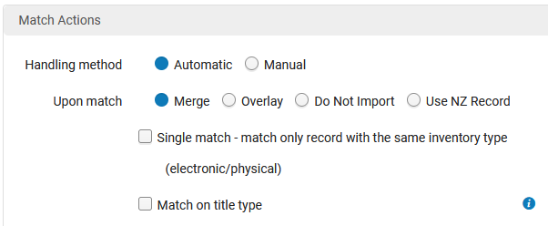
Import profiles – best practices
What to do “upon match” is highly dependent on what your incoming records look like. Know your data.
Never use the overlay option!
Notes:
What to do “upon match” is highly dependent on what your incoming records look like. Merge is the most common and has options attached.
Never use the overlay option!
The "single match" and "match on title type" boxes are useful if you're using the fuzzy matching options I warned against in the previous slide.

Slide 17
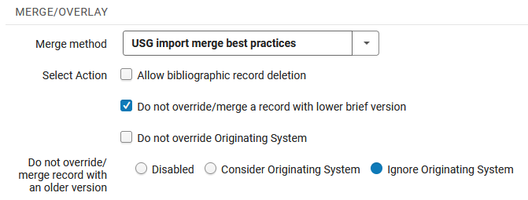
Import profiles – best practices
Importing good-quality records
Notes:
When you're bringing in records, there's a very good chance that we already have them in the catalog in some form. You might have a brief order record waiting for full cataloging, or another institution may have added the record before you.
Because of this, finding the matching record and merging is usually what needs to happen.
Here the merge choices are crucial, and for merge method, I strongly recommend you use the rule called "USG import merge best practices." This is the companion rule set to the normalization rule from earlier, and also aligns with the bibliographic record policy created by the Cataloging Committee.
If you want to use the incoming record in the cases where the system finds a matching record in the NZ, you really want to use this merge rule. Just make sure that what you're importing is likely to be better than what is already in the catalog.
If you're unsure, there are some wiggle room options here. Check the box to avoid merging the record with a lower brief version-- meaning that the incoming record doesn't score as high as the existing one. And the same goes with the "do not override/merge with an older version." If the OCLC record you're importing is older than the OCLC record in the NZ, you shouldn't keep it.

Slide 18

Import profiles – best practices
Importing good-quality records
If in doubt, or you just need the inventory fields
Notes:
And if you're not sure, or are only really interested in the incoming records for the unique ones or to generate inventory, use the "USG - Keep existing bib record" merge method.

Slide 19
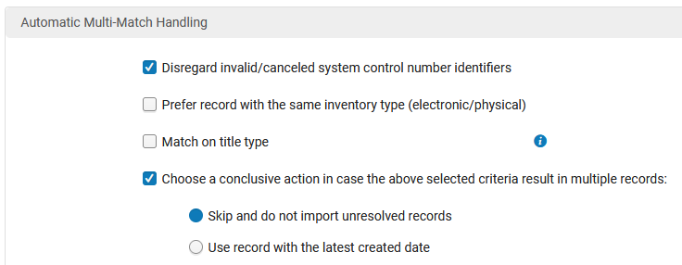
Import profiles – best practices
Notes:
Finally, there are some options for handling records that match more than one record in the NZ. The options checked here - "disregard invalid or canceled system control number identifiers" and "skip and do not import unresolved records" - are set up to help smooth over the most common multi-match issues in our daily record loads from OCLC. These other options come into play more often if you are using one of the fuzzier match methods. In those cases, please remember to use the "USG - keep existing bib record" merge method.

Slide 20
Import profiles – best practices
Cataloging Committee policies
USG MARC field policy: https://docs.google.com/document/d/1rv7V41dcGCjSXP1wk0PxI9ZTbJFy6OV-/edit
Choice of Network Zone or Institution Zone: https://docs.google.com/document/d/1hdAfr-7WepC4V9dSZMItYE73kNsvAUlPKgsEm8G1T0Y/edit?tab=t.0
email: simon@uga.edu
GIL Support ticket: helpdesk@usg.edu
Thanks!

Slide 21

Primo NDE Customization
Everything is fine.

Slide 22
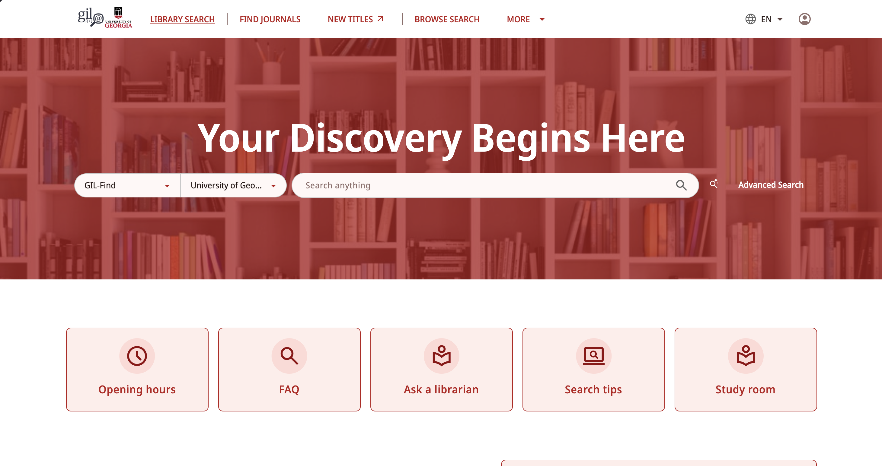

A new interface

Slide 23
When will this happen?
Ex Libris will be moving everyone over to NDE in January 2028
Customizations will occur throughout the rest of 2026 and Spring/Summer of 2027.
Staff and Faculty can explore and become familiar with NDE now, but full UX/instruction engagement will likely not happen until Spring 2027

Slide 24
The more things change...
What changes from current Primo VE:
Homepage/Landing page text (HTML)
Look and feel (CSS)
Customizations (Javascript)
Things like Banners, Chat Widgets, HathiTrust links, etc.

Slide 25
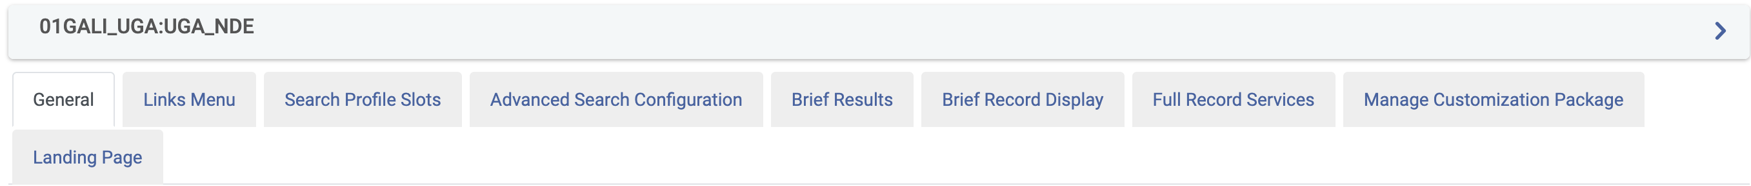
The more they stay the same.
What does NOT change from current Primo VE:
Normalization Rules – how the records appear on the page
Both Brief and Full records displays
Search Scopes
Currently "My Institution", "USG/GIL Express", local scopes
Authentication
Kevin Cottrell's blood pressure is safe
Most other configurations found in Alma->Configuration->Views

Slide 26
That sounds like a lot of work.
True, but thankfully, it's not your problem – it's mine (wait...):
Like with Primo VE, Ex Libris has created a development environment that can be used for the HTML, CSS, and JS customizations that we will need, called customModule-main
So, the process we currently have will stay in place – GIL Support will maintain Primo changes/packages in a central repository so we can have one correct and updated source. This will be done through tickets and/or through the OPAC/Discovery committee.

Slide 27
We have already started
What has been done so far -
Everyone has a production NDE view to test with
This does not conflict with the current VE view.
It can be found in your Config->Views->More Actions->Go to View
The development environment has been set up
Including with a script to change the target view on the dev server.
Some changes to the UGA Landing page HTML
Opening Hours/Ask a Librarian/Study Room links are now active
"Announcments" and "About" have been changed
I plan to meet with other Institutions over the summer to get their desired changes for the Home/Landing page HTML and CSS.

Slide 28
What remains
Central Package (NZ) and Institutional CSS
Central and Institutional JavaScript customizations
A lot of third-party add-ons have already been developed
Third-Iron/Browzine
StackMap
Many others have already been developed by other groups that have gone live with NDE.
HathiTrust
AEON
Yet more are currently in development.
Springshare chat widget.

Slide 29
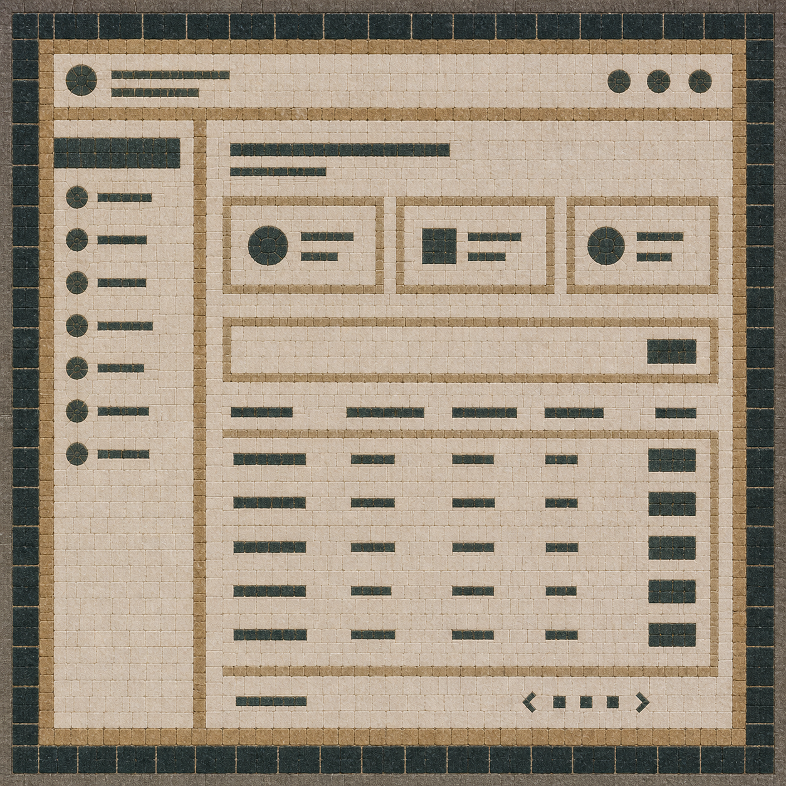
Dedicated GIL Area Inside
GALILEO Admin
Notes:
Introduction
Me: I work with the GALILEO and GIL teams on development and infrastructure
The distinction between GALILEO and GIL has been gradually fading, especially during the FOLIO migration work.
Going to talk about what we're starting to work on for GIL: A dedicated GIL Area inside GALILEO Admin
Where Institutions will be empowered to manage aspects of their own Alma/Primo integrations

Slide 30
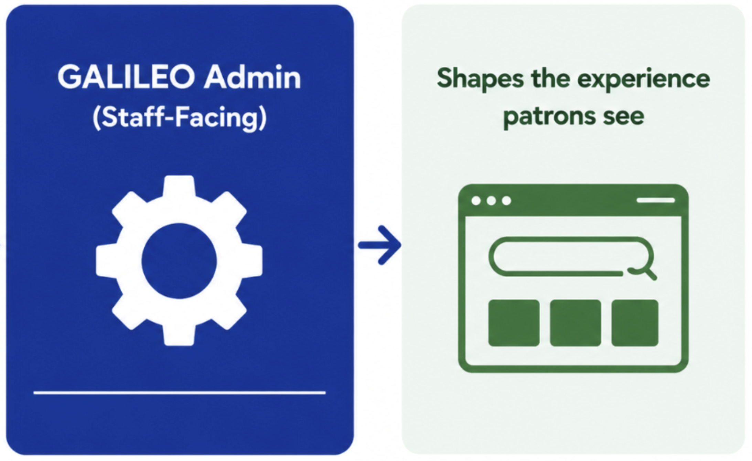
Aside: What is GALILEO Admin?
Notes:
GALILEO Admin is:
GALILEO Admin is the back end for the GALILEO SEARCH Portals used by 2500+ libraries across the state (eresources, bento boxes, etc)
Rather than creating a whole new platform for GIL, we are leveraging GALILEO admin

Slide 31
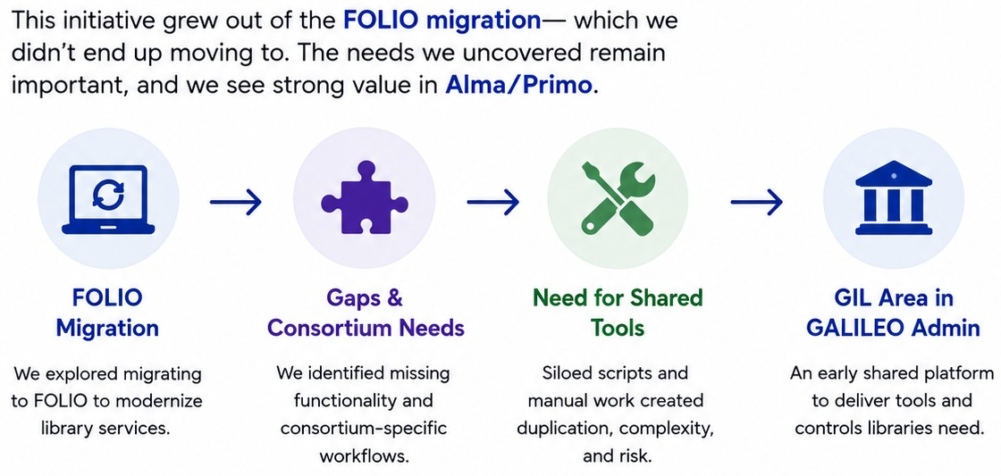
Early Thinking Behind a GIL Area Inside GALILEO Admin
Notes:
Where did the idea for this came from?
FOLIO required the GALILEO dev team to join with the GIL team to both retool existing Alma/Primo integrations, and create new ones:
NEW FOLIO work focused around the LACK of Analytics in FOLIO. Metabase and LDlite.
It also involved re-tooling the GIL integrations with Alma
OCLC Nightly sync, Patron Loads, Gil Express Blocking, Inst Billing, New Titles, etc
We saw this as an opportunity to CONSOLIDATE separate GIL tools into one place, we had planned to do this after FOLIO go-live.
Obviously we're not migrating to FOLIO, but the desire and benefits from consolidating into one place and giving institutions a window. Into these tools.
This was a necessity for FOLIO, for Alma/Primo it's cake icing.

Slide 32
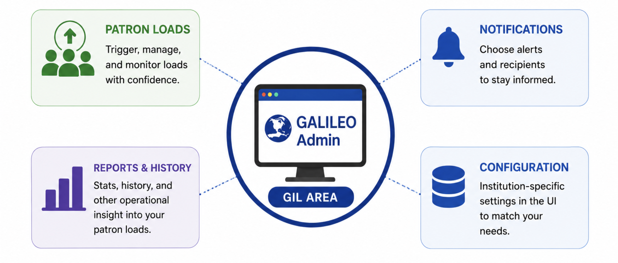
Example Tool: Patron Loads
Notes:
Quick example. Patron loads, to illustrate what this may look like for ONE of the tools:
Currently the institutions don't really have a "window" into their own patron loads
Doing this will provide that window and empower institutions to do the things in the slide
Configure their loads. Patron group mapping, etc.
Manually run their own loads when needed. Like to reset expire dates.
View load history and stats.
Configure notifications

Slide 33
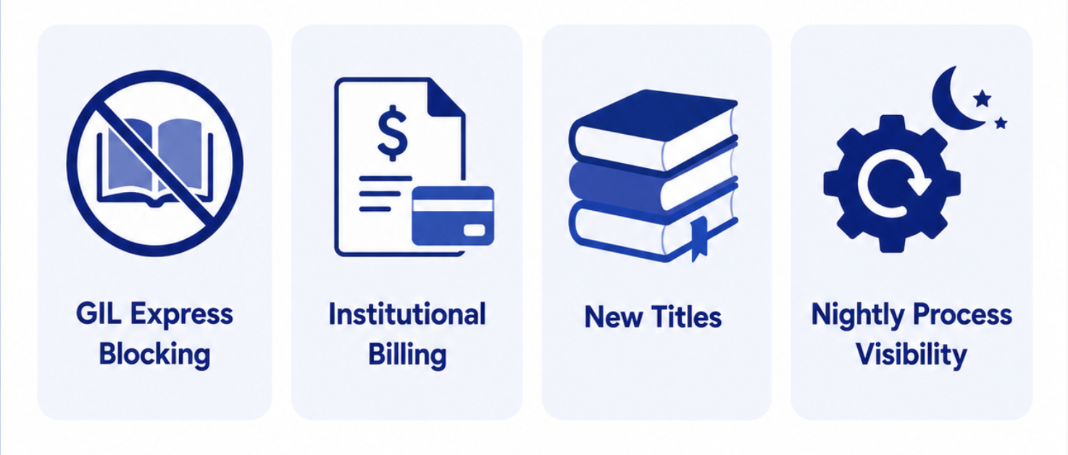
Other Tools We Plan to Include
Notes:
Other Tools will likely include:
GIL Express Blocking
Institutional Billing
New Titles
Views into nightly processes like EDS Catalog uploads and OCLC nightly sync.

Slide 34
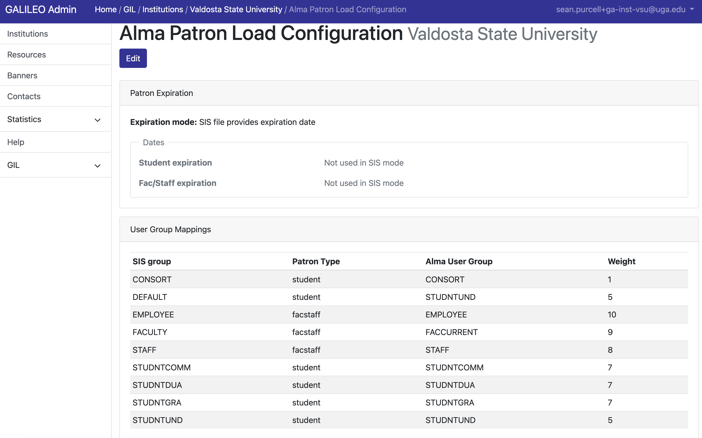
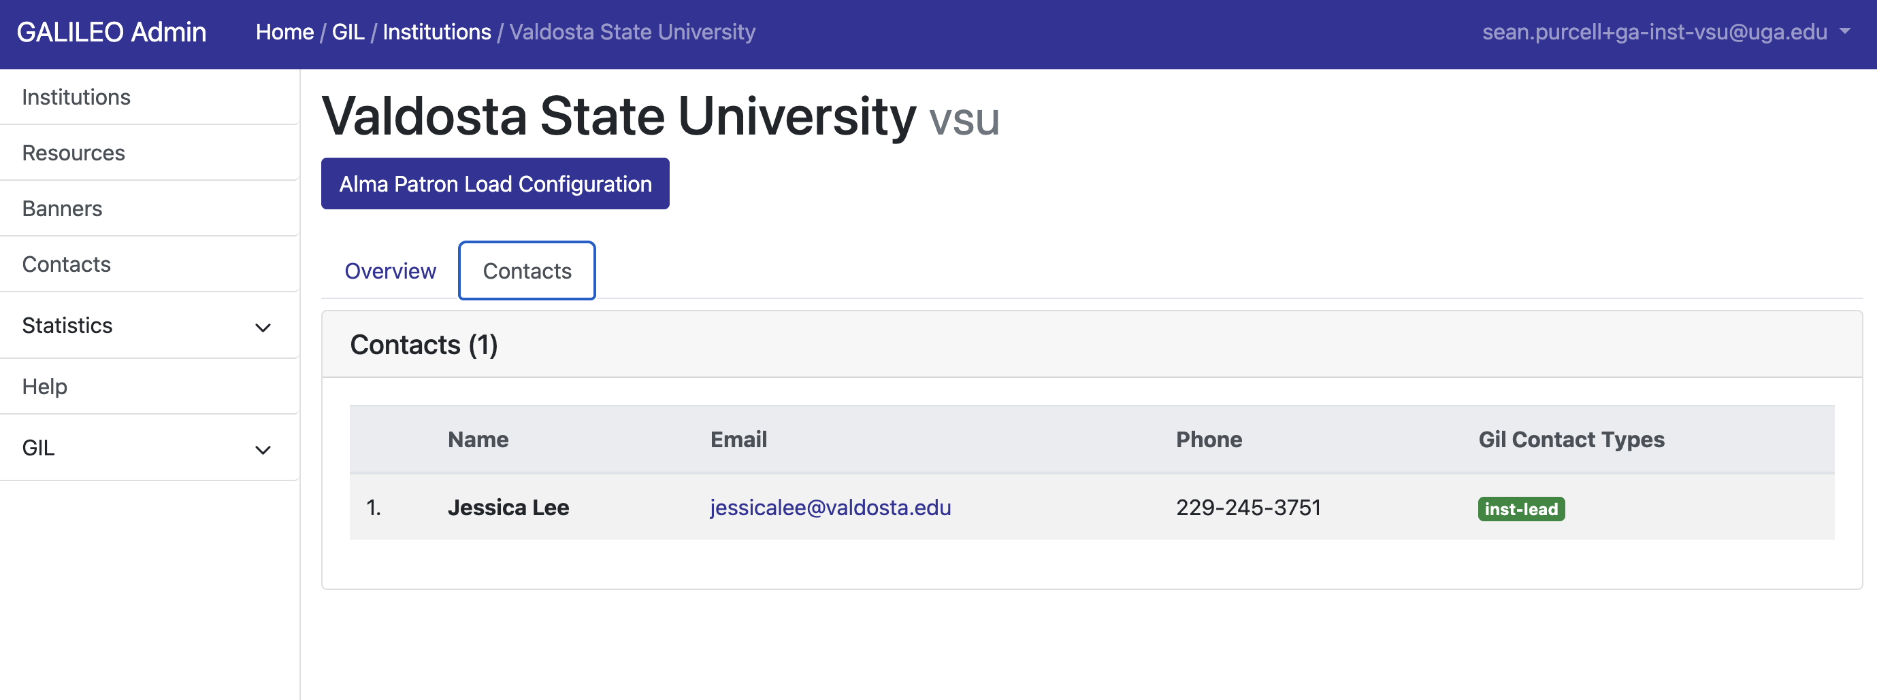
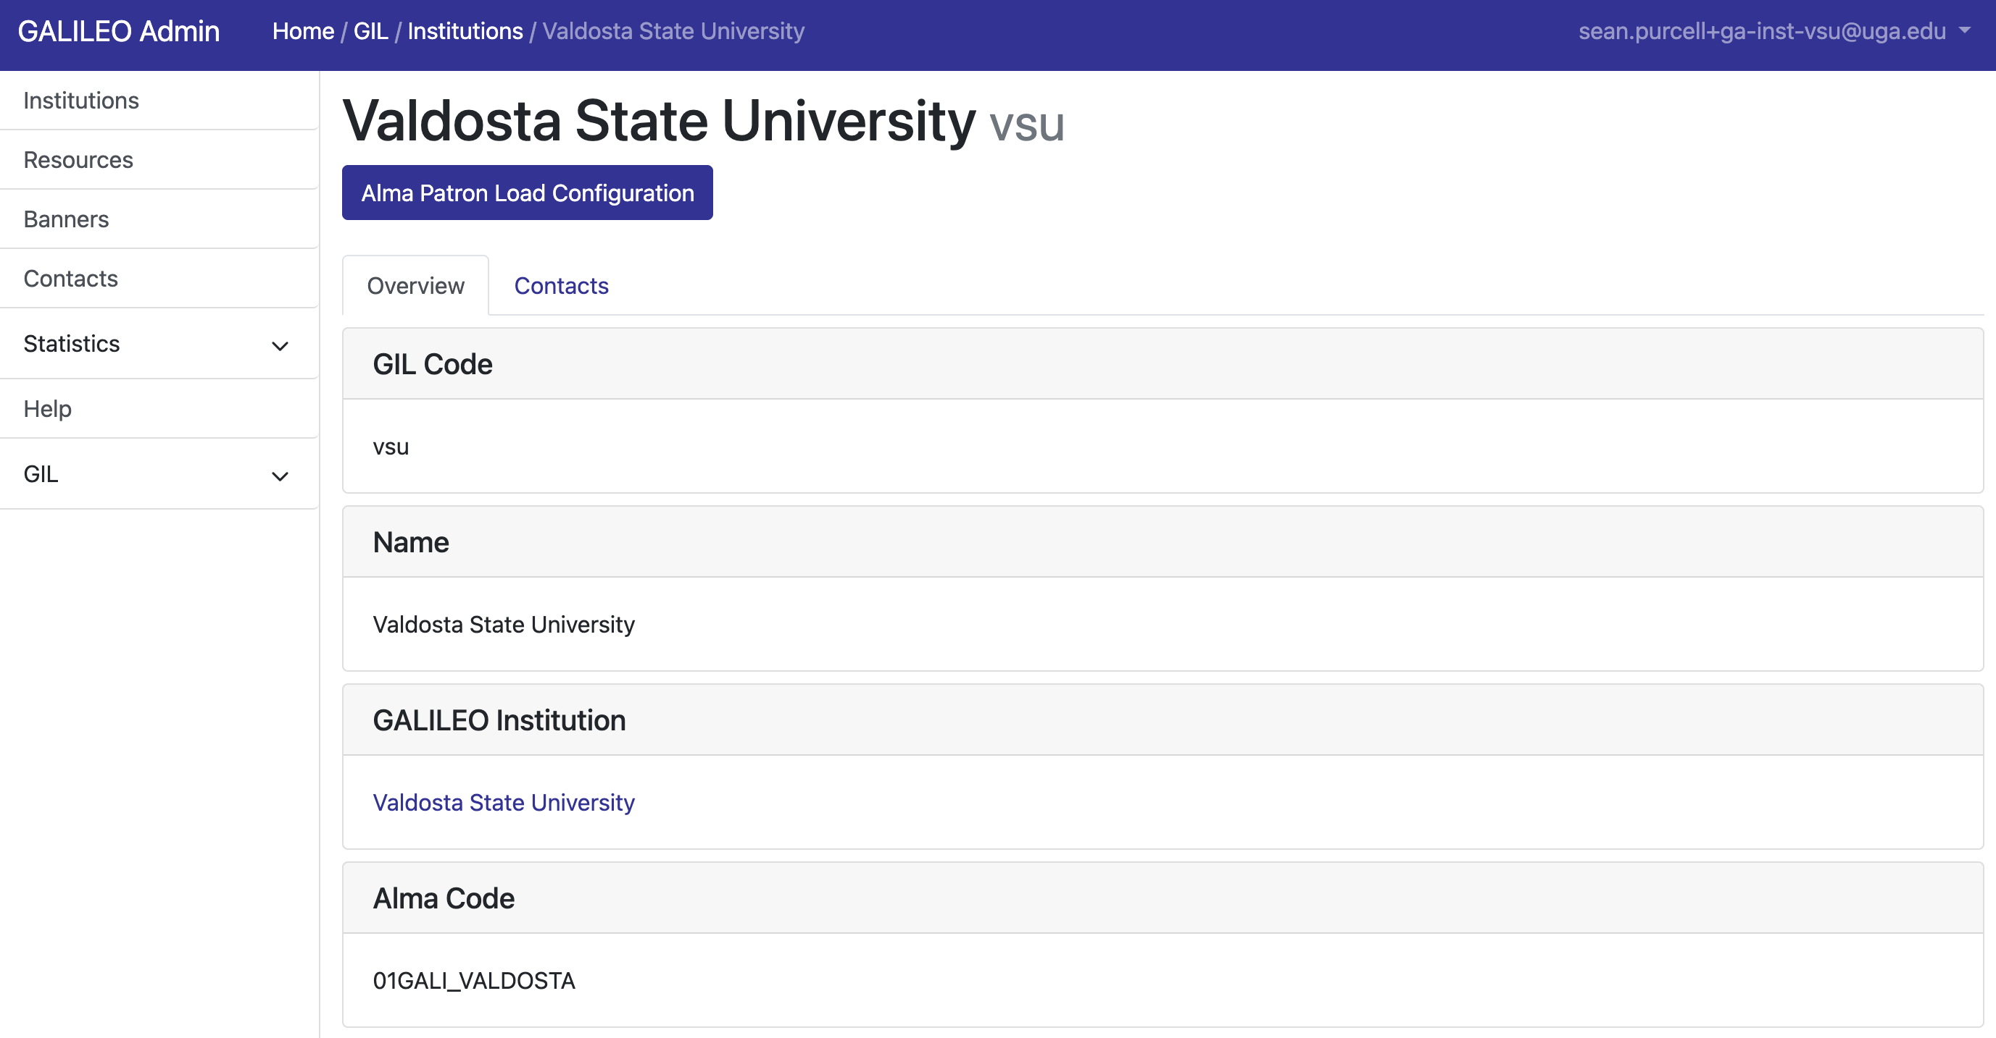
Early Progress
Notes:
Brief demo. Use VSU inst user.

Slide 35
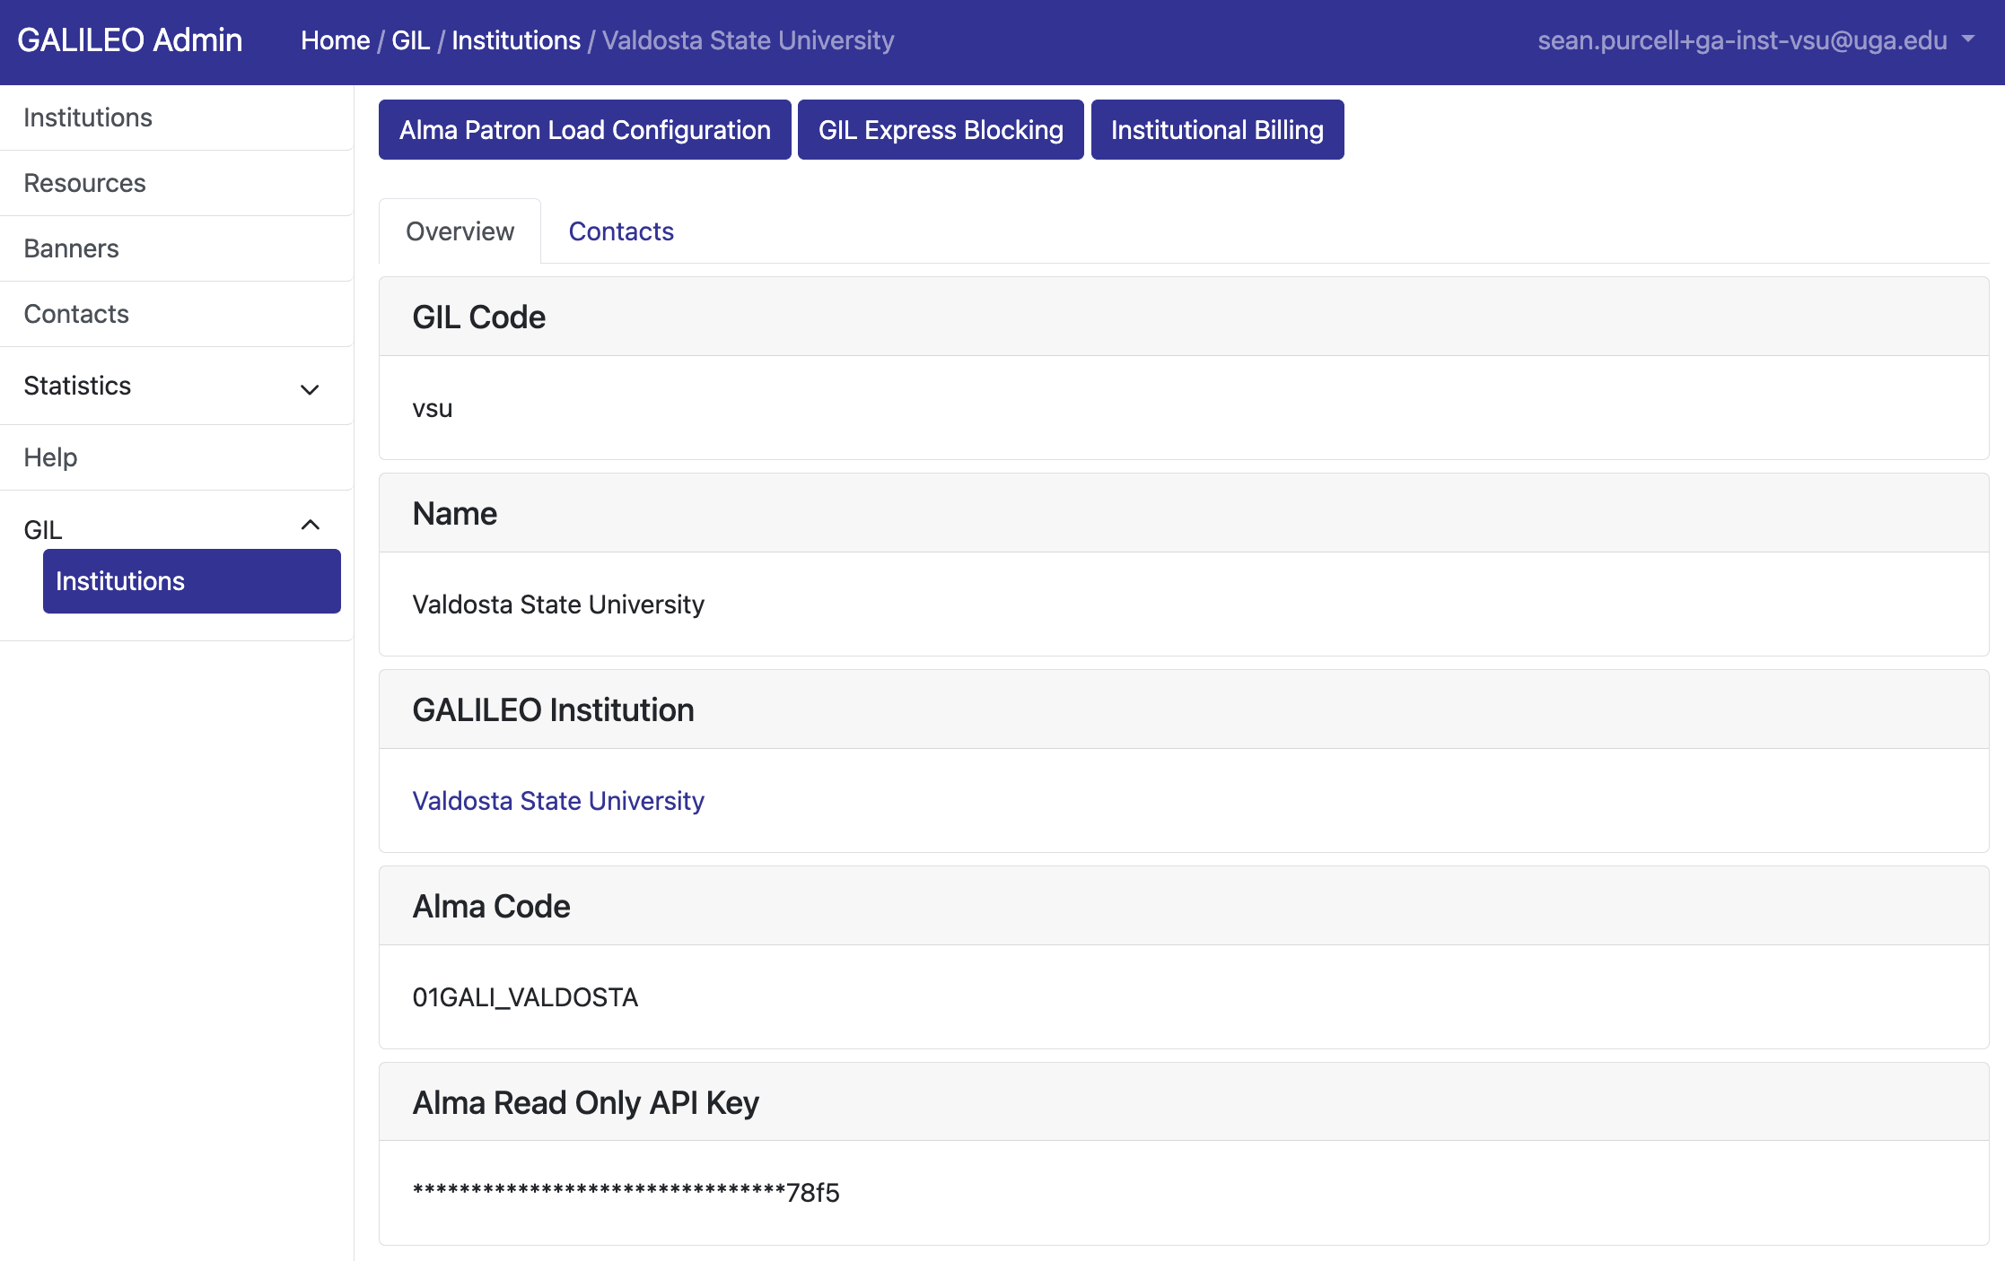
Notes:
GIL Institution Page for VSU. Note the GIL Tools buttons at the top.

Slide 36
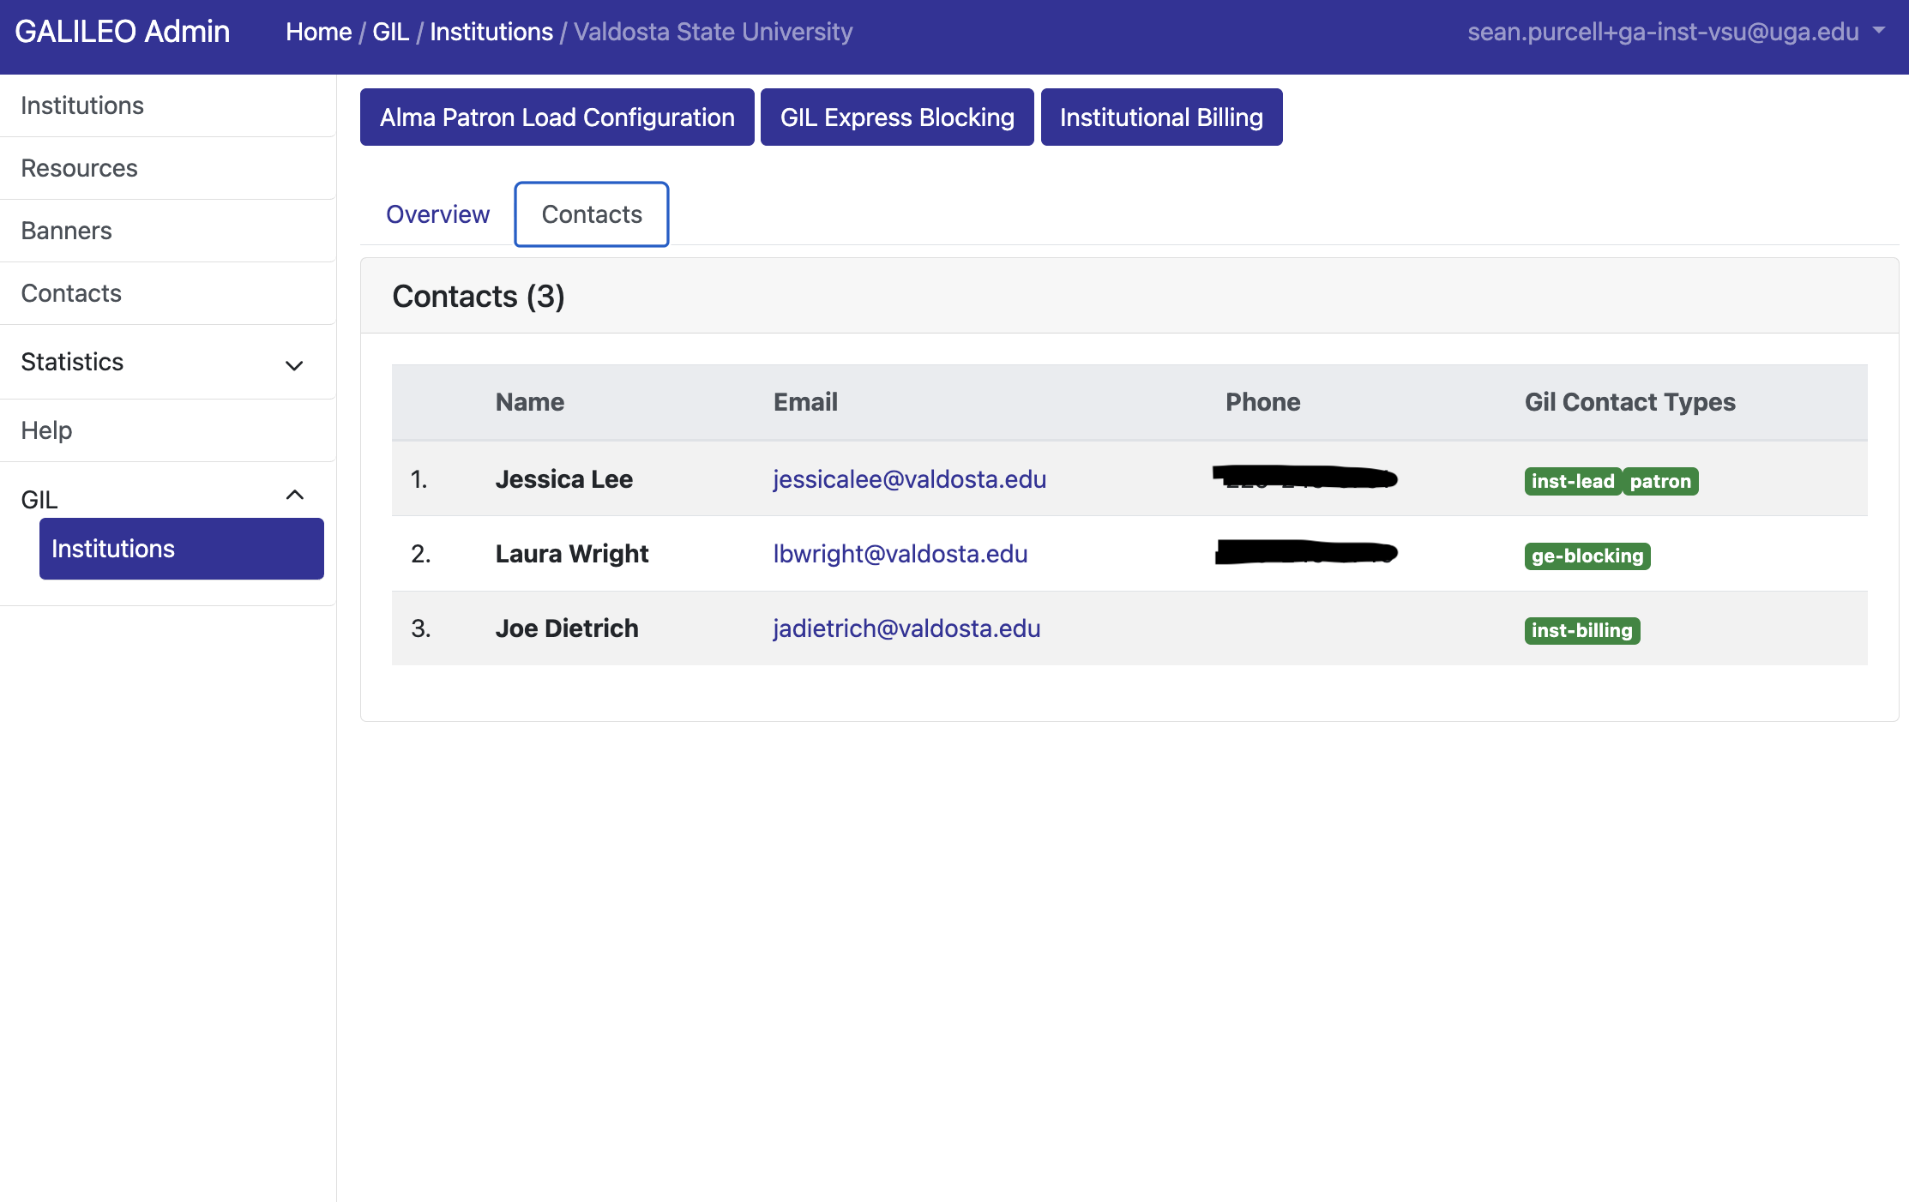
Notes:
GIL Contacts Page

Slide 37
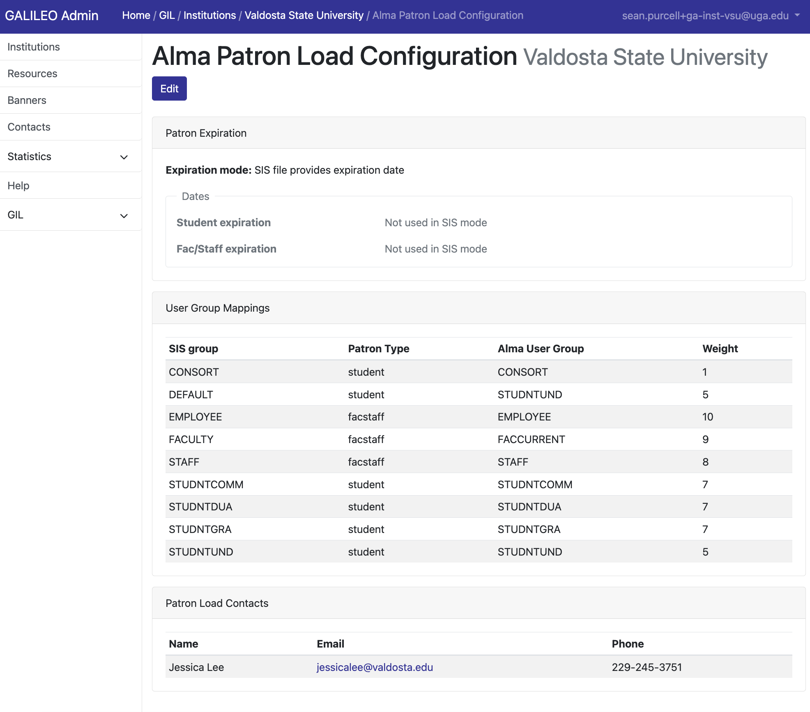
Notes:
Patron Load Info Page for VSU

Slide 38
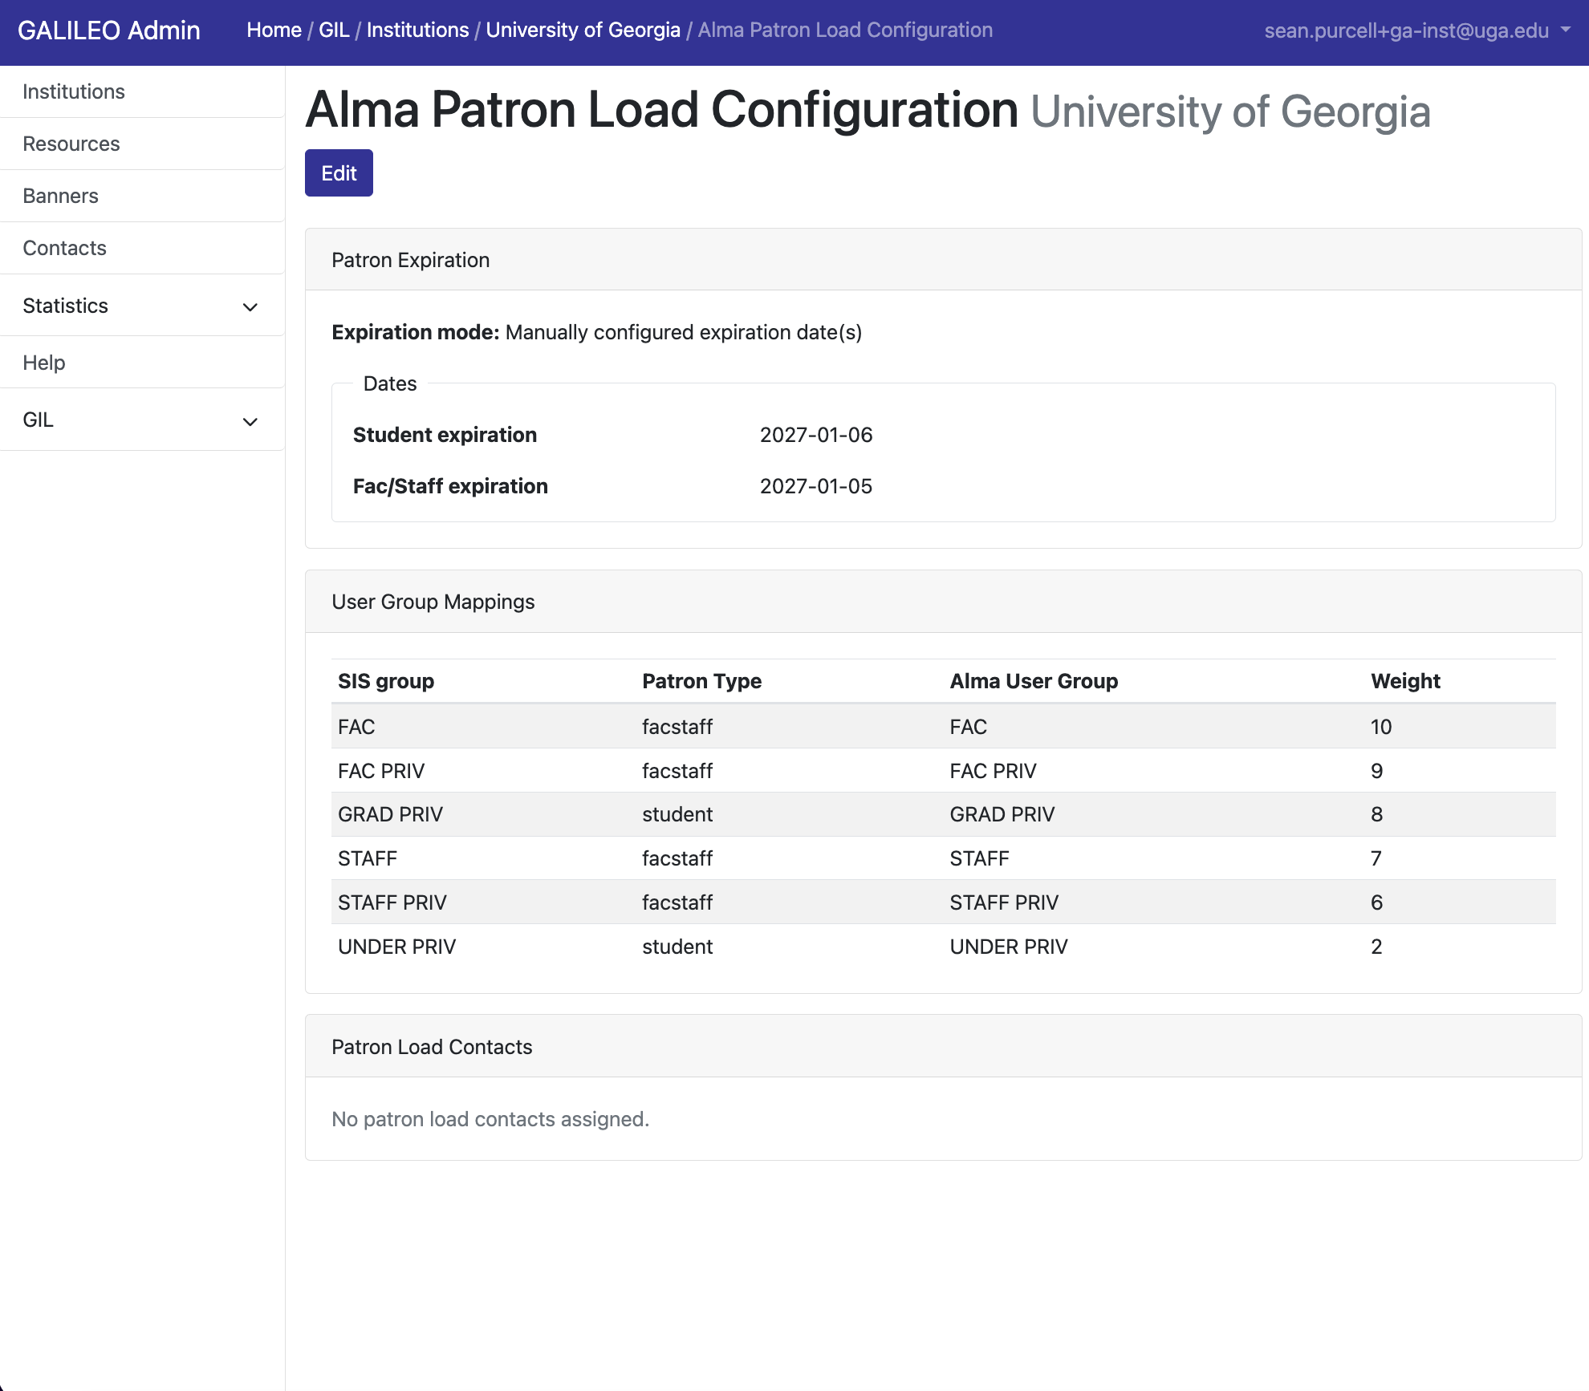
Notes:
Patron Load Info Page for UGA to illustrate expiration dates

Slide 39
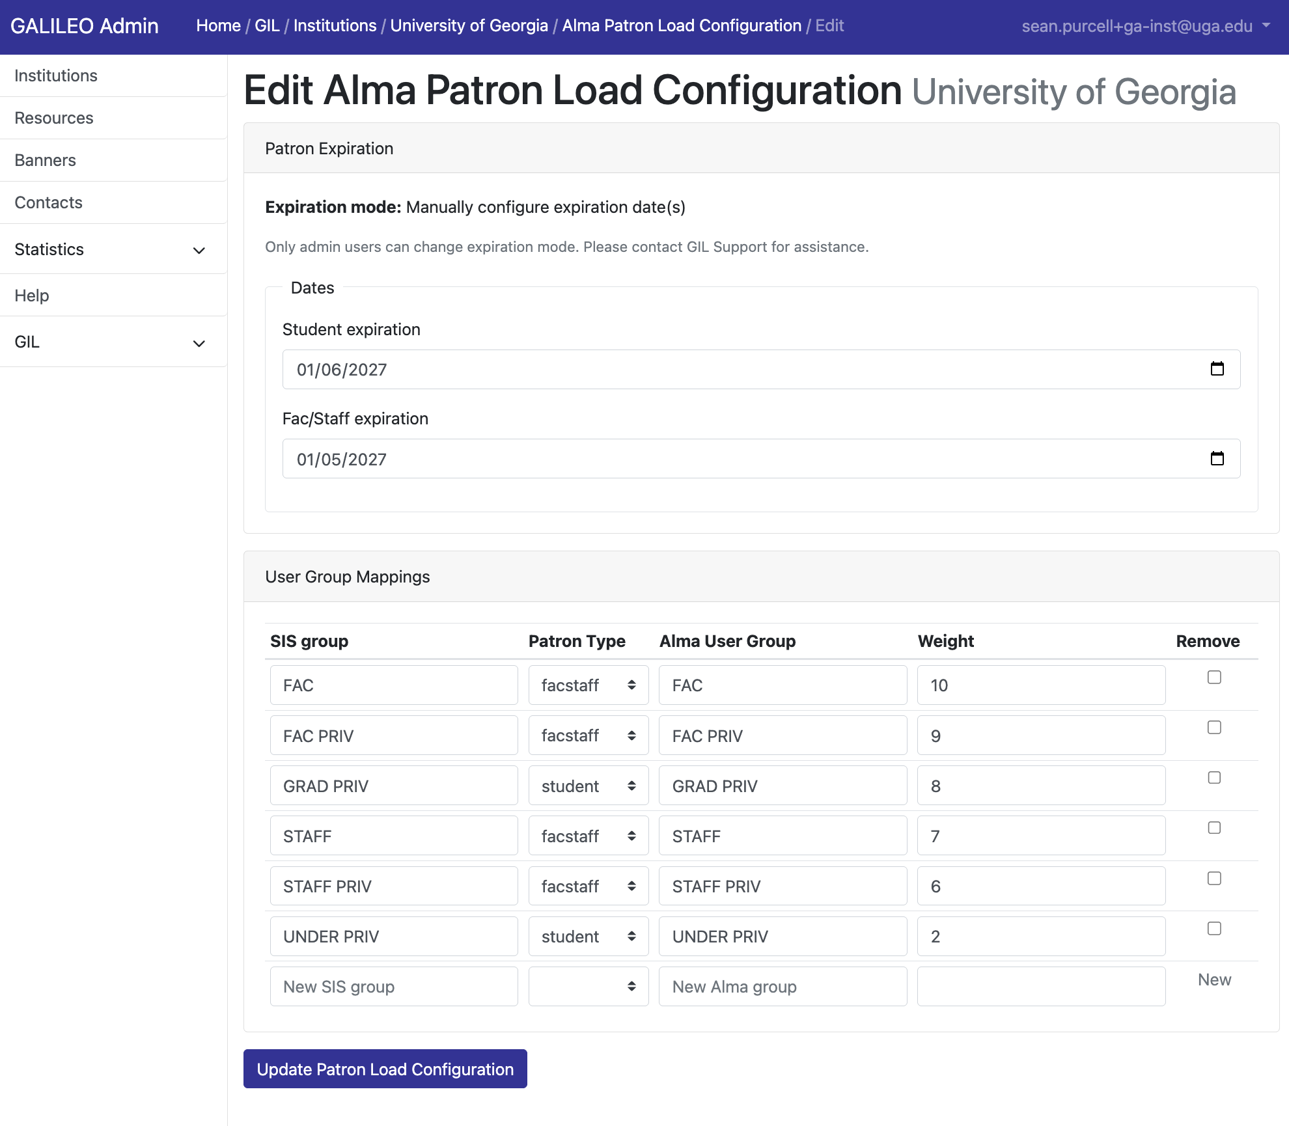
Notes:
Patron Load Edit Page for UGA

Slide 40
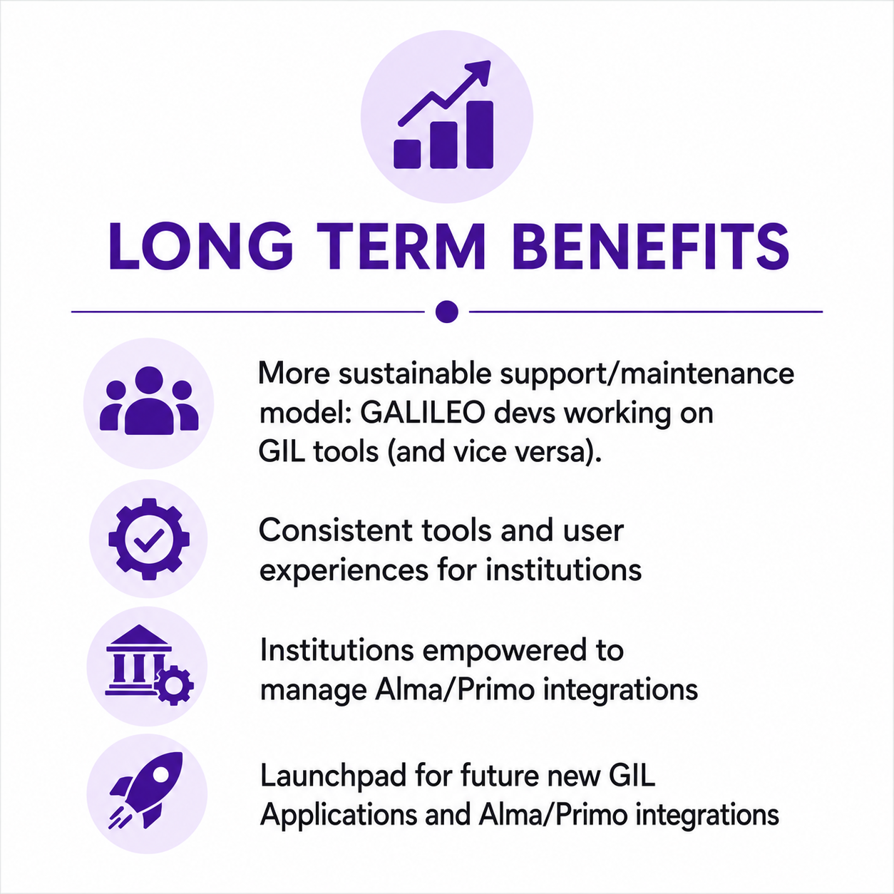
Why This Matters Long-Term
Notes:
Re-iterating Long term benefits
More devs will understand working with GIL tools, Alma APIs, etc. One platform where we build Api frameworks all tools can use
Consistent user experience
Institutions are empowered to manage their own Alma/Primo integrations (If they want)
Are for future integrations, where we're building/refining a framework for building things with Alma/Primo

Slide 41
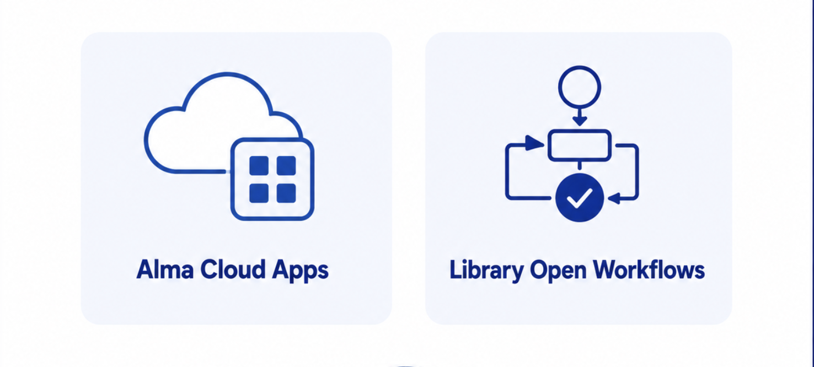
Future Investigations?
Notes:
The gist: What can we do within Alma?
We're not ignoring what might be possible to implement WITHIN ALMA ITSELF
First off, Chris F built an Alma Cloud App, so we have some expertise there.
We reserve the right to go into a different direction for some of the existing things (or new things) if they would be better suited as something like an Alma cloud app.
NOTE WE DON'T HAVE Library Open Workflows.

Slide 42
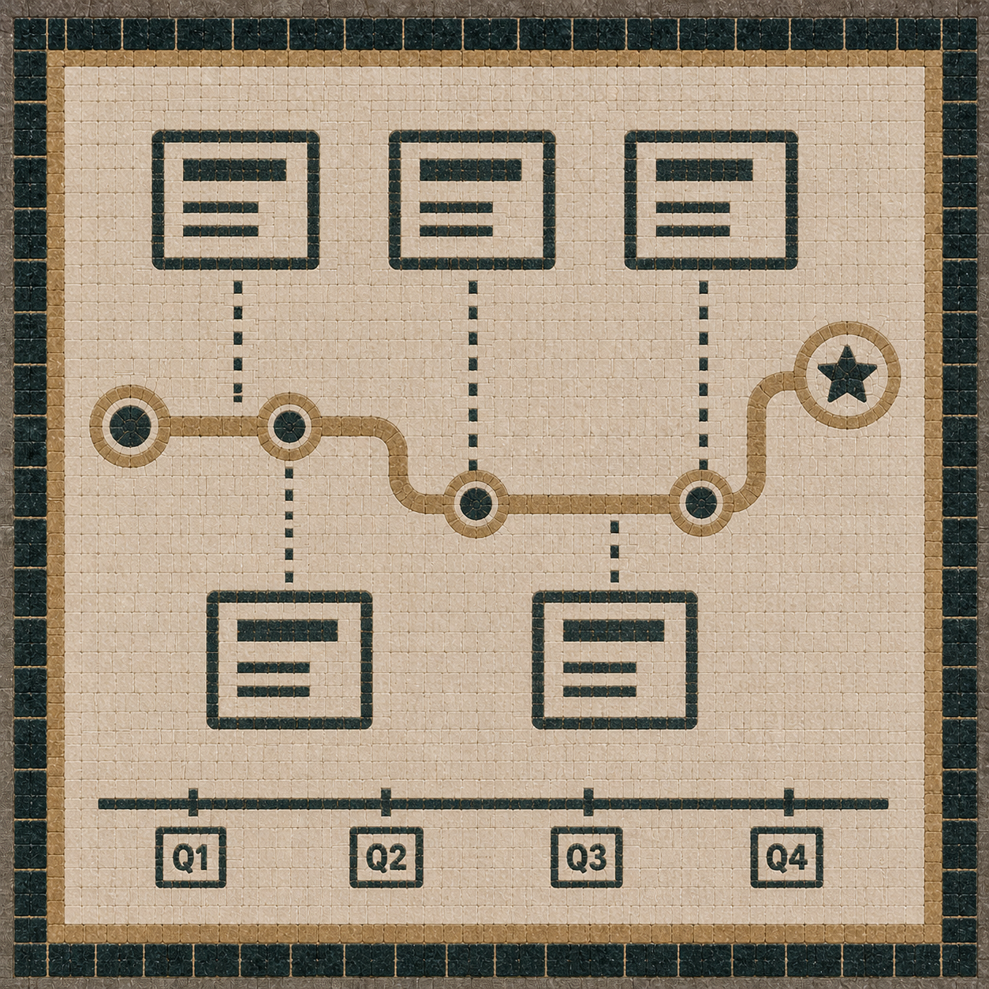
GIL Roadmap Update
2026 - 2028

Slide 43
Project Roadmap
GIL and the Functional Committee Chairs have been discussing and planning for project initiatives that would occur over the next two years.
These initiatives would require engagement of GIL, the functional committees, and library fac/staff
Aspects of these initiatives will affect library fac/staff as well as library patrons
Committees and CAGAL Exec have had an opportunity to review
Feedback received from Fulfillment Committee and CAGAL Exec

Slide 44
GIL High Level Roadmap – 2026-2028
GIL Documentation Migration
2026
Training Initiatives
Rapido
Summer 2026 – Demo/Training
Fall 2026 - Config, Implementation,
Primo NDE
Spring 2027 – Implementation, Testing
Summer 2027 – Go Live
Jan 2027 - Go Live (Phase 1– GE)
Committees, ExLibris, & GIL
2026
GIL & Committees
Institutional Check-Ins
GIL & Libraries
2026
Alma Specto
Summer 2026 – Demo/Training
GIL, Committees, ExLibris, & Libraries
GIL, Committees, ExLibris, & Libraries
GIL, Committees, ExLibris, & Libraries
Fall 2026 – Implementation Decision / Implementation
Additional Initiatives
CDI, e-Reserves (possible early imp/planning), etc.
2027/2028
Rapido Phase 2
Summer - Fall 2026 – Demos/Training/Testing

Slide 45
Internal GIL Initiatives – Documentation Migration
Documentation migration
Project will begin in 2026 and be ongoing
GIL is working to update and migrate documentation from the GIL/GALILEO Google site - https://sites.google.com/view/g3almatraining - to a new LibGuide - https://libguides.galileo.usg.edu/gil
GIL will coordinate with Functional Committees to update existing documentation as well provide support for committees as they create and maintain new documentation

Slide 46
Internal GIL Initiatives – Training
Training
Project will begin in 2026 and be ongoing
GIL will work with libraries/functional committees to develop or identify necessary training for library fac/staff to retool and retrain. Examples include:
Alma Administration Certification
Committee developed training
ExLibris training opportunities – videos, conference sessions, etc
GIL will work with ExLibris to offer specific training on an as needed basis
Task committees with annual review/update of training resources

Slide 47
Internal GIL Initiatives – Institutional Check-ins
Check-ins
Project will begin in 2026 and be ongoing
Meet annually with libraries (on an opt-in basis)
Discuss staffing updates, general questions, configurations, projects, etc.

Slide 48
USG Initiatives – Alma / Primo
Projects resulting for contract terms and internal ExLibris development efforts
High level timeline and project plans
More detailed project plans will be developed with functional committee and library input

Slide 49
GIL High Level Roadmap – 2026-2028
GIL Documentation Migration
2026
Training Initiatives
Rapido
Summer 2026 – Demo/Training
Primo NDE
Spring 2027 – Implementation, Testing
Summer 2027 – Go Live
Committees, ExLibris, & GIL
2026
GIL & Committees
Institutional Check-Ins
GIL & Libraries
2026
Alma Specto
Summer 2026 – Demo/Training
GIL, Committees, ExLibris, & Libraries
GIL, Committees, ExLibris, & Libraries
Fall 2026 – Implementation Decision / Implementation
Additional Initiatives
CDI, e-Reserves (possible early imp/planning), etc.
2027/2028
Rapido Phase 2
Summer - Fall 2026 – Demos/Training/Testing
Fall 2026 - Config, Implementation,
Jan 2027 - Go Live (Phase 1– GE)
GIL, Committees, ExLibris, & Libraries

Slide 50
USG Initiatives – Alma Specto
What is it?
Digital asset management solution within Alma
Project will begin in 2026
ExLibris asks that libraries commit to implementation in 2026
Each USG library will receive Specto Essentials with 3TB of storage
GIL will work with ExL and Libraries to develop detailed implementation plan and training
How will this be used?
GIL will work with Special Collections Committee to iron our implementation possibilities and limitations/boundaries

Slide 51
GIL High Level Roadmap – 2026-2028
GIL Documentation Migration
2026
Training Initiatives
Rapido
Summer 2026 – Demo/Training
Primo NDE
Committees, ExLibris, & GIL
2026
GIL & Committees
Institutional Check-Ins
GIL & Libraries
2026
Alma Specto
Summer 2026 – Demo/Training
GIL, Committees, ExLibris, & Libraries
Fall 2026 – Implementation Decision / Implementation
Additional Initiatives
CDI, e-Reserves (possible early imp/planning), etc.
2027/2028
Rapido Phase 2
Summer - Fall 2026 – Demos/Training/Testing
Fall 2026 - Config, Implementation,
Jan 2027 - Go Live (Phase 1– GE)
GIL, Committees, ExLibris, & Libraries
Spring 2027 – Implementation, Testing
Summer 2027 – Go Live
GIL, Committees, ExLibris, & Libraries

Slide 52
USG Initiatives – Rapido
What is it?
Library Resource Sharing platform within Alma
Facilitates resources sharing within USG and beyond
High level timeline
Roughly a 14-16 week process from start to go live
Summer 2026 – Demo/Training
Fall 2026 – Configuration/Testing
Winter Break 2026 – Go Live

Slide 53
USG Initiatives – Rapido
Project Phases
Fall – Winter 2026
Phase One : recreate current GIL Express lending/borrowing functionality and experience by Go Live
Spring 2027 and beyond
Phase Two : evaluate and implement additional functionality, such as Digital Lending, ILL integrations, Resource Sharing with other Rapido systems, full RapidILL integration, etc.
GIL will work closely with libraries/committees to develop detailed project plans for any additional functionality
Project Plan
GIL will detail plan for all libraries to implement together as well as gather project needs/concerns from functional committees

Slide 54
GIL High Level Roadmap – 2026-2028
GIL Documentation Migration
2026
Training Initiatives
Rapido
Summer 2026 – Demo/Training
Primo NDE
Spring 2027 – Implementation, Testing
Summer 2027 – Go Live
Committees, ExLibris, & GIL
2026
GIL & Committees
Institutional Check-Ins
GIL & Libraries
2026
Alma Specto
Summer 2026 – Demo/Training
GIL, Committees, ExLibris, & Libraries
GIL, Committees, ExLibris, & Libraries
Fall 2026 – Implementation Decision / Implementation
Additional Initiatives
CDI, e-Reserves (possible early imp/planning), etc.
2027/2028
Rapido Phase 2
Summer - Fall 2026 – Demos/Training/Testing
Fall 2026 - Config, Implementation,
Jan 2027 - Go Live (Phase 1– GE)
GIL, Committees, ExLibris, & Libraries

Slide 55
USG Initiatives – Primo NDE
What is it?
Primo VE Next Discovery Experience (NDE) - interface upgrade and UI design
ExL Quarterly Release plan - https://knowledge.exlibrisgroup.com/Primo/Product_Documentation/020Primo_VE/Primo_VE_(English)/Go_NDE/Available_Features%2C_Functionality_and_Release_Plan_for_NDE_UI
High level timeline
Spring 2026 – Fall 2026 – Dev environments, Customization work
Summer 2026 –Fall 2026 – Demos and Training
Fall 2026 – Institutions conduct preliminary UX/UI testing
Spring 2027 – Configuration/Testing/Finalize Dev work
Summer 2027 – Go Live
Per ExL - January 2028 : gradual sunset for existing UI

Slide 56
USG Initiatives – Primo NDE
Project Phases
Phase One (2026):
Demos and Training
Current Primo Integrations : GIL investigate and modify, for NDE
Examples: Chat widgets, Links (finding aid, Aeon, etc.), institutional customizations, etc.
Stage NDE in sandboxes and production
GIL has set up NDE views that run in parallel in these systems
Work closely with OPAC / Cataloging committees as well as public services groups to test and provide feedback regarding NDE performance, config, look/feel, etc.
Fall 2026: Institutions begin initial UX/UI testing

Slide 57
USG Initiatives – Primo NDE
Project Phases
Phase Two (2027):
Work with ExL to develop detail project plan for final go live activities (Summer 2027 go live)
Current Primo Integrations : GIL implement modified/tested integrations
Libraries continue UI/UX testing, verify data, etc.

Slide 58

Questions?

