Slide 1
GIL EXPRESS: WHAT IS AND WHAT WILL BE
Rosemary Humphrey, Kennesaw State University
Mary Poland, University of Georgia
Viki Timian, University of Georgia

Slide 2
WHAT IT IS
GIL Express is a program allowing eligible students, faculty, or staff members from any University System of Georgia institution to borrow books from any other University System of Georgia Library.
Materials may be borrowed in person from the lending library (Walkup Charges) or materials may be requested from the GIL-Find Catalog to be sent to patron’s preferred pickup library (Remote Charges).

Slide 3
First Things – GIL Express
Subscribe to these lists:
GIL Fulfillment Community - G2FULFILLMENT@LISTSERV.UGA.EDU
GIL Express Courier Information – GIL-COURIER-L@LISTSERV.UGA.EDU
GIL General Information – GA-G2ALL@LISTESERV.UGA.EDU
To subscribe to the email lists go to the website - listserv.uga.edu
Or, email helpdesk@usg.edu
Review this website:
https://sites.google.com/view/g3almatraining/

Slide 4
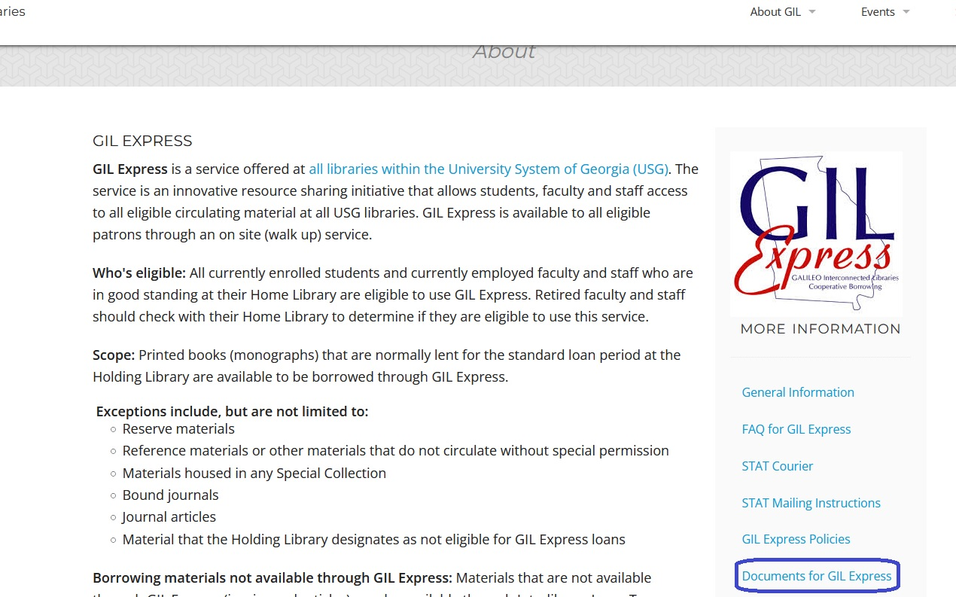
GIL EXPRESS WEBSITE
http://gil.usg.edu/gil_express

Slide 5
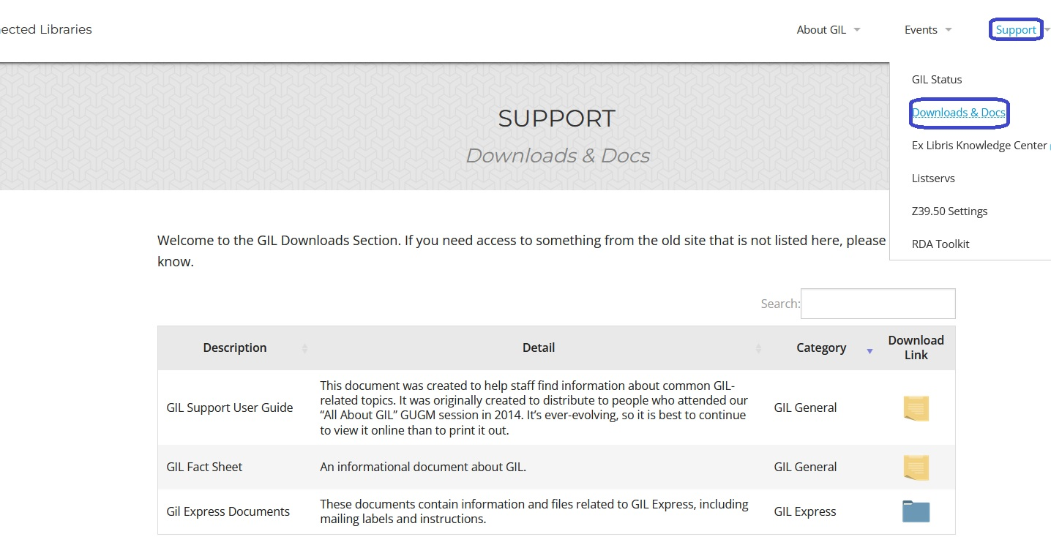
DOWNLOADS & DOCS
https://gil.usg.edu/

Slide 6
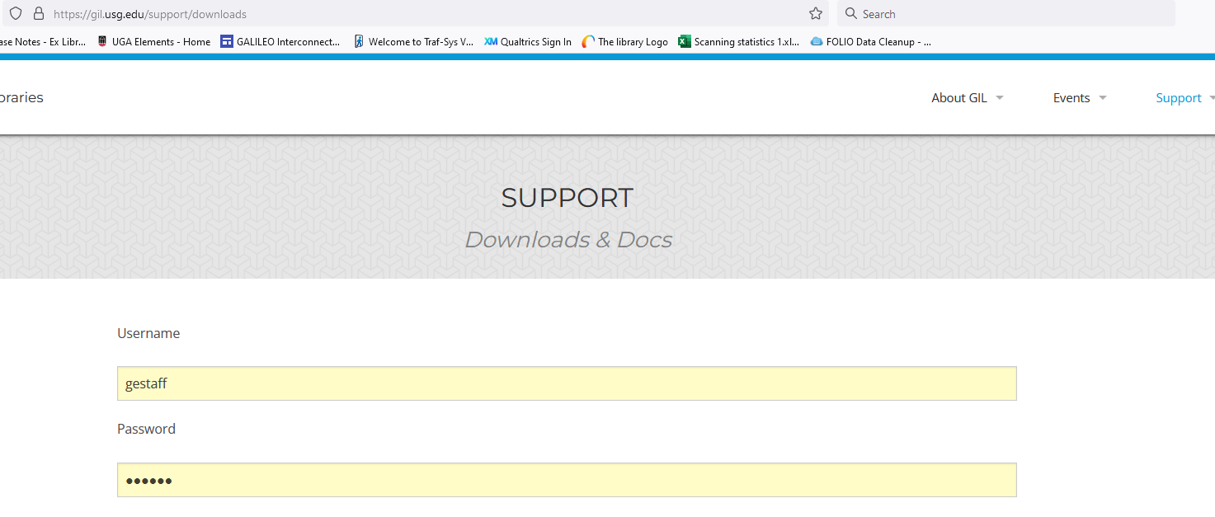
DOWNLOADS & DOCS LOGIN

Slide 7
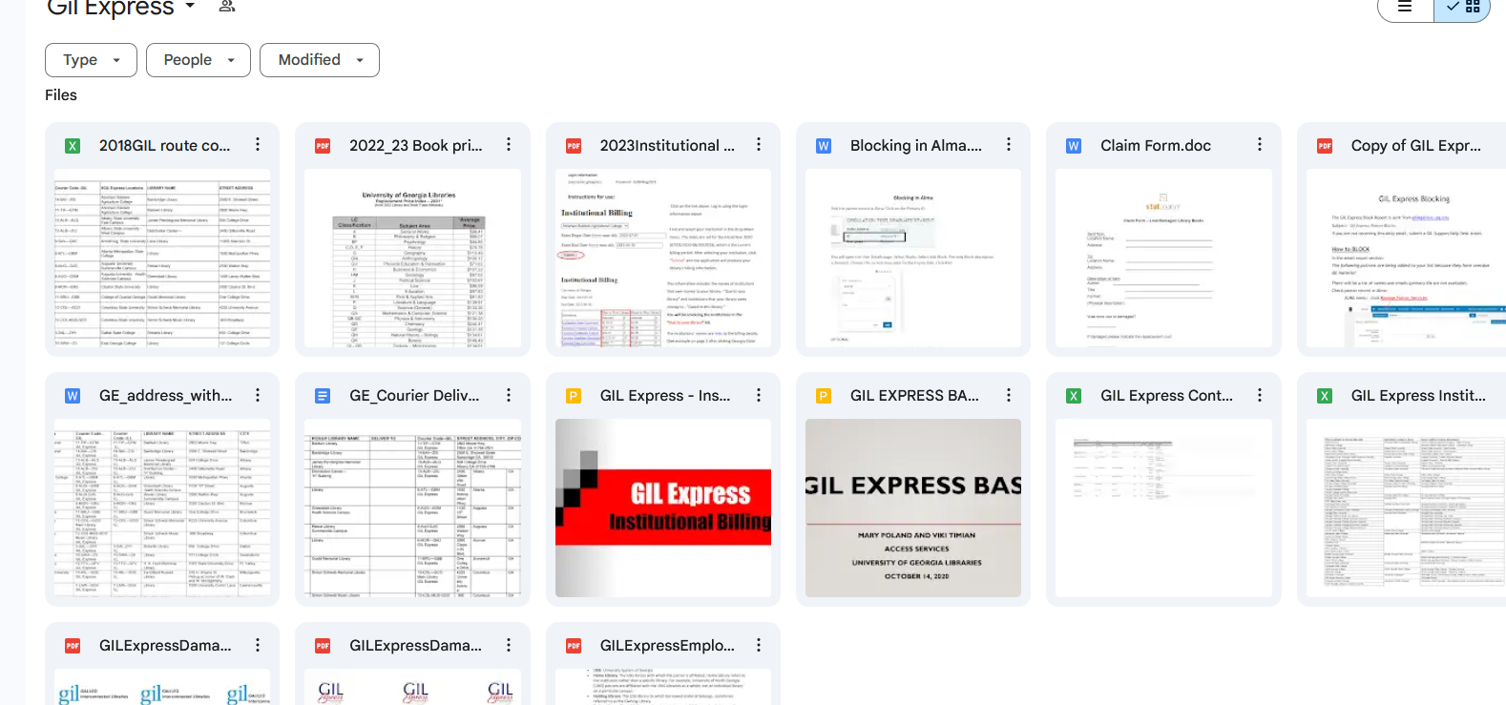
GIL EXPRESS DOCUMENTS
GIL Express Documents Google Drive

Slide 8
DOCUMENT HIGHLIGHTS
GIL Express Contacts List – List of library staff at each institution who can be contacted about a GIL Express issue.
GIL Express Blocking – Guide on how to block accounts for overdue GIL Express books.
Institutional Billing – Guide describing the annual institutional billing process.
GIL Express Employees-Policies – Documentation detailing policies for library employees.
GIL Express Damaged Book Slips – Slips to be used when a book borrowed through GIL Express is damaged.

Slide 9
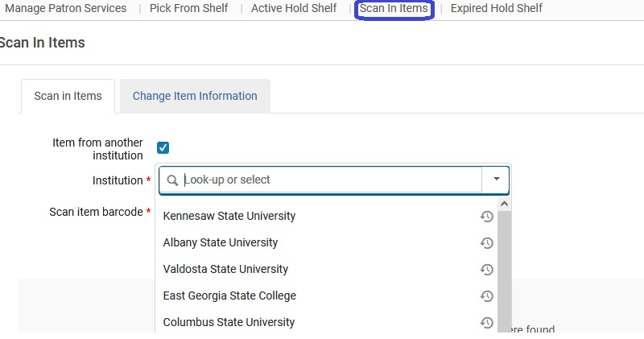
Search and process requests daily Fill or cancel requests within 4 business days Remember to use the Scan In function to move books through the workflow process
GIL Express in ALMA

Slide 10
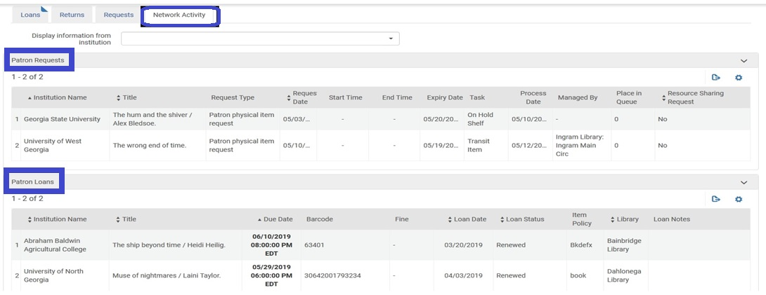
Viewing GIL Express Activity
GIL Express information, including the Hold status, is located under the “Network Activity” tab on the Patron’s Account

Slide 11
MANAGING ACTIVE HOLDS
Patron doesn’t want the item – cancelling an active hold
Go to the Active Hold Shelf
For Gil Express items, Update Expiry is the only option available to change
Update expiration date to a past date
This action sends the record to the Expired Hold Shelf
Patron doesn’t pick up an item - hold expires
Record is automatically moved to the Expired Hold Shelf

Slide 12
EXPIRED HOLD SHELF
Send to Institution: Items to go to another institution (GIL Express)
Reshelve: Items handled by your “currently at” location’s circulation desk
Send to Circulation Desk: Items handled by another circulation desk within the same Library
Send to Library: Items to go to another library within your institution
Activate Next: Items that have another request pending in the queue for pickup at that same circulation desk

Slide 13
SHIPPING/DELIVERY
Some institutions have multiple library locations, please double check that books are being sent to the correct locations.
Remember to put book bands on books going to other libraries
Leave a little room in the zip ties on the book bags
Separate ILL and GIL Express books. Don’t send them in the same bag. We use white labels for GE and blue labels for ILL to differentiate.
STAT Courier charges by the stop. Report to the GIL Support help desk any time the courier does not come to your location.

Slide 14
GIL EXPRESS REPORTS IN ANALYTICS
Reports for GIL Express loans of local materials can be found at the institution level of Analytics.
User Role – Designs Analytics
GIL Express Reports Dashboard

Slide 15
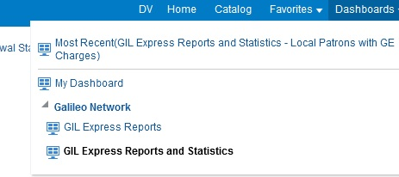
REPORTS IN THE NETWORK ZONE
Statistics on local patrons’ GIL Express requests and charges are available in the Network Zone at
https://galileo-network.alma.exlibrisgroup.com/.
The institutional leads for each library have the login credentials for Alma in the Network Zone or you can submit a GIL Support help desk ticket to request them.

Slide 16
WHAT IT WILL BE
THE FUTURE OF GIL EXPRESS

Slide 17
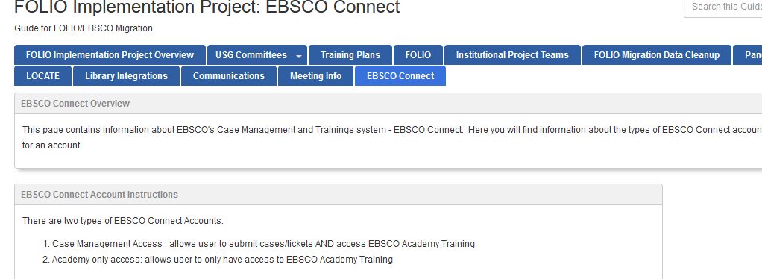
EBSCO FOLIO IMPLEMENTATION PROJECT
https://libguides.galileo.usg.edu/GIL-FOLIO

Slide 18
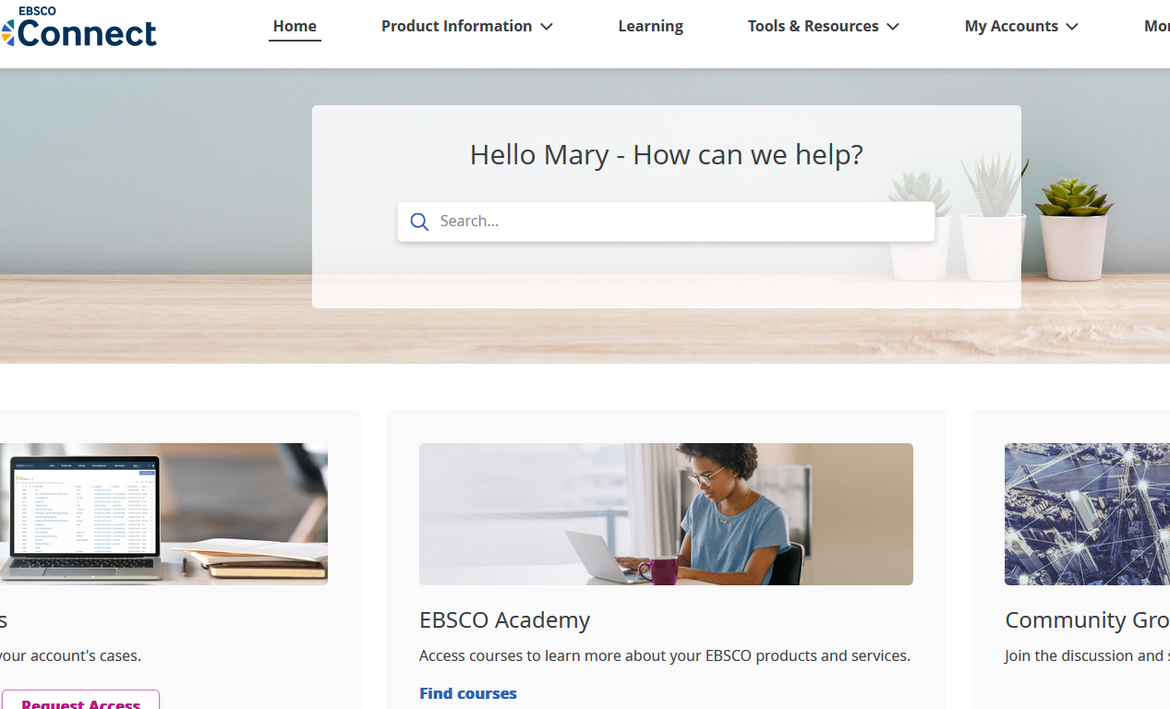
EBSCO CONNECT

Slide 19
EBSCO ACADEMY

Slide 20
EBSCO FOLIO Implementation and GIL Express
Managing borrowing/lending
Lessons (to be) learned

Slide 21
OpenRS
https://openrs.org/

Slide 22
FUTURE DELIVERY SERVICE
FY25 – STAT COURIER
FY26 AND BEYOND – RFP TO SELECT MOST COST EFFECTIVE DELIVERY SERVICE

Slide 23
Stay Tuned … Let’s Find Out What Comes Next!
Viki Timian – vtimian@uga.edu
Rosemary Humphrey – rhumph13@kennesaw.edu
Mary Poland – mwpoland@uga.edu

