Slide 1
Interlibrary Loan 101
Tabitha Huddleston
Melissa Jackson
2026
Spring
Notes:
Tabitha speaks here

Slide 2
AGENDA
Presenters
1
ILL Overview
2
ILL Breakdown
3
Borrowing
4
Lending
5
Document Delivery
6
Shipping
7
Copyright and Helpful Tips
8
Contact Information
9
Thank you!
10
Notes:
Each presenter will tell the group about themselves. Tabitha will cover Lending and Shipping. Melissa will cover Borrowing and Doc Del.

Slide 3
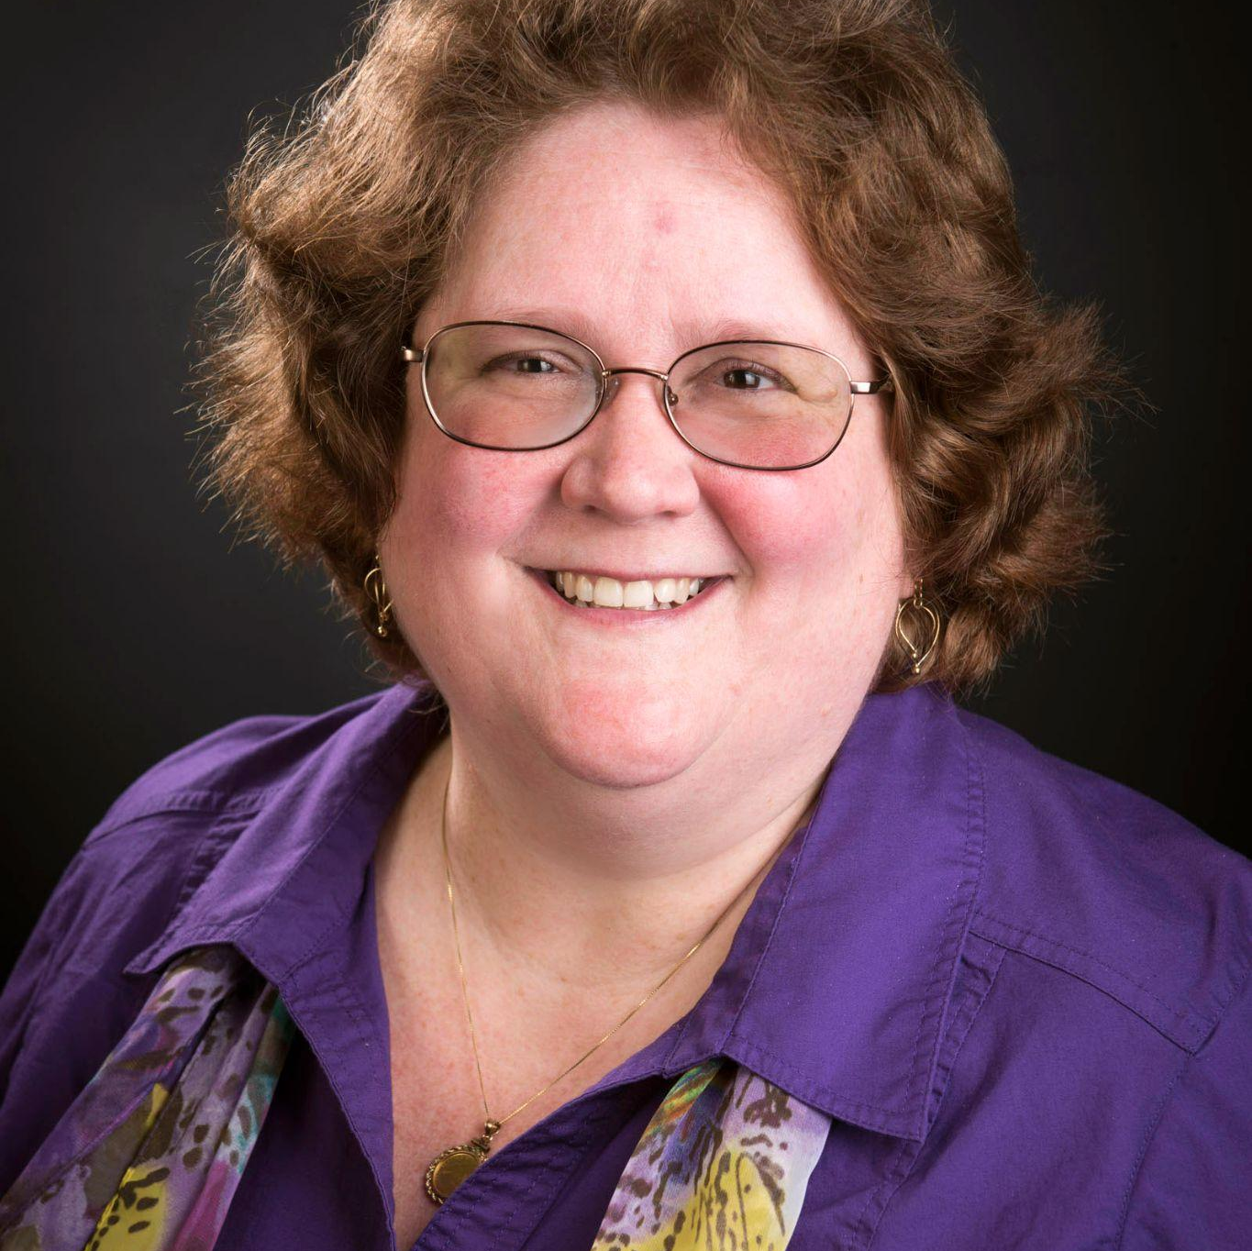
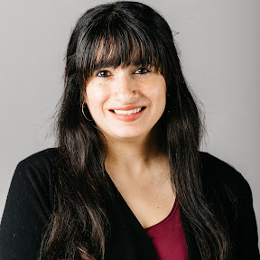

Melissa L. Jackson
Tabitha Huddleston
ILL Lender/Borrower
Presenters
Borrowing
Le
Lending
Document Delivery
ILL Librarian
Melissa is the ILL Librarian for Georgia Southern University. She has been in the position for over 25 years, and presented on various topics several time.
Based at the East Georgia Campus of Georgia Southern University. She has been working with interlibrary loan for 6 years.
Notes:
Melissa will speak here

Slide 4
Interlibrary loan is a borrowing service that allows for the sharing of materials between libraries across the country. In addition to requesting physical items, you can request digital copies of articles, book chapters, reports and other resources.
Overview
"Interlibrary loan is the process by which a library requests material from, or supplies material to, another library. ... The purpose of interlibrary loan as defined by this code is to obtain, upon request of a library user, material not available in the user's local library."
Notes:
Tabitha speaks here

Slide 5
ILL Breakdown
Borrowing
Lending
– What is interlibrary loan borrowing?
– Why verify citations?
– Resource sharing groups
– What is interlibrary loan lending?
– What can be sent and what can’t?
– How do I keep track?
Document Delivery
Shipping
– To provide or not to provide? Pros and Cons.
– Verifying status and retrieving items.
– Books vs. articles and how to deliver them.
– Best practices
– Packaging
– Labels and postage
Notes:
Melissa Speaks here

Slide 6
Presenters
Borrowing
Lending
Document Delivery
Verifying citations
-May be AI
-Patrons do not remember correctly
-You may own it
-May find online for free
-Lenders appreciate complete, accurate citations
Resource Sharing Groups
-Why join?
-Where to find them? Here! https://help.oclc.org/Resource_Sharing/WorldShare_Interlibrary_Loan/Policies_Directory_guide/080OCLC_profiled_groups
-How to let lenders know you’re a member?
Where to get help
-National and state ILL codes
-Listservs
-RUSA Stars
-Webjunction for recorded webinars
-Journals
-Other libraries’ web pages or LibGuides
-Conferences
Notes:
Melissa speaks here

Slide 7

Borrowing
Presenters
Lending
Document Delivery
Mailable Materials
Each institution has different policies, but a good rule of thumb is that if it does not check out to students, staff, and faculty, then it should not be mailed out.
-Disclaimer: Materials that are damaged should not be mailed out.
Article Sharing
Be sure to stay within copyright guidelines for any and all article sharing!
Notes:
Tabitha speak

Slide 8
Document Delivery
Presenters
Borrowing
Lending
Yea or Nay?
-Pros
Patrons get what they need easily
Good PR
Get statistics
-Cons
Doesn’t teach patrons Delayed delivery
Hard to find staff time
Verifying and retrieving
-Call number is not enough
-Is item really there? -Undamaged?
The one time you don’t check will be when your catalog lies to you!
Delivery options:
-Hold books for pickup?
-Send to certain patron groups like faculty?
Articles
-Pull journal volumes and let patron scan?
-Scan and deliver for patron? Electronic or print?
Notes:
Melissa speaks here

Slide 9
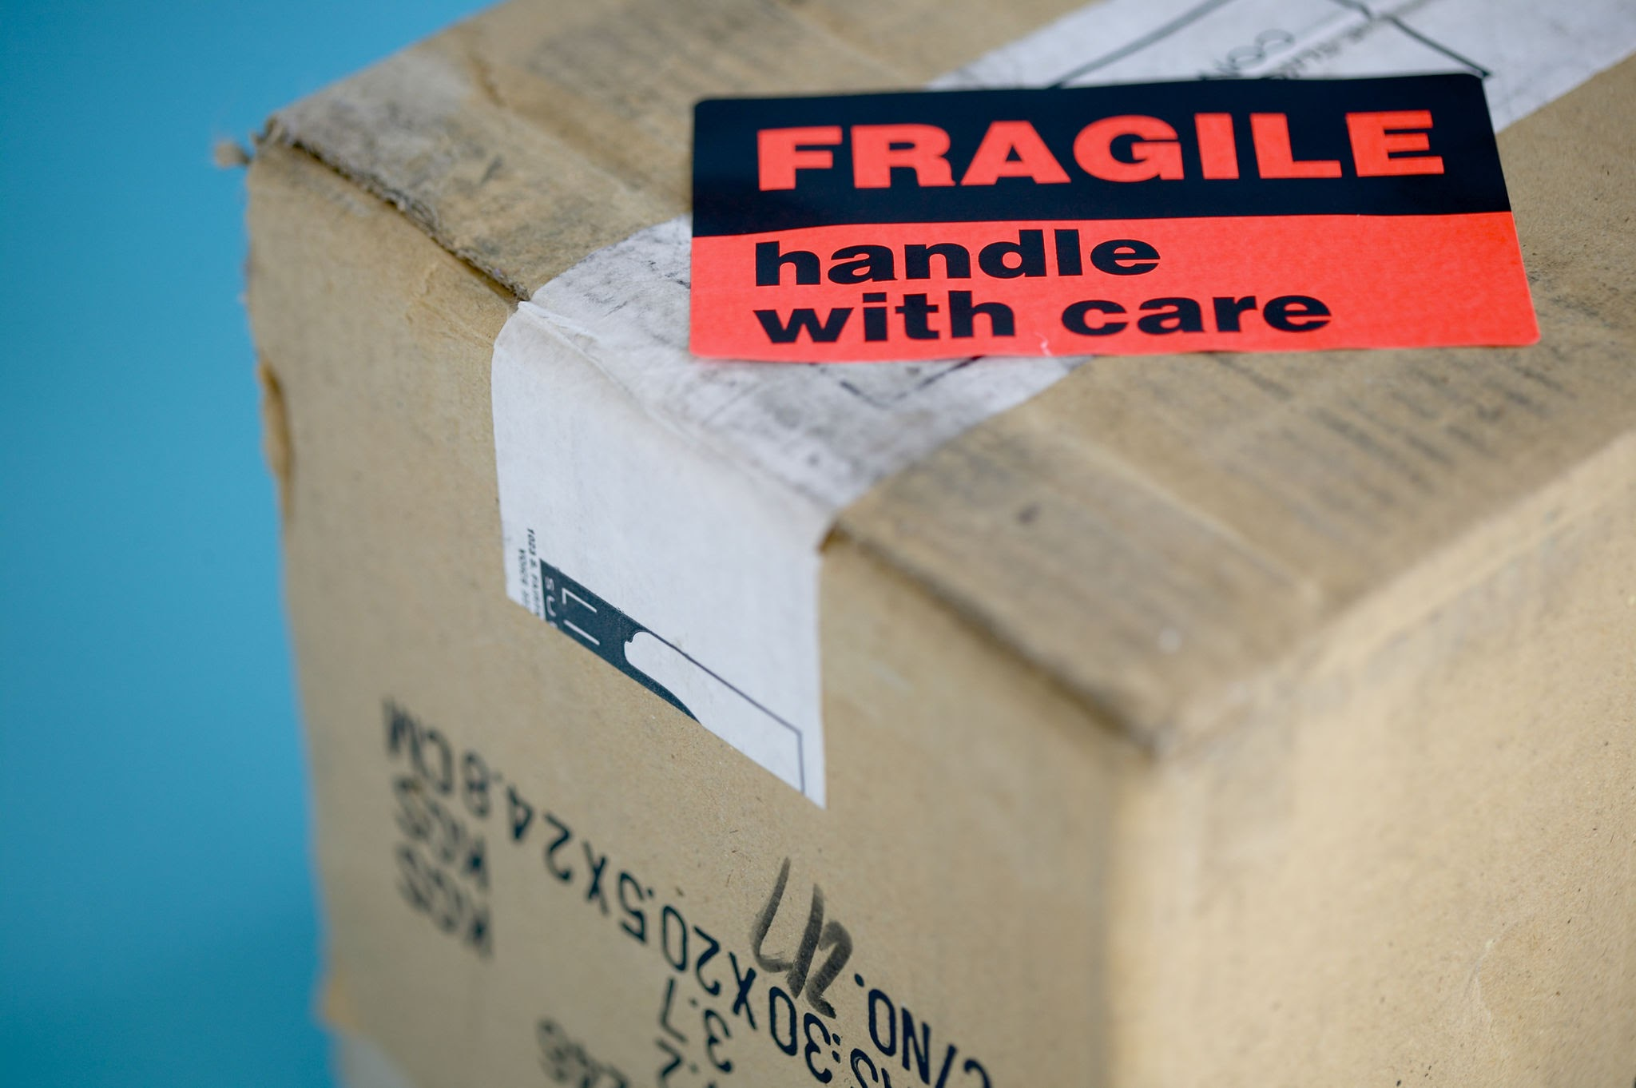
Shipping
Packaging
Use approved mailing packages for the shipping out of items.
Be sure the packaging is fully sealed to prevent damage during transit.
Make sure weight is being taken and address labels are clearly visible.
Mailing Services
Each institution has their own contract with a select mailing service. Whether it be FedEx, UPS, or USPS, it is important to follow the procedures outlined by that service provider.
Notes:
Tabitha speak

Slide 10
Copyright
Does it really matter? Yes! Just ask Georgia State University.
– CONTU guidelines
- CCC
– Fair Use vs. licenses - which wins?
– Where to get more information
Helpful Tips
Policy Directory
Supplier versus NonSupplier
2,4,8,12 days?
Custom Holdings
Evil Items!
Fluff bags
Staples
Stickers
Notes:
Melissa speaks here

Slide 11
Contact us if you have questions!
Melissa Jackson: mljackson@georgiasouthern.edu
Tabitha Huddleston: thuddleston@georgiasouthern.edu
Contact Information
Notes:
Tabitha speak

Slide 12
Thank you!
The End
Notes:
Both

