Slide 1
Importing and exporting records in Alma
Sean Purcell
Manager, GIL & GALILEO Tech Support Services
University System of Georgia
Simon Hunt
Head of Database Maintenance, Cataloging Department
University of Georgia

Slide 2
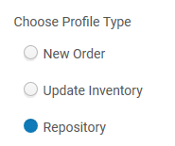
Importing records: two scenarios
Batch loading e-resource packages (for example, from WorldCat)
Editing IZ records (previously exported and not linked to the NZ)

Slide 3
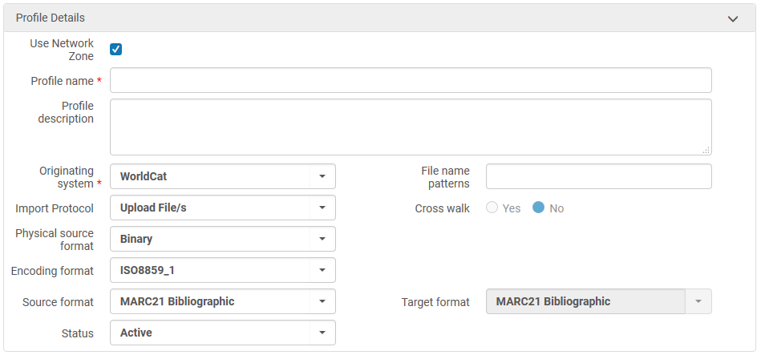
Consider the type of record you’re importing.
A MARC file (.mrc) is a binary file
Make sure formats conform to what is being imported.

Slide 4
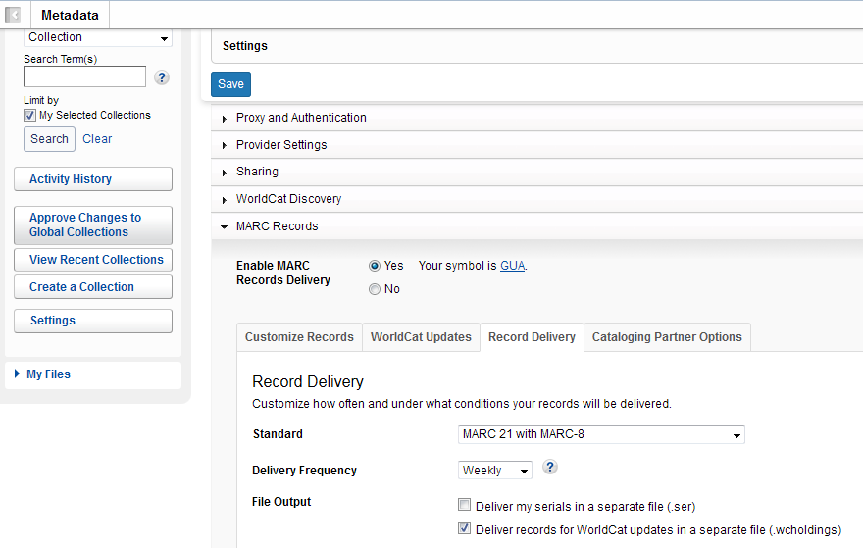
For example- the encoding standard being exported from WorldCat matches the encoding format in the Alma profile (MARC-8 is the same as ISO8859_1).

Slide 5
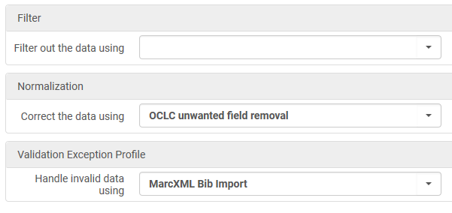
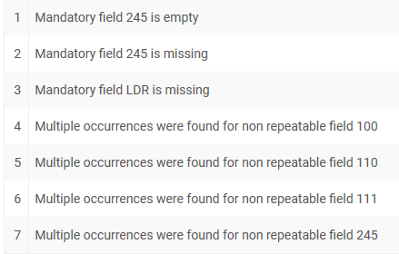
apply indication and normalization rules created via the MD Editor
indication rules
normalization rules

Slide 6
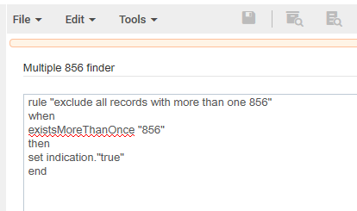
Indication rule example
will filter out all records with more than one 856 field
MD Editor
Note- the indication “true” means records that meet the criteria will be excluded.
This is the opposite of how indication rules work when used on sets, where records flagged with a “true” indication are retained in the filtered set.
Also, there is no corresponding “false” indication.

Slide 7
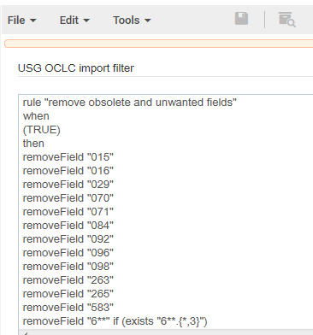
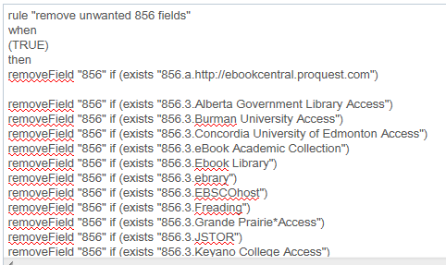
Normalization rules
- “OCLC unwanted field removal” (called “USG OCLC import filter” in the MD Editor) is recommended for clearing obsolete and unwanted fields from new bibliographic records.

Slide 8
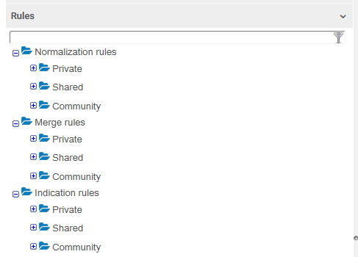
Feel free to use the rules that exist already, but take care:
Read through the rules in the MD Editor before applying them to your imports, exports or sets- they might not do what the titles implies.
If you want to change or add to a rule, make a copy first. The rules in the Shared folders may be in use, and you could end up affecting huge batches of records-- things like the OCLC nightly load.

Slide 9
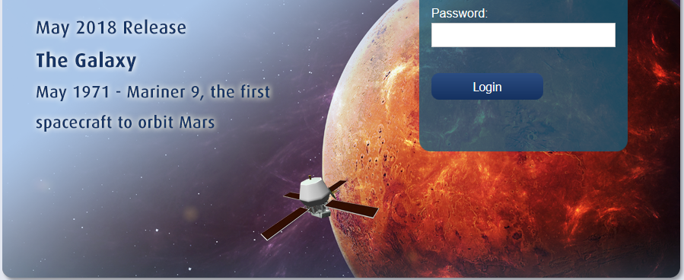
Test your rules thoroughly: use the “preview” feature in the MD Editor to see how individual records will be affected.
However, rules sometimes behave differently in the MDE than when applied in a job or import/export, so test them out:
In the sandbox first, then
on small sets in the live environment.
now back to the import profile…

Slide 10
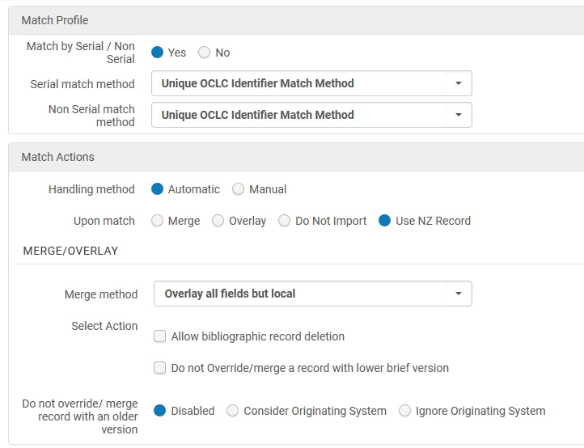
Matching- “unique OCLC identifier” is the ideal method for cataloged records with OCLC numbers (with one exception).
Always prefer what is already in the NZ.

Slide 11
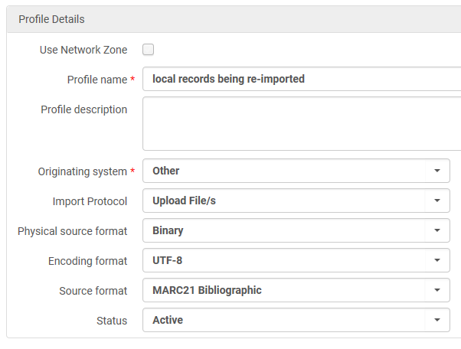
The exception:
when re-importing IZ records after external editing.
de-select this!
In this case, the MMS ID match method should be used for a one-to-one re-linking.

Slide 12
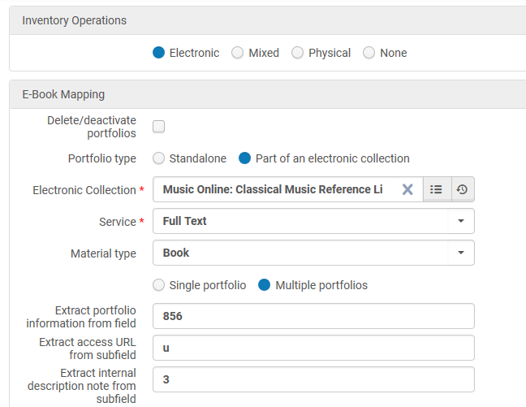
Inventory tab- will create new holdings or portfolios as you import.
A new electronic collection was created for this batch of records so they can be managed as a whole.
If you select multiple porfolios (for example, if your records will link to multi-volume works), make sure your source records contain only the 856 fields you want!

Slide 13
Records are filtered (indication rules)
sequence of import events
Inventory attached
Matches are identified (Match Profile)
Normalization rules are applied to incoming record
Records are merged/overlaid according to profile settings

Slide 14
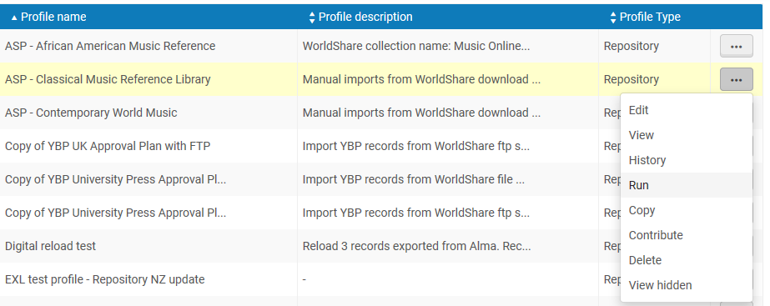

Slide 16
Set is created (advanced search or imported set from Analytics)
sequence of export events
Data Enrichment adds selected holdings/item record fields
Records are filtered (indication rules)
Normalization rules are applied
Records are exported

