Slide 1
Live, Laugh, Alma
A Comprehensive Review of E-Resource Management in Alma

Slide 2
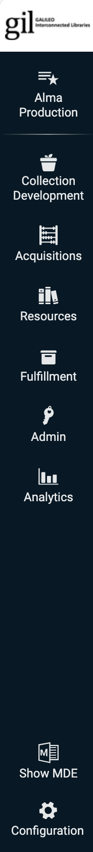
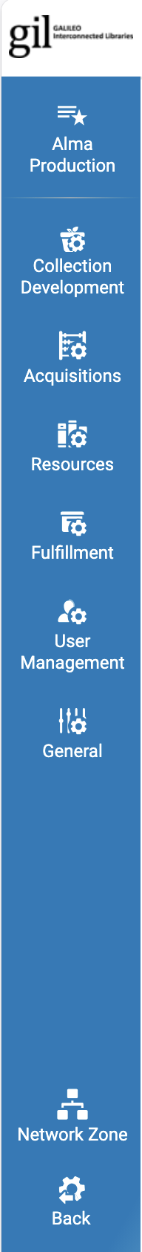
Configuration and Functional Views
Configuration View
Organized by major functional areas (Resource Management, Fulfillment, and Acquisitions)
Some configurations for ERM
Set up and manage Integration Profiles
Uploading Electronic Holdings
Authentication (Proxy/OpenAthens)
Display Logic rules
Controls General Electronic Services (ILL, request links)

Slide 3
Configuration and Functional Views
Functional View
Day‑to‑day workspace where staff perform operational tasks
Includes functional menus such as Resource Management, Fulfillment, Acquisitions, and Analytics
Used to activate e‑collections, manage portfolios and coverage, etc.
Task‑oriented and workflow‑focused rather than rules and settings defined in Configuration

Slide 4
Alma Zones
Alma Zones are layered data environments that determine where records live and who controls them.
Community Zone (CZ) – Global vendor data
Network Zone (NZ) – Consortium‑wide shared data – GALILEO Collections
Institution Zone (IZ) – Your local library’s data
https://knowledge.exlibrisgroup.com/Alma/Training/AlmaEssentials/Alma_Essentials_-_English/A_Terminology_and_Inventory_Models/C_Electronic_Resources_in_Alma_-_The_Three_Zones

Slide 5
Alma Zones
Community Zone is Alma’s global knowledge base
Maintained by: Ex Libris, Content providers, and Library community (contributions)
Contains: Electronic collections, Portfolios (journals, e‑books) and Linking, coverage, vendor updates
Libraries use the CZ to: Activate vendor‑supplied e‑collections, Receive automatic updates, Reduce local maintenance
You CANNOT: Edit global CZ records directly, Delete CZ collections, Change vendor‑managed data

Slide 6
Alma Zones
Institution Zone is your library’s Alma environment
Local overrides of CZ data
Collection name
Local coverage, access, notes
Create local collections
Manage Selective CZ activated collections
Configurations like Authentication and Display Logic

Slide 7
Alma Zones
The Network Zone sits between the CZ and IZ.
Share data across institutions
Standardize configurations
Reduce duplicate work
What Lives in the Network Zone?
GALILEO USG/Base Collections + Costshare
GALILEO NZ Collections are branded with “GALILEO”
GALILEO licenses
Display Logic for GALIEO’s EBSCO and ProQuest collections

Slide 8
CKB Updates
CKB updates in Alma
Regular updates that keep electronic collections aligned with Community Zone data
Include title additions/removals, coverage changes, bib updates, and link changes
Automatically applied to activated CZ collections based on local settings in the Full Text Service
https://knowledge.exlibrisgroup.com/Alma/Product_Materials/050Alma_FAQs/E-Resource_Management/Central_KnowledgeBase_(CKB)
https://knowledge.exlibrisgroup.com/Content/New_and_Upcoming_Collections/Alma_CKB_Release_Notes

Slide 9
Electronic Collections aka Electronic Inventory
Electronic inventory is the structured way Ex Libris represents a library’s online content. Collections activated from the Community Zone is one way to create electronic inventory in the Institution Zone, while still linked to the CKB
Electronic inventory has three main parts:
Collection [level] is at the top of the hierarchical structure. At this level you can customize the name of the collection, and you can link acquisition and license data at this level. A collection‑level URL (database access) can also be controlled at this level.
Full Text Service functions as the middle “service” layer of electronic inventory, sitting between the collection level and the title‑level portfolios
Portfolios function as the title‑level “items” for e‑resources. Each portfolio holds the practical access details—URLs, coverage dates, and linking parameters—that Alma uses to determine availability.
Electronic Collection → contains → Full Text Service → Portfolios → control → Access and coverage

Slide 10
Electronic Collections
Types of Electronic Collections
Database: Only links out to the vendor database/platform level. No individual titles/portfolios. “Database” is an electronic collection without Full Text Service and Portfolios. Examples: Abstracting and indexing databases or Reference resource, like Britannica.
Collection (with portfolios): Grouped together titles, like journal package, and e‑book collections. Examples: / JSTOR Arts & Sciences & Ebook Central Academic
Collection (with portfolios + Collection Level linking Enabled): An Alma Collection with the database/platform level link enabled. This allows users to search and find the collection in Primo, in addition to the individual titles.

Slide 11
Electronic Collections - Portfolios
A Portfolio represents a single electronic title, typically within a collection. However, you can create/maintain a standalone portfolio independent of a collection.
Portfolios contain title level coverage, linking information, as well as public and internal notes.
Title level metadata can be as minimal or robust as you would like.

Slide 12
Electronic Collections – Full Text Service
You cannot attach portfolios directly to a collection without a Full Text Service.
Full‑Text service functions as the middle “service” layer, sitting between the collection level and the title‑level portfolios.
Service activation status: Allowing you to activate or deactivate the display of the title level access point to the end-users.
Where Authentication is enabled: OpenAthens and Linking Parser Parameters

Slide 13
Electronic Collections - Activation
Complete Activation
Complete Collections and Databases
All portfolios activated
Selective Activation
Only selective portfolios are activated
Common for journal subscriptions and PDA/DDA e‑books
Supports various methods of portfolio activation
Manual activation
Batch data loading
Upload Electronic Holdings Integration Profile

Slide 14
Electronic Collections – Complete Activation
Complete Activation
Complete Collections and Databases
All portfolios activated
Do you want the collection searchable in Primo?
Must have collection Level URL
Unsuppressed Bib
Sometimes CZ Collection’s Collection level URL is for product information and needs to be changed.
Recommended to use persistent link from your Databases AZ list (GALILEO ExpressLink or LibGuide URLs)
https://knowledge.exlibrisgroup.com/Alma/Product_Documentation/010Alma_Online_Help_(English)/Electronic_Resource_Management/030_Working_with_Local_Electronic_Resources/015Managing_Electronic_Resources#Managing_Electronic_Collections

Slide 15
Electronic Collections – Selective Activation
Selective Activation
Only selective portfolios are activated
Common for journal subscriptions and PDA/DDA e‑books
Supports various methods of portfolio activation
Manual activation
Batch data loading
Activate all (then deactivate selective portfolio)
Integration Profile

Slide 16
Electronic Collections – Selective Activation - Integration Profile
Alma Configuration → General → Integration Profile → Upload Electronic Holdings
https://knowledge.exlibrisgroup.com/Alma/Product_Documentation/010Alma_Online_Help_(English)/Electronic_Resource_Management/020_Working_with_Community_Zone_Electronic_Resources/040Automatic_Upload_of_Electronic_Holdings
Ebook Central (be aware of owned titles with local bib records)
Elsevier
JSTOR
Ovid
Oxford
Sage
Springer
T&F
Wiley

Slide 17
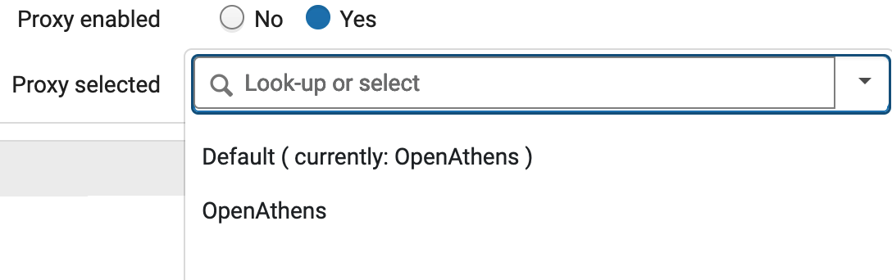
Electronic Collections - Activation - Authentication
Proxy enabled / selected
Can be set at Service Level (preferred) or Portfolio Level.
Proxy managed in Alma Configuration → General → Integration Profile → Resolver Proxy (GALILEO managed)

Slide 18
Electronic Collections - Activation - Authentication
Linking Parser Parameters
Alma and SFX Linking Parser Parameters Guide https://knowledge.exlibrisgroup.com/Cross-Product/Integrations/Alma_and_SFX
Some example of vendors that require Linking Parser Parameters:
EBSCO
Gale
Ebook Central
ProQuest
Ovid

Slide 19
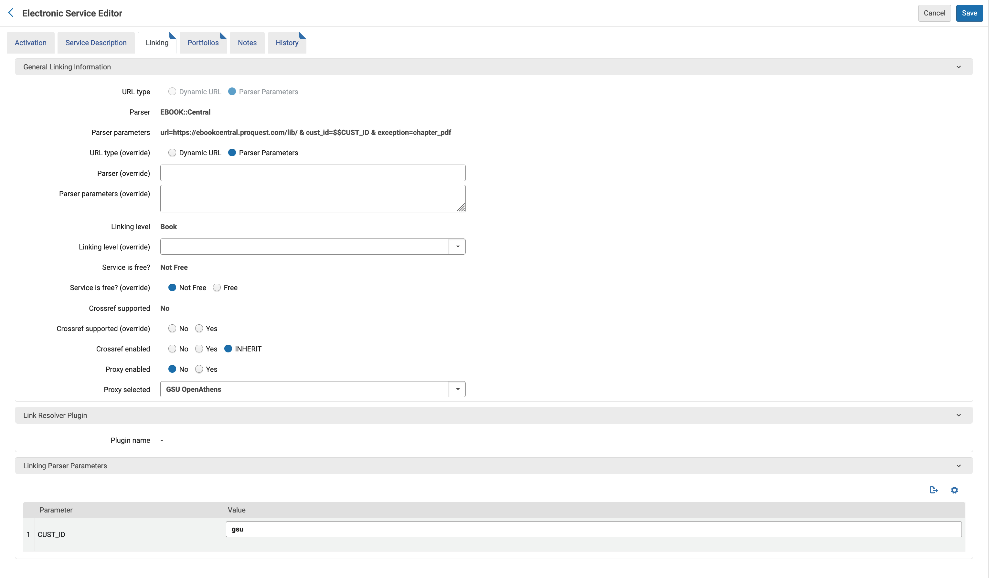
Electronic Collections - Activation - Authentication

Slide 20
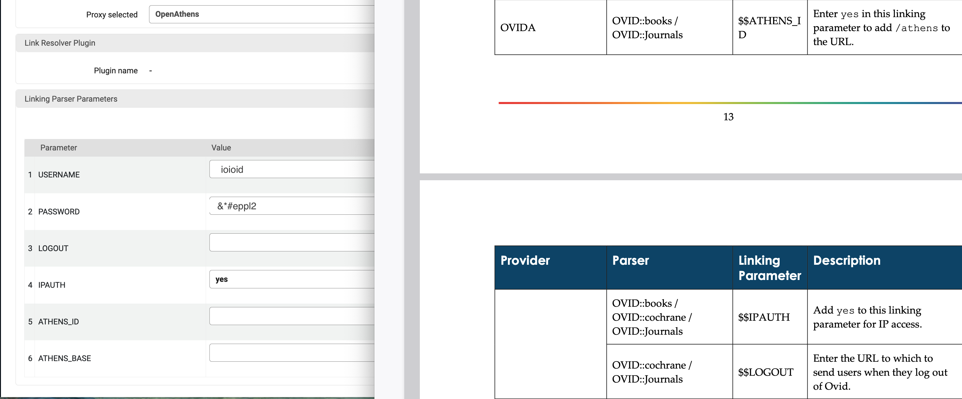
Electronic Collections - Activation - Authentication

Slide 21
Electronic Collections - Local
Electronic collection activated from the Community Zone
Based on shared, centrally maintained knowledge‑base data
Receives ongoing updates (titles, coverage, links) from the Community Knowledge Base (CKB)
Requires less local maintenance
Allows local overrides while staying linked to CKB
Locally created electronic collection
Created and managed entirely in the Institution Zone
Independent of CKB updates and requires full local maintenance of titles, coverage, and URLs
Used when no suitable CZ collection exists
Also used when non-CZ bib records (locally created or from vendor) are preferred. Example: Kanopy

Slide 22
Electronic Collections - Local
Local Collections can be…
Collections with Service and Portfolios
Database
Single Portfolio
Adding Local Electronic Collections https://knowledge.exlibrisgroup.com/Alma/Product_Documentation/010Alma_Online_Help_(English)/Electronic_Resource_Management/030_Working_with_Local_Electronic_Resources/015Managing_Electronic_Resources#Adding_a_Local_Electronic_Collection

Slide 23
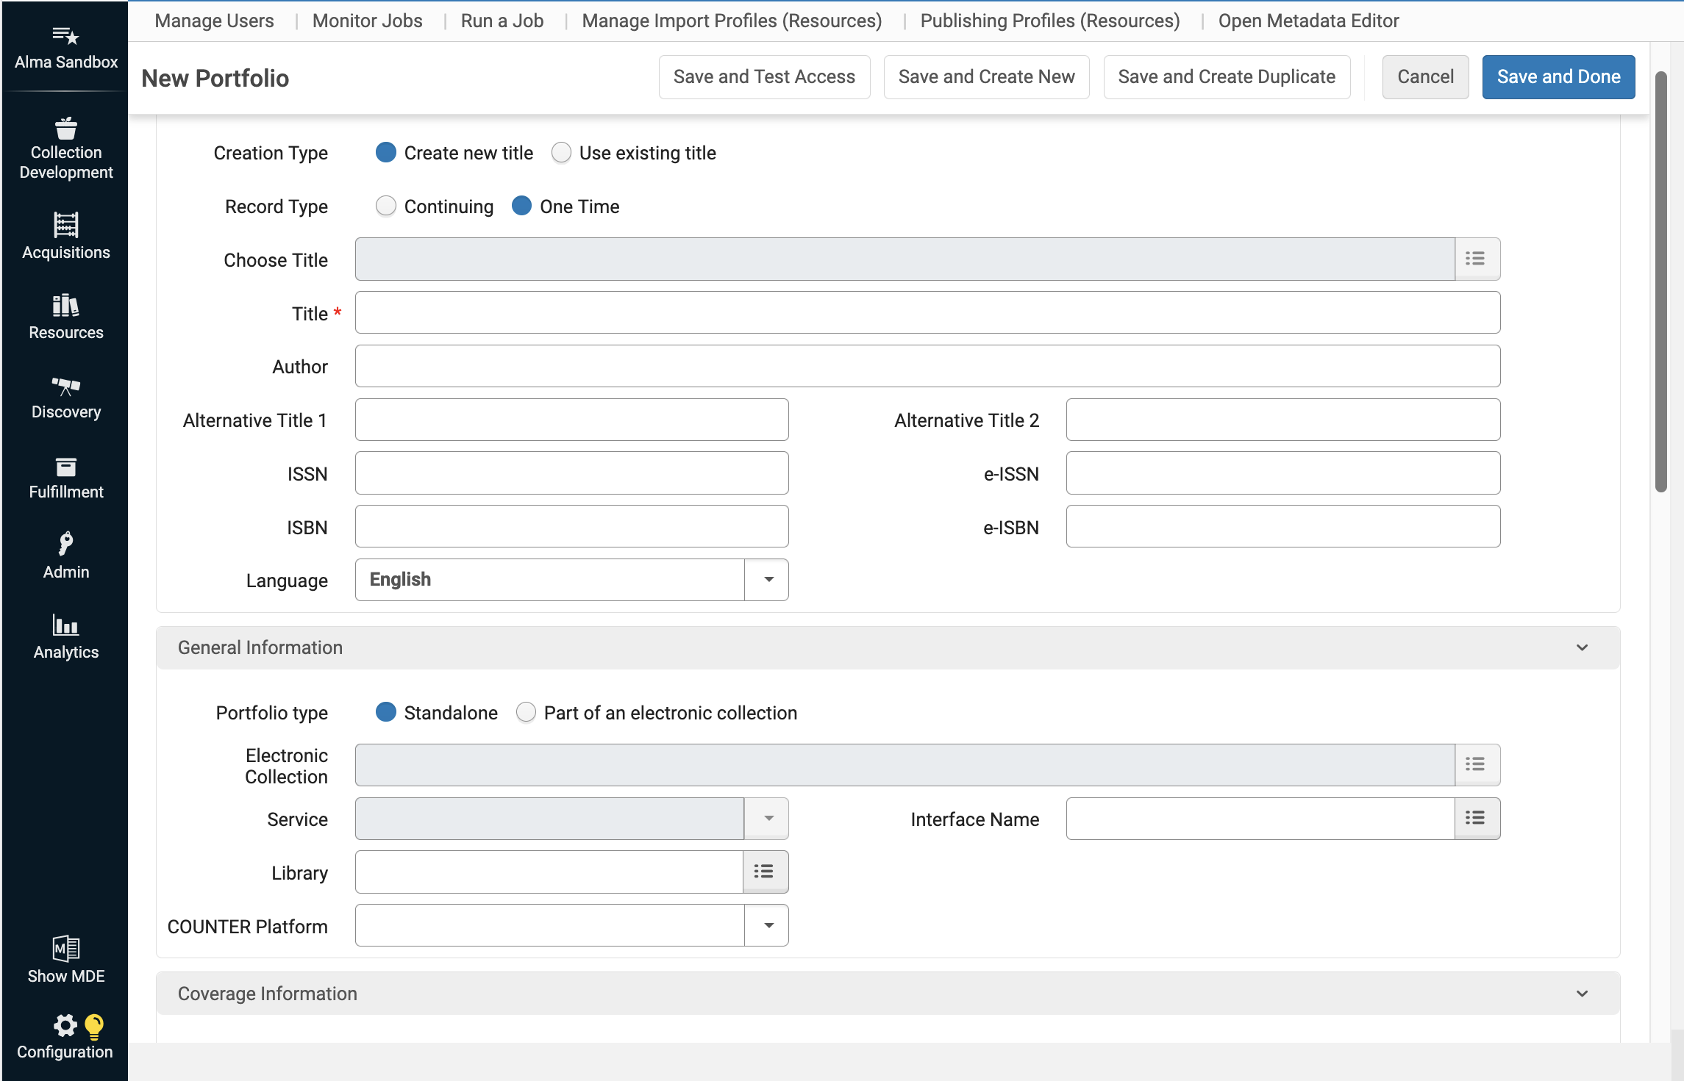
Electronic Collections - Local
Metadata
Basic metadata in portfolio record

Slide 24
Electronic Collections - Local
Import vendor or local provided MARC records
Portfolios can be created by the Import Profile when importing MARC records
Alma Side menu → Resources → Import → Import Profile
Import Profiles https://knowledge.exlibrisgroup.com/Alma/Product_Documentation/010Alma_Online_Help_(English)/040Resource_Management/060Record_Import/020Managing_Import_Profiles

Slide 25
Link Resolver / Display logic
Configuration > Fulfillment > Discovery Interface Display Logic > Display Logic Rules
Display Logic is set up in the NZ for GALILEO’s EBSCO and ProQuest databases, except for Cost-Share
Example: If a resource is in Academic Search Complete, don’t show links to other EBSCOhost collections
Reduces the number of collection links for a single title.
Local Considerations
To give priority to X over Y. For example, e-Collection X may be lower cost than e-Collection Y, or e-Collection X may have better linking quality and reliability.
Open Access – View open access full text (for example, hide open access if full text exists or hide full text if open access exists).
https://knowledge.exlibrisgroup.com/Alma/Product_Documentation/010Alma_Online_Help_(English)/030Fulfillment/080Configuring_Fulfillment/090Discovery_Interface_Display_Logic/035ViewIt
https://knowledge.exlibrisgroup.com/Alma/Product_Documentation/010Alma_Online_Help_(English)/Electronic_Resource_Management/051Link_Resolver/010Alma_Link_Resolver_Workflow#Control_Ability_to_Ignore_Title-Based_Link_Resolving

Slide 26
Links
GIL ERM Documenation: https://sites.google.com/view/g3almatraining/erm
Ex Libris: https://knowledge.exlibrisgroup.com/Alma/Product_Documentation/010Alma_Online_Help_(English)/Electronic_Resource_Management/010Working_with_Electronic_Resources_-_Overview
GALILEO Contact: https://about.galileo.usg.edu/support

